Slide 1
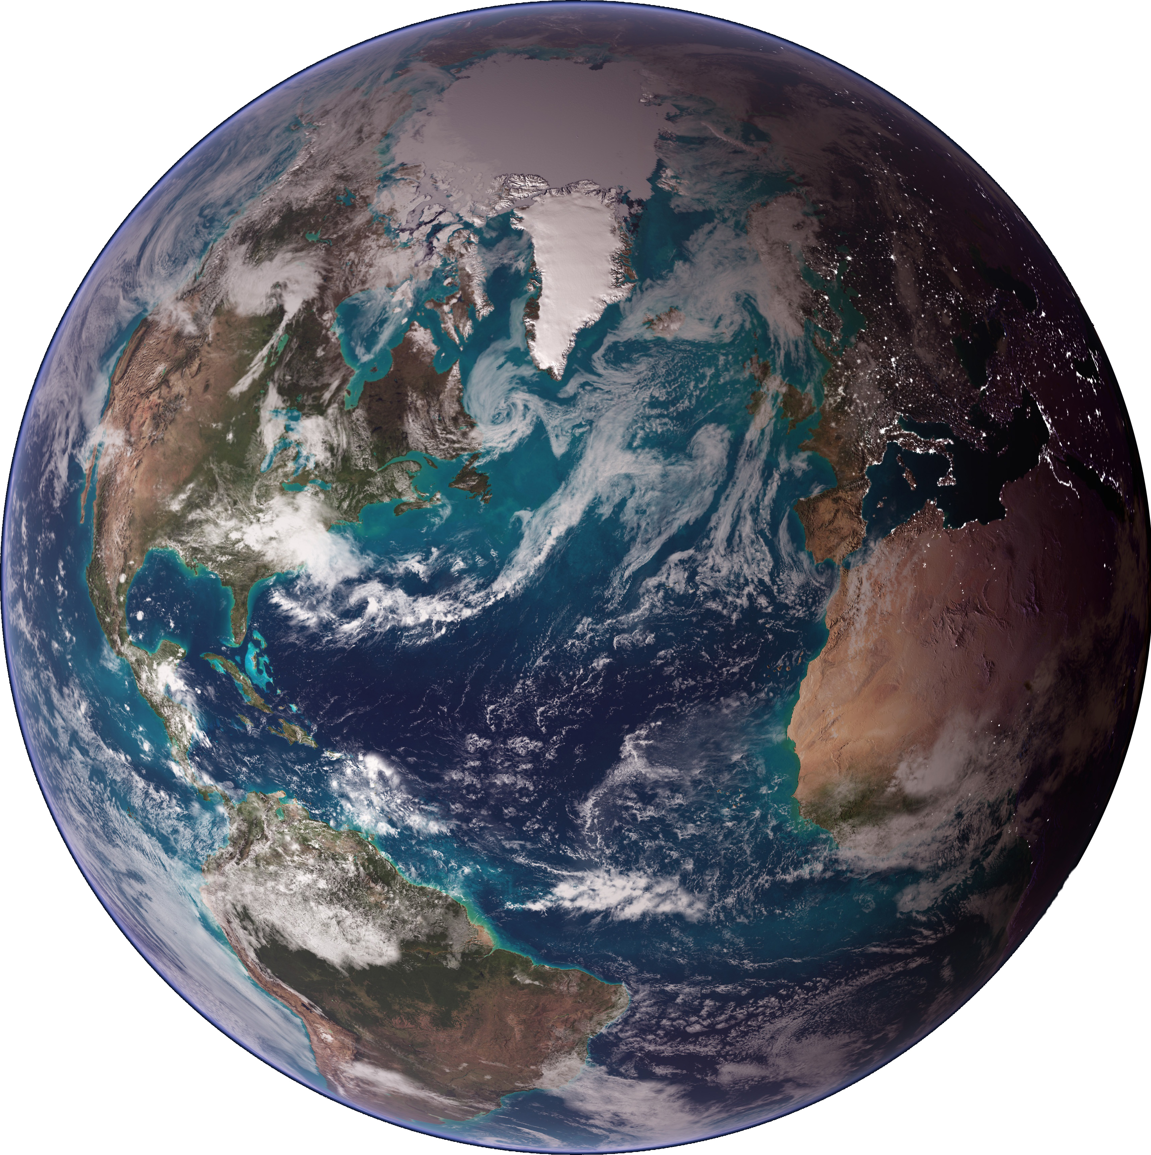

NOAA RESEARCH • ESRL • PHYSICAL SCIENCES DIVISION
Science of Arctic Change- Implications for Central US Water and Agriculture
Martin Hoerling
With
Lantao Sun
Jon Eischeid
Arctic Climate Workshop,
UN-Lincoln School of Natural Resources
November 2015

Slide 2
What is Known About Arctic Change?
• Larger Surface Warming of the Arctic Than Rest of World: Arctic Amplification

Slide 3
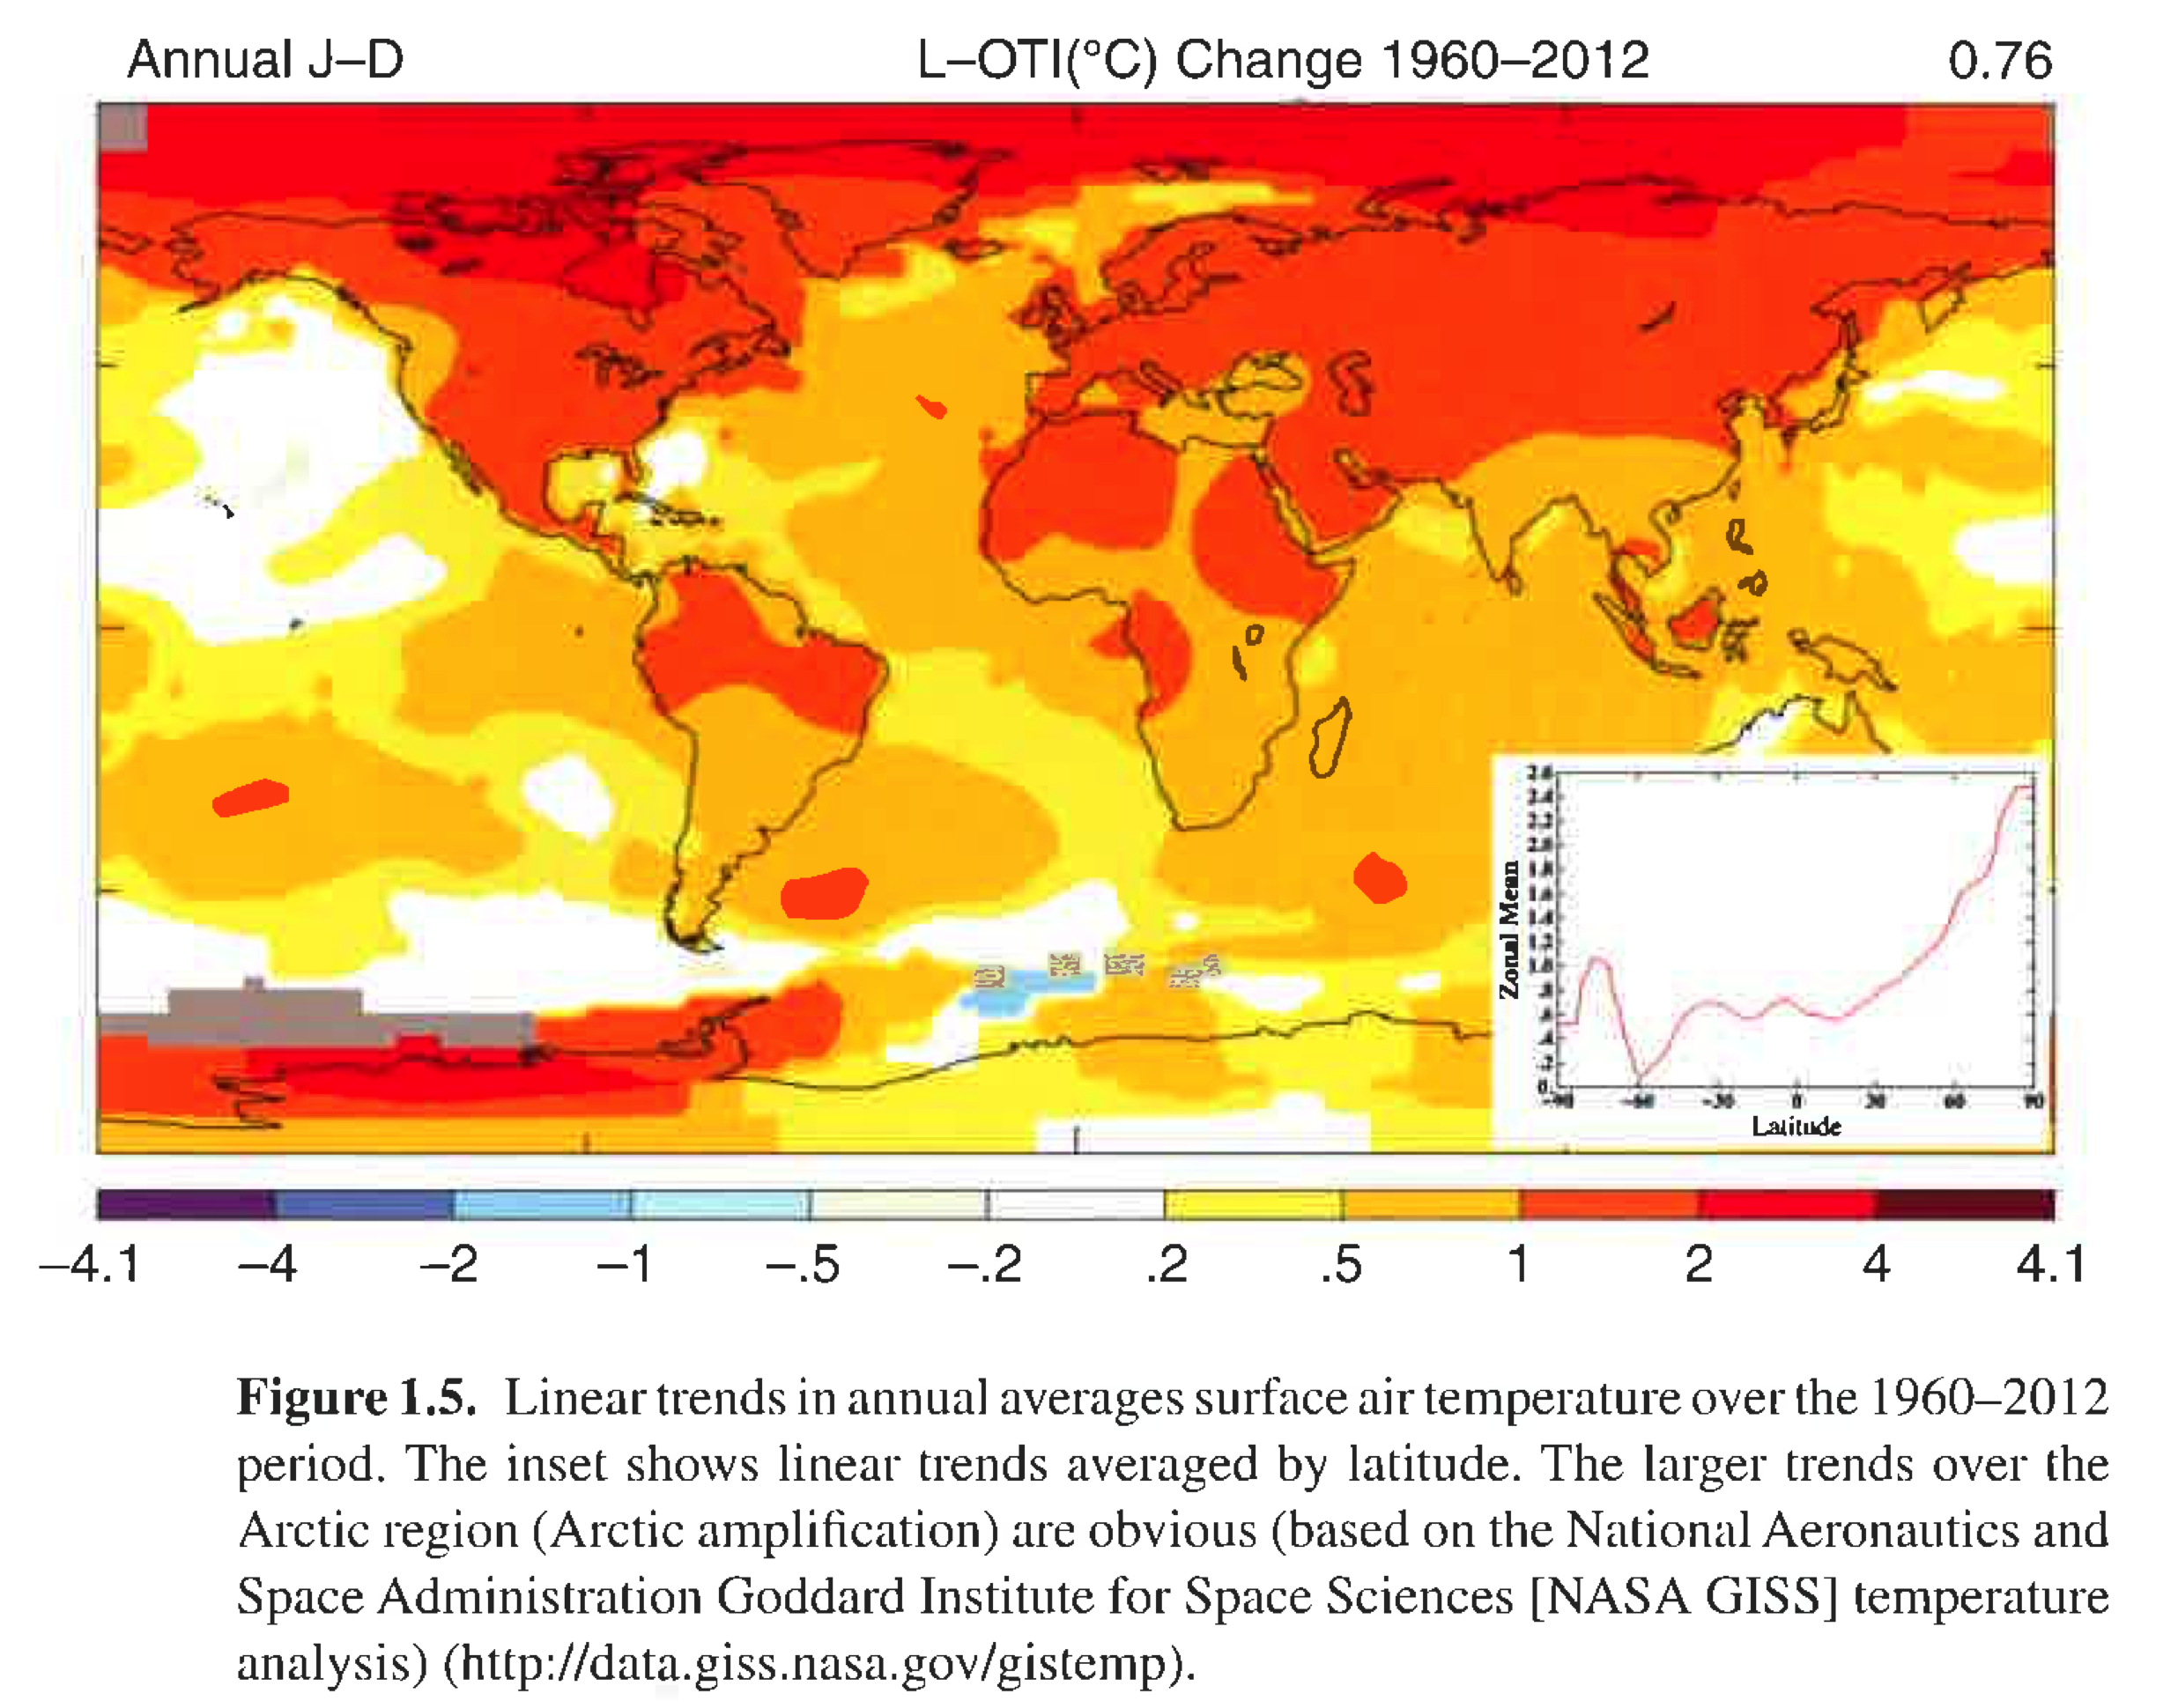
What is Known About Arctic Change?
• Larger Surface Warming of the Arctic Than Rest of World : Arctic Amplification
SP
EQ
NP
From Serreze and Barry, 2014: The Arctic Climate System

Slide 4
What is Known About Arctic Change?
• Arctic Surface Warming Accelerated as Sea Ice Melted

Slide 5
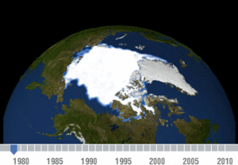
What is Known About Arctic Change?
• Arctic Surface Warming Accelerated as Sea Ice Melted

Slide 6
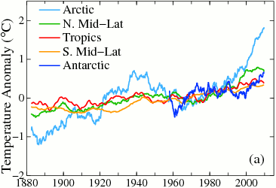
What is Known About Arctic Change?
• Arctic Surface Warming Accelerated as Sea Ice Melted
Data based on the NASA GISS analysis

Slide 7
What is Known About Arctic Change?
• Arctic Sea Ice Loss Largely Due to Human-Induced Change
From Serreze and Barry, 2014: The Arctic Climate System

Slide 8
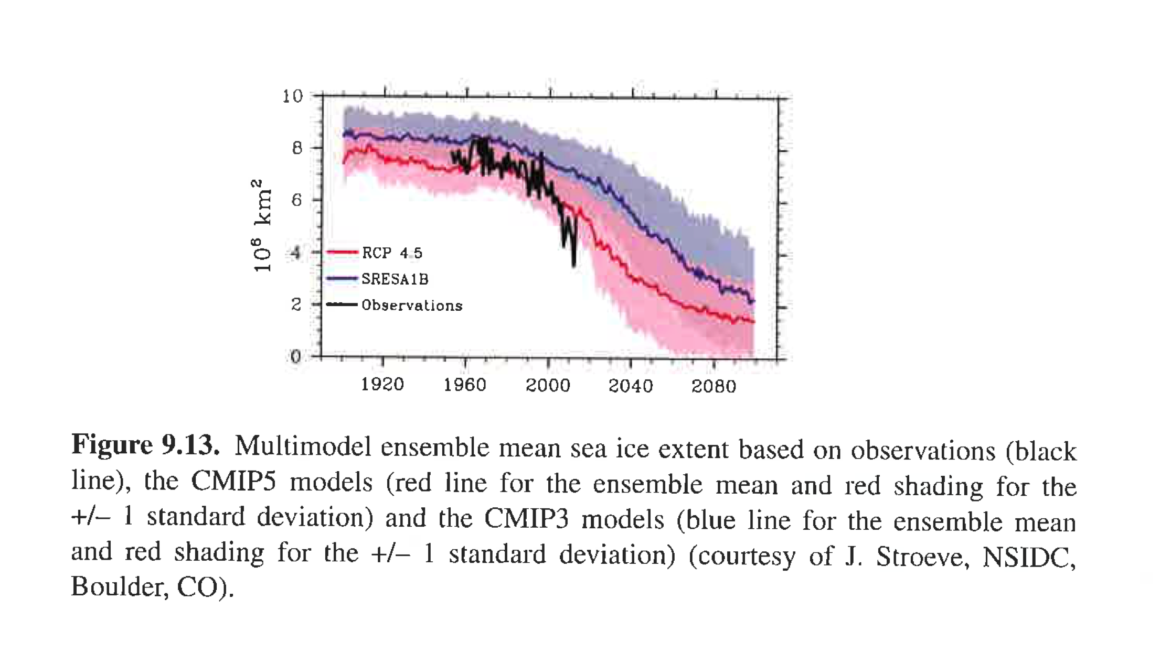
What is Known About Arctic Change?
• Arctic Sea Ice Loss Largely Due to Human-Induced Change
From Serreze and Barry, 2014: The Arctic Climate System

Slide 9
What is Known About Arctic Change?
• The Arctic Has Warmed Throughout the Troposphere
(Recent Decade Compared to 1980s)
Little or No Arctic Amplification in the Middle and Upper Troposphere
from Perlwitz et al , 2015 : Assessing Why the Arctic Has Warmed and Linkages to Lower Latitudes

Slide 10
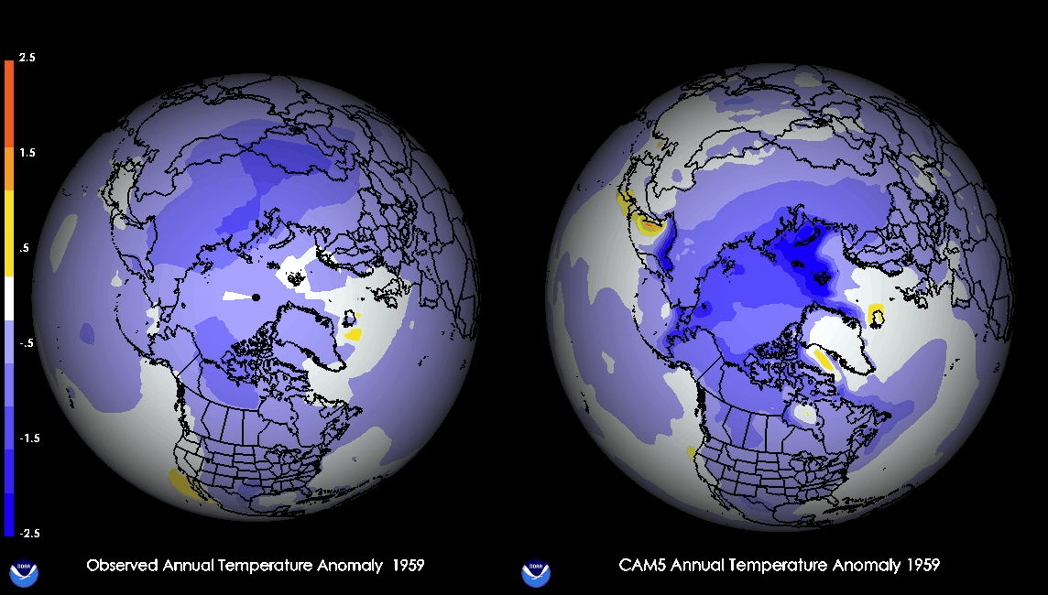
What is Known About Arctic Change?
• Arctic Sea Ice Loss is A Major Cause for Arctic Surface Warming

Slide 11
Interpretation of Observed Recent Arctic Change
[see also NOAA’s Arctic Report Card http://www.arctic.noaa.gov/reportcard]
° Late Summer Arctic Sea Ice is Declining ~13%/decade, in the Recent Era Post-1990s.
° Much (>50%) of Arctic Sea Ice Decline is Likely Due to Human-Induced Climate Change.
° Arctic Surface Temperatures Have Warmed.
° Arctic Surface Warming Is Faster (~2x) Than Warming Over the Rest of the World.
° Little or No Arctic Amplification of Deep Tropospheric Warming.

Slide 12
What is Known About Arctic Change Impacts?

Slide 13
J. Francis (2013 NAS Workshop)

Slide 14
What is Known About Arctic Change Impacts?
• The Arctic Has Warmed Throughout the Troposphere
(Recent Decade Compared to 1980s)
from Perlwitz et al , 2015 : Assessing Why the Arctic Has Warmed and Linkages to Lower Latitudes

Slide 15
What is Known About Arctic Change Impacts?
• Climate Models Reproduce the Tropospheric Warming Pattern
from Perlwitz et al , 2015 : Assessing Why the Arctic Has Warmed and Linkages to Lower Latitudes

Slide 16
What is Known About Arctic Change Impacts?
• The Deep Tropospheric Warming is Mostly Unrelated to Sea Ice Loss
from Perlwitz et al , 2015 : Assessing Why the Arctic Has Warmed and Linkages to Lower Latitudes

Slide 17
“It has been suggested that sea ice losses have been a primary driver of Arctic tropospheric warming which, through a cascade of processes, has led to more persistent and extreme weather conditions in mid-latitudes (Francis and Vavrus, 2012). Perlwitz et al. (2015) results provide an alternate interpretation of Arctic-midlatitude interactions that may have occurred during recent years.
In contrast to Francis and Vavrus (2012), Perlwitz et al. findings suggest that over the recent decade the Arctic troposphere has been more responding to changes in lower-latitude weather and climate than forcing them. Their analysis also suggests that the main drivers for mid-latitude regional circulation differences observed between the decades of 1979-1988 and 2003-2012 are more likely to have resulted from internal variations in the atmosphere-ocean system rather than as a forced response to global climate change.”
from Perlwitz et al , 2015 : Assessing Why the Arctic Has Warmed and Linkages to Lower Latitudes

Slide 18
Detectability of Arctic Change Impacts on the Jet Stream
From Barnes and Screen 2015 : Impact of Arctic Warming on the Mid-latitude Jet Stream: Can it?, Has it? Will It?

Slide 19
Detectability of Arctic Change Impacts on the Jet Stream
see Screen, Deser, Simmonds, and Thomas, 2014: Atmospheric Impacts of sea ice loss, 1979-2009, separating
forced change from internal atmospheric variability.

Slide 20
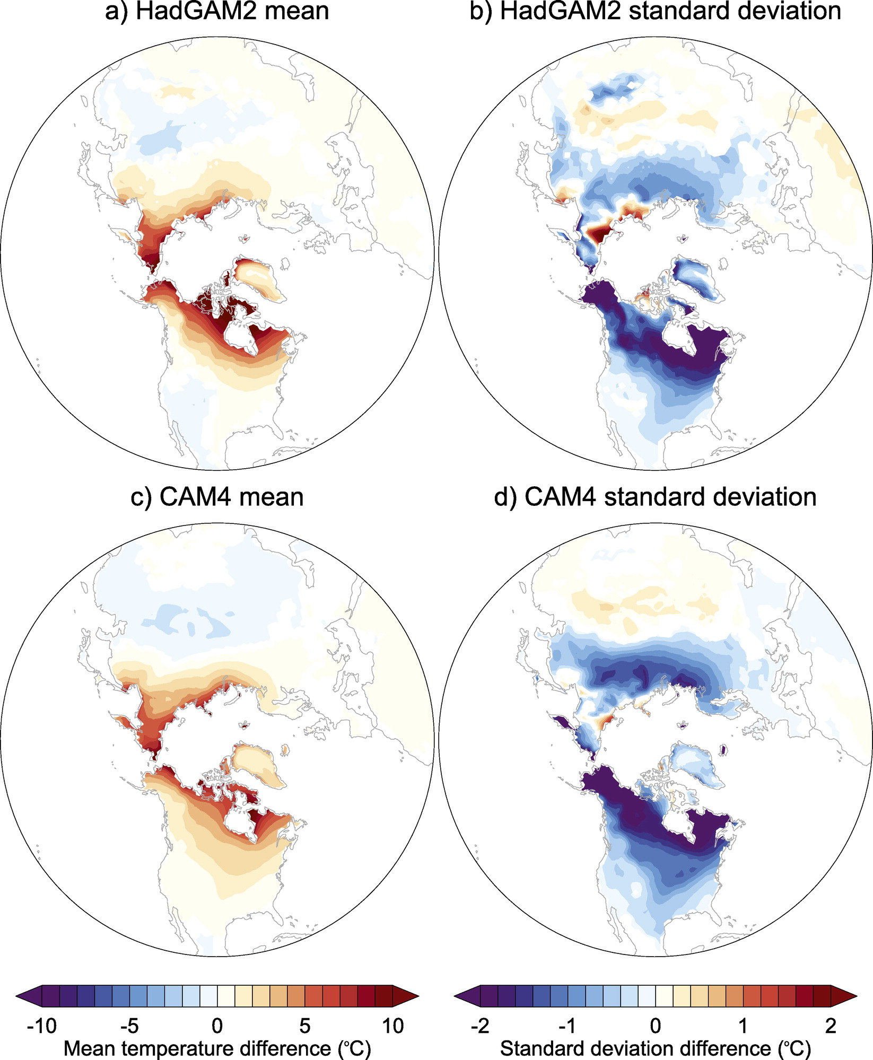
Impacts of Arctic Change on Weather Extremes
see Screen et al., 2015: Reduced Risk of North American Cold Extremes Due to Continued Sea Ice Loss (BAMS)

Slide 21
Overall Global Climate Change: Arctic vs Tropics
Winter
Summer
from Barnes and Polvani 2015: CMIP5 Projections of Arctic Amplification, of the North American/North Atlantic
Circulation, and of Their Relationship.

Slide 22
Interpretation of Science on Arctic Change & Impacts
° Sea Ice Loss is the Main (But Not Sole) Cause for Arctic Amplification of Surface Warming
° Sea Ice Loss Does Not Drive Deep Arctic Tropospheric Warming.
° The Critical First Link in the Chain Proposed to Connect Arctic Amplification to
Mid-latitude Weather Extremes is Weak.
° Extreme Weather Responds to Arctic Amplification: Reduced Risks of Cold Extremes.
° Arctic Change Impacts on Mid-latitudes are Mostly Undetectable, at This Time,

Slide 23
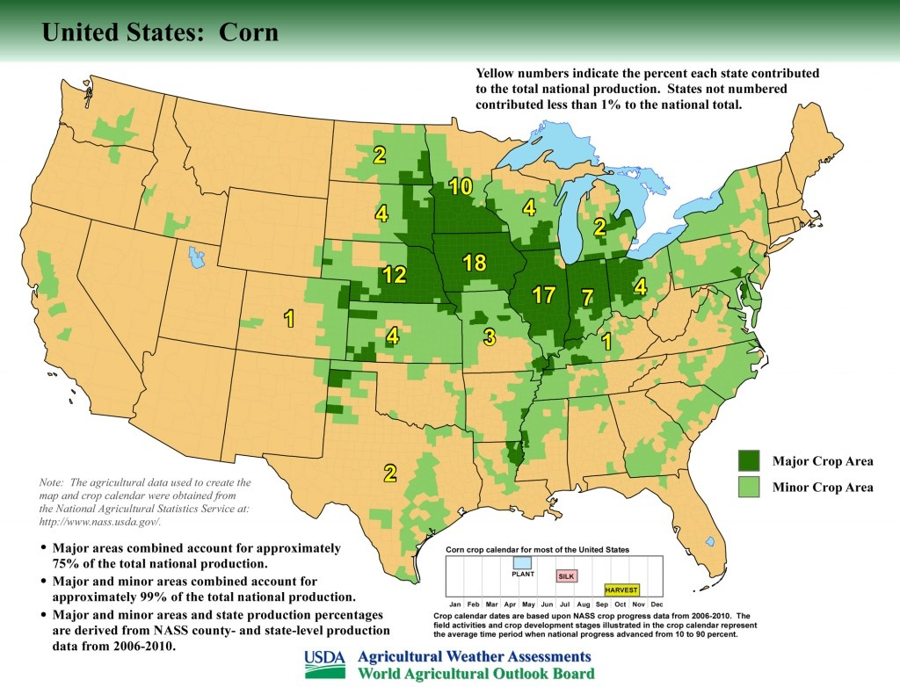
What Features of GP Climate Matter Most for Corn Production?

Slide 24
Periodic weakening of trade
winds relaxes the tension
between cold tongue and warm pool. An eastward movement
of warm water and rainfall
often results in El Niños.

Slide 29
How Has OBS Climate Changed During GP Growing Season?

Slide 30
How Has OBS Climate Changed During GP Growing Season?
Since the Early 20th Century, GP Climate Has Become More Favorable for Corn Production

Slide 31
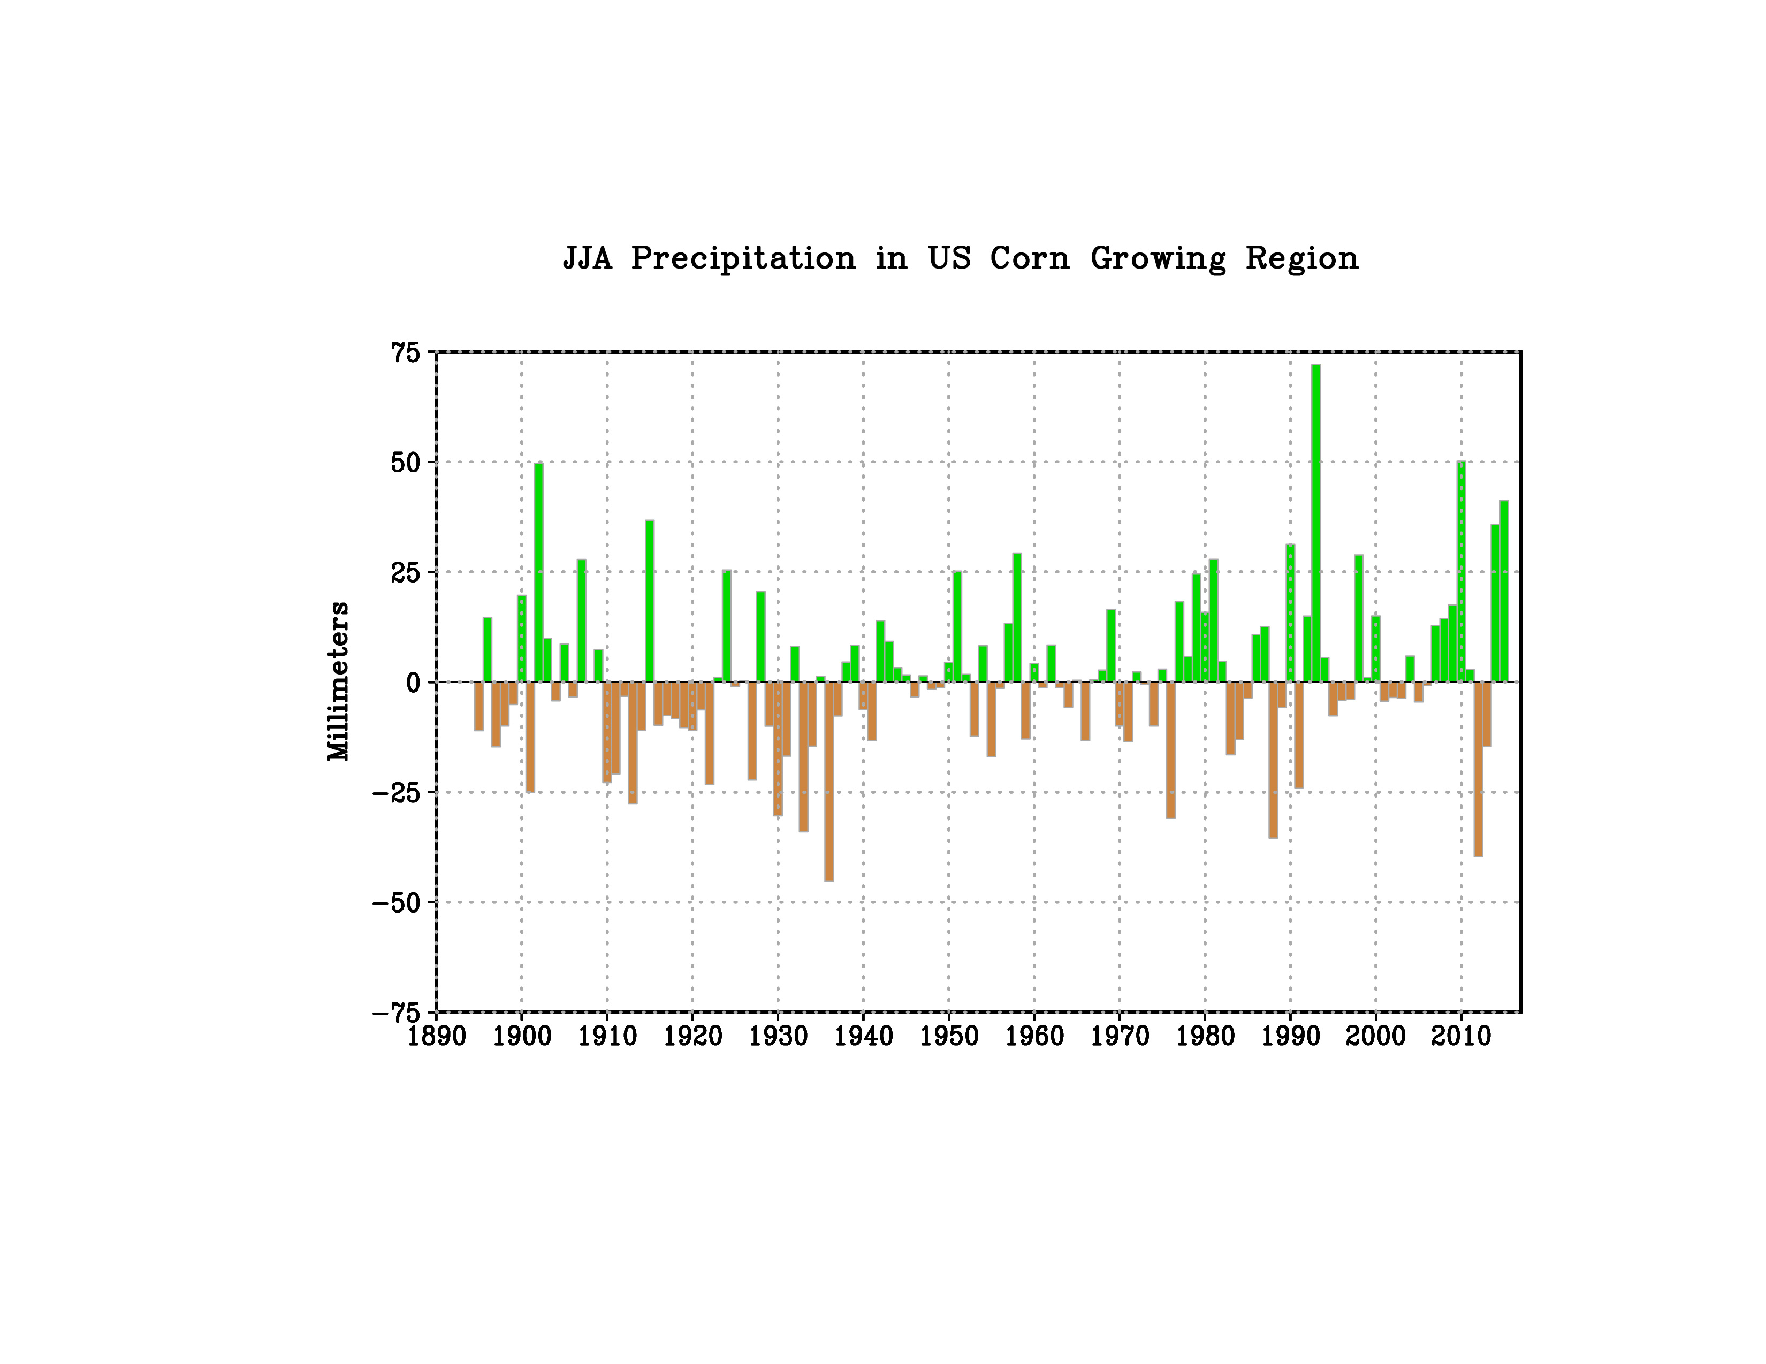
Summers Have Become Wetter Over the Corn Belt
2012 “Flash Drought”
Data: NOAA NCEI

Slide 32
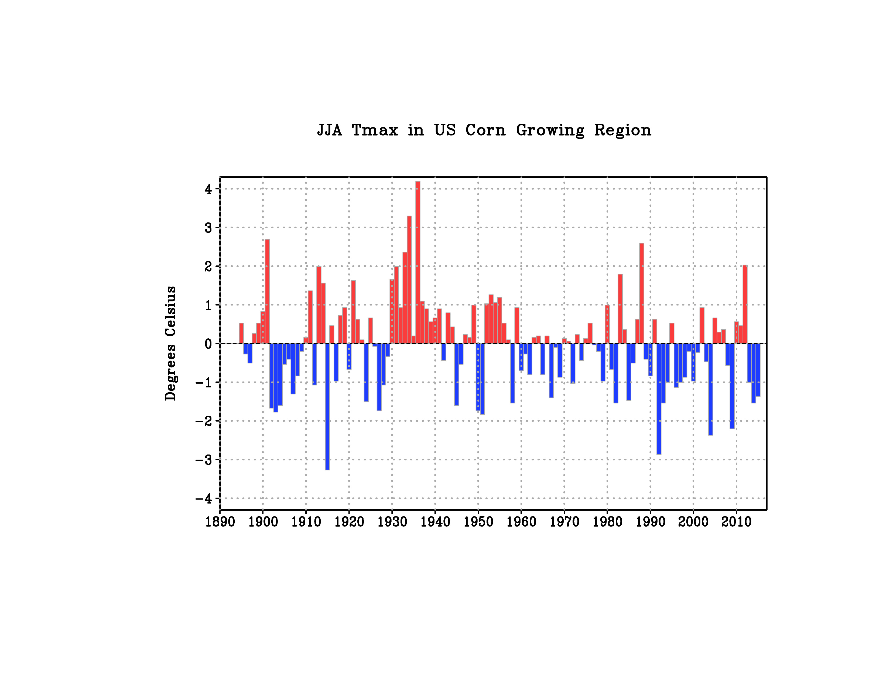
Summer Daytime Temperatures Have Become Cooler in the Corn Belt
“Hot Dustbowl”
“Cool Current Regime”
Data: NOAA NCEI

Slide 33
Has Arctic Change Caused the More Favorable GP Climate?

Slide 34
Historical and Counterfactual Climate Model Simulations
Atmosphere Model* driven by observed monthly varying sea ice, sea surface temperatures, and GHGs since 1979.
(Historical AMIP)
Atmosphere Model* driven by observed monthly varying sea surface temperatures, GHGs since 1979. Polar sea ice held fixed, according to 1979-1989 climatology.
(Counterfactual CLIM_POLAR)
ΔICE = AMIP – CLIM_POLAR
*ECHAM5, global model ~85km spatial resolution, 30-member ensembles
see Perlwitz et al. 2015
also Screen et al. (2013a,b); Screen et al. (2015); Mori et al. 2014 for other modeling studies

Slide 35
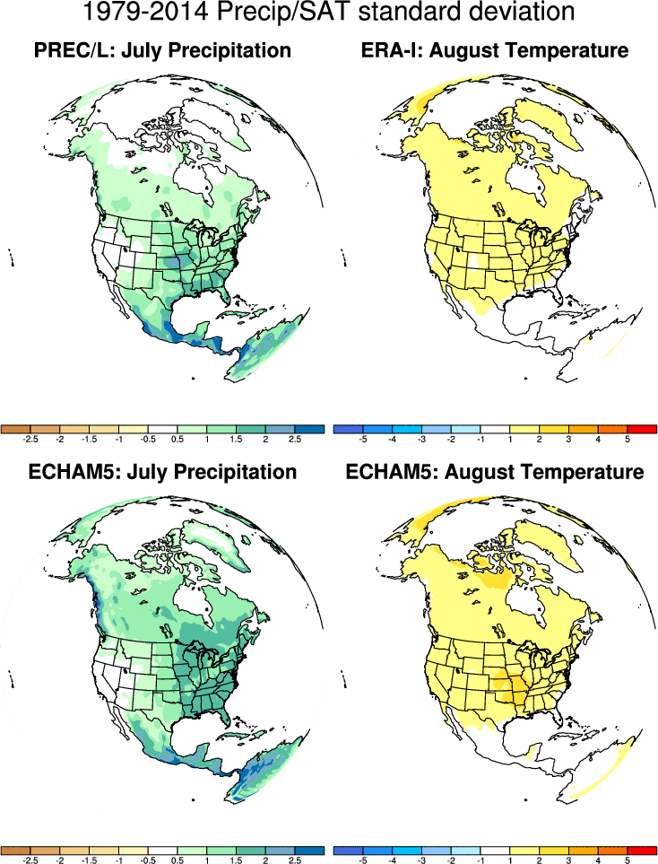
July and August Climatological Variability
Observations
mm/month
°C
Model

Slide 36
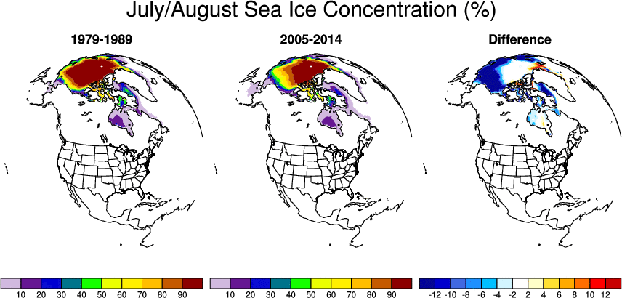
Observed July/August Sea Ice Change

Slide 37
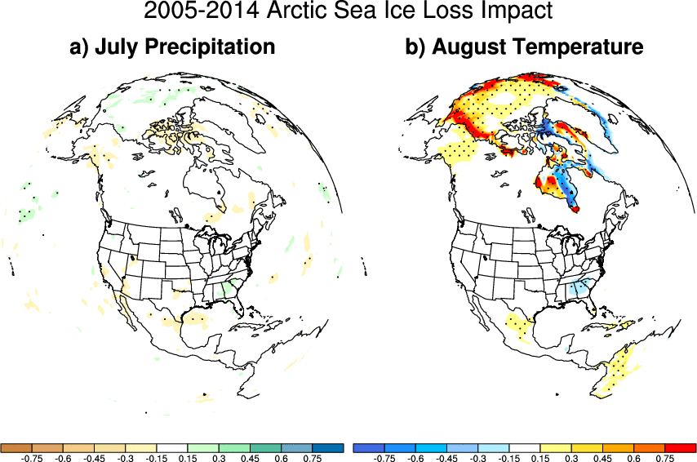
Simulated Impact of Sea ice Change on July/August Climate
Standardized
Standardized

Slide 38
Interpretation
° Arctic climate response to sea ice loss is relatively small in summer:
Physical reason: ° small air-sea contrast at that time of year
° small summer heat exchange between ocean/atmosphere
° limited thermodynamic response to summer sea ice loss
(different from winter; see also Deser et al. 2010)
° No detectable effect of Arctic change on continental US summer rainfall/sfcT:
Physical reason: ° Little remote dynamical response in summer to Arctic sea ice loss
° Monthly/daily summertime GP variability insensitive to Arctic change
° Typical summertime GP variability an order of magnitude larger
than sea ice related impacts
° Dynamic and thermodynamic links are ineffective.

Slide 39
Summary
° Sea Ice Change is Currently a Major Climate Change Driver in the Arctic
° A Significant Factor Causing Arctic Change is Human-Induced GHG Emissions
° Natural Variability Also Causes Arctic Change on Multi-Decadal Scales
°A Changing Arctic is Not Materially Affecting Ag/Water Resources in the Central U.S.
° Climate in the Corn Belt Has Become More Favorable for Yields over the Last Century
° A Changing Arctic Is Not The Cause for The More Favorable Summer GP Climate

Slide 40
Extra Slides

Slide 41
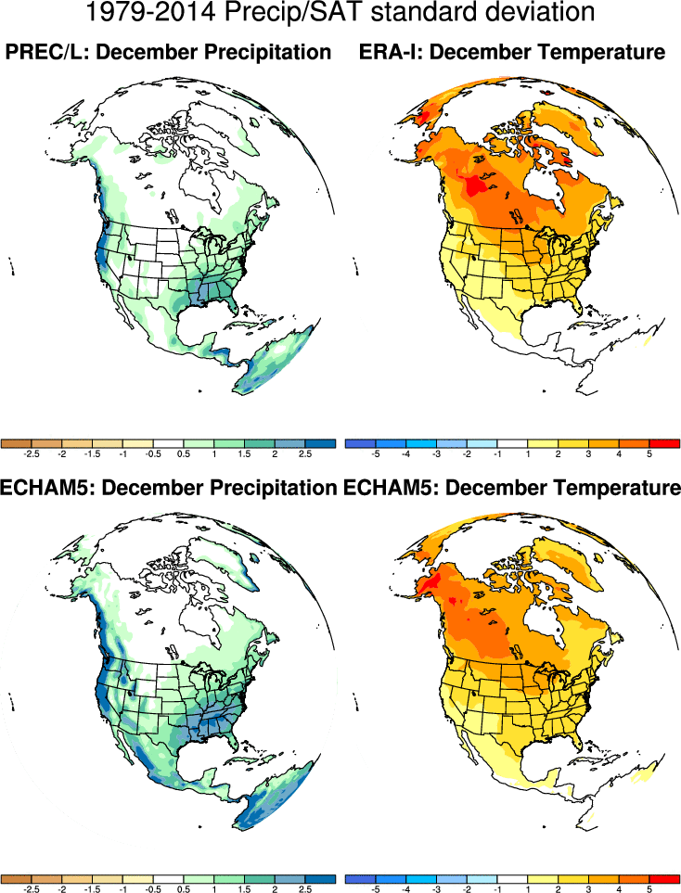

Slide 42
