Slide 1
A kernel-density based ensemble filter applicable (?) to high-dimensional systems
NOAA Earth System
Research Laboratory
Tom Hamill
NOAA Earth System Research Lab
Physical Sciences Division
Presentation at 91st AMS Annual, Seattle, WA, 15th IOAS-AOLS

Slide 2
“Research is the process of going up alleys to see if they are blind.”
Marston Bates

Slide 3
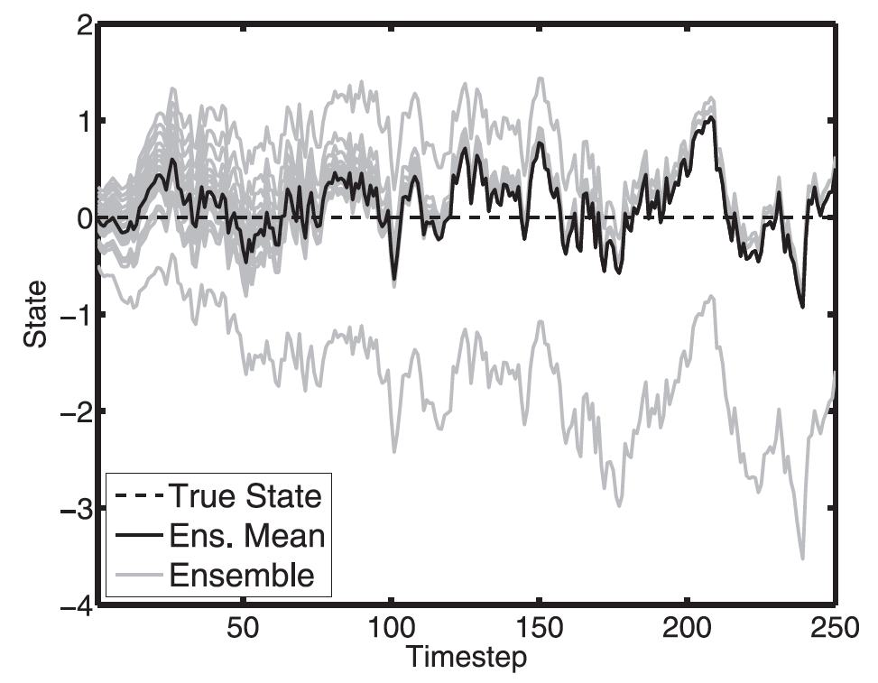
What to do when in ensemble filters when prior is obviously non-Gaussian?
Cycled EnKF can create non-Gaussian states, especially when (a) ensemble size is
large, and (b) when the forecast model contains significant nonlinearity. See Lawson and
Hansen, MWR, 2004; Mitchell and Houtekamer, MWR, 2009 and Anderson, MWR, 2010.
Example: data assimilation with
EAKF in simple dynamical system
where
x_{t+1}=x_{t} + 0.05 (x_{t} + αx_{t} |x_{t}|)
where α=0.2, n=20, obs~ N(0,1)
from Jeff Anderson, MWR, 2010.

Slide 4
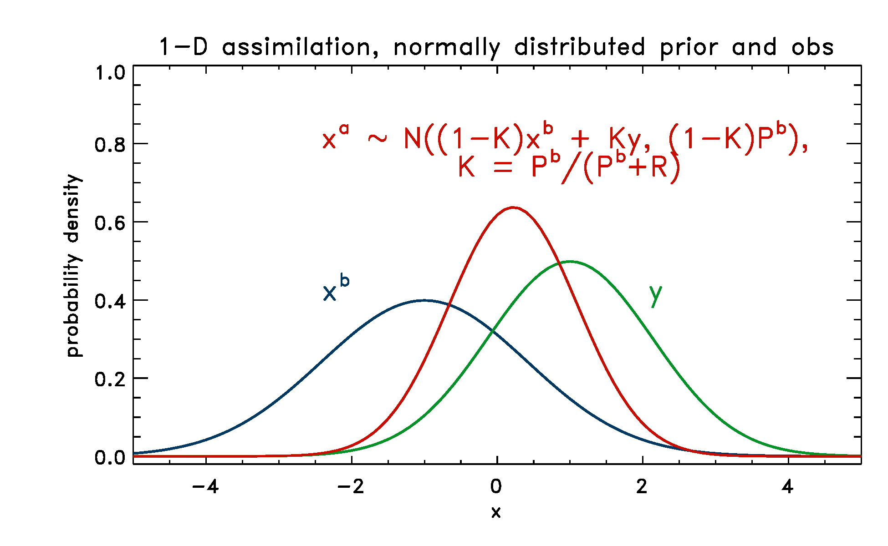
Gaussian distributions easy.
Most common data assimilation updates are well behaved when prior and observation are
normally distributed, as shown here, with an analytical solution for this 1-D problem.

Slide 5
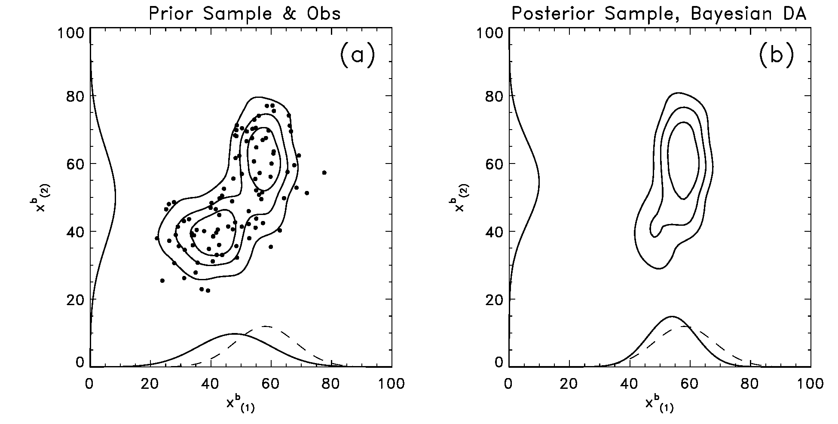
Estimating prior as fully non-Gaussian may work when state dimension is small.
Here ensemble is used to estimate probability density in 2-D, which is then
Bayesian updated to an observation in one component. Approaches
such as these are computationally and scientifically impractical for
large dimensional systems, e.g., “curse of dimensionality.”
from Hamill, chapter 6 in “Predictability of Weather and Climate”

Slide 6
Flavors of non-Gaussianity
Ensemble non-Gaussian, but
very high correlation between state
components, i.e, effectively
non-Gaussian only in 1 direction.
(potentially solveable, & intended
focus of this talk)
(2) Ensemble non-Gaussian, curved
attractor
(well beyond my current capabilities
& available computational resources)

Slide 7
Two insights of Jeff Anderson relevant to non-Gaussian data assimilation (of the first type)
Serial ensemble filters can split the update into two steps (Anderson, MWR, 2003) :
Update prior at observation location to the observation
(b) Regress increments to the rest of the state to the updated observation prior.

Slide 8
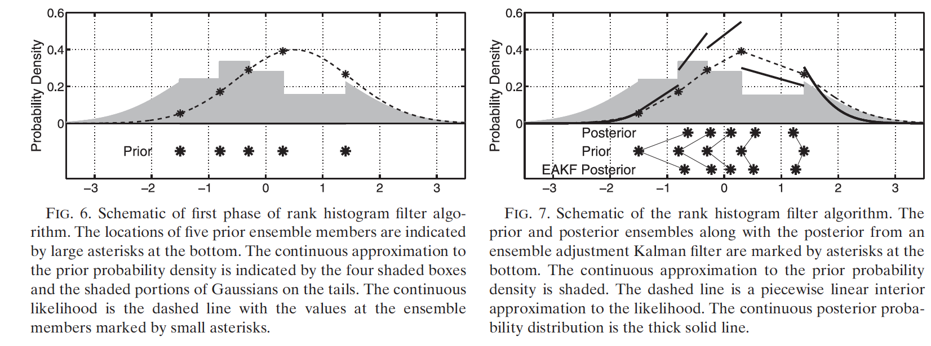
Insight 2: only in updating the observation prior, relax the Gaussianity assumption.
“Rank Histogram Filter” -- a probability mass of 1 / (n+1) is assigned between each
ensemble member observation prior. Given the observation likelihood (dashed),
piecewise construct a product of the prior and likelihood. For i^{th} sorted observation prior,
determine the value associated with the posterior CDF at i / (n+1). This replaces step (1) of
Anderson (2003). From Anderson, MWR, (2010).

Slide 9
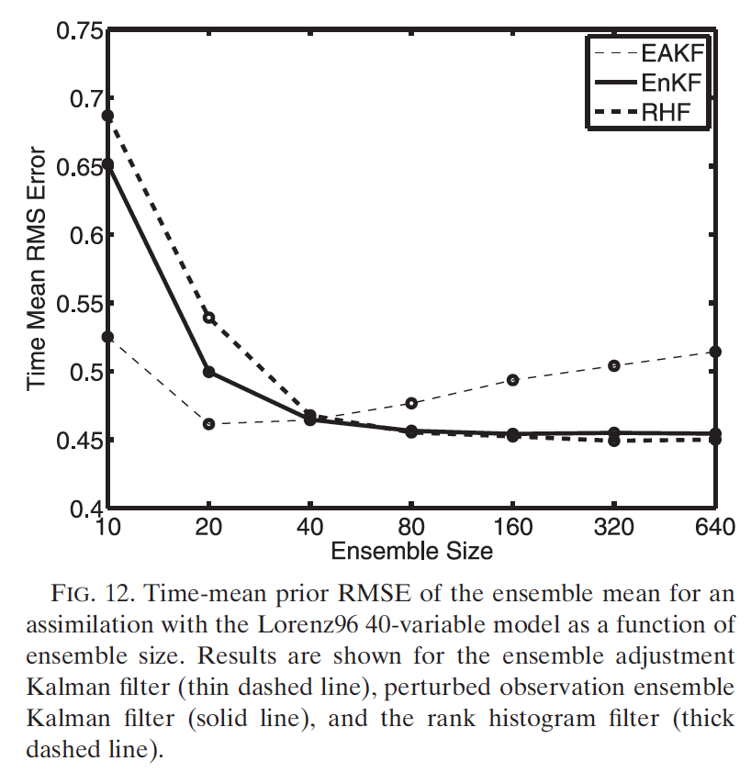
Anderson’s tests with Lorenz ‘96 model
Make a non-Gaussian
filter as good
as EAKF at
small ens sizes?
F=8.0; fixed localization
“half width” of 12 grid points.
Observations
Adaptive spatially varying
inflation following Anderson,
Tellus, 2009.
Note poor performance of
both RHF and EnKF when
ensemble size is 10 (see
Whitaker and Hamill MWR
2002), poor performance of
EAKF when ensemble size is
large (Lawson and Hansen,
MWR 2003).
Still as good as EnKF at large ens sizes?

Slide 10
Possible errors introduced with rank histogram filter (RHF)
Ensembles may, due to sampling variability, have large or small deviations between members. Are there consequences of having 1/(n+1) probability between each?
same 1/(n+1)
probability mass
between both?

Slide 11
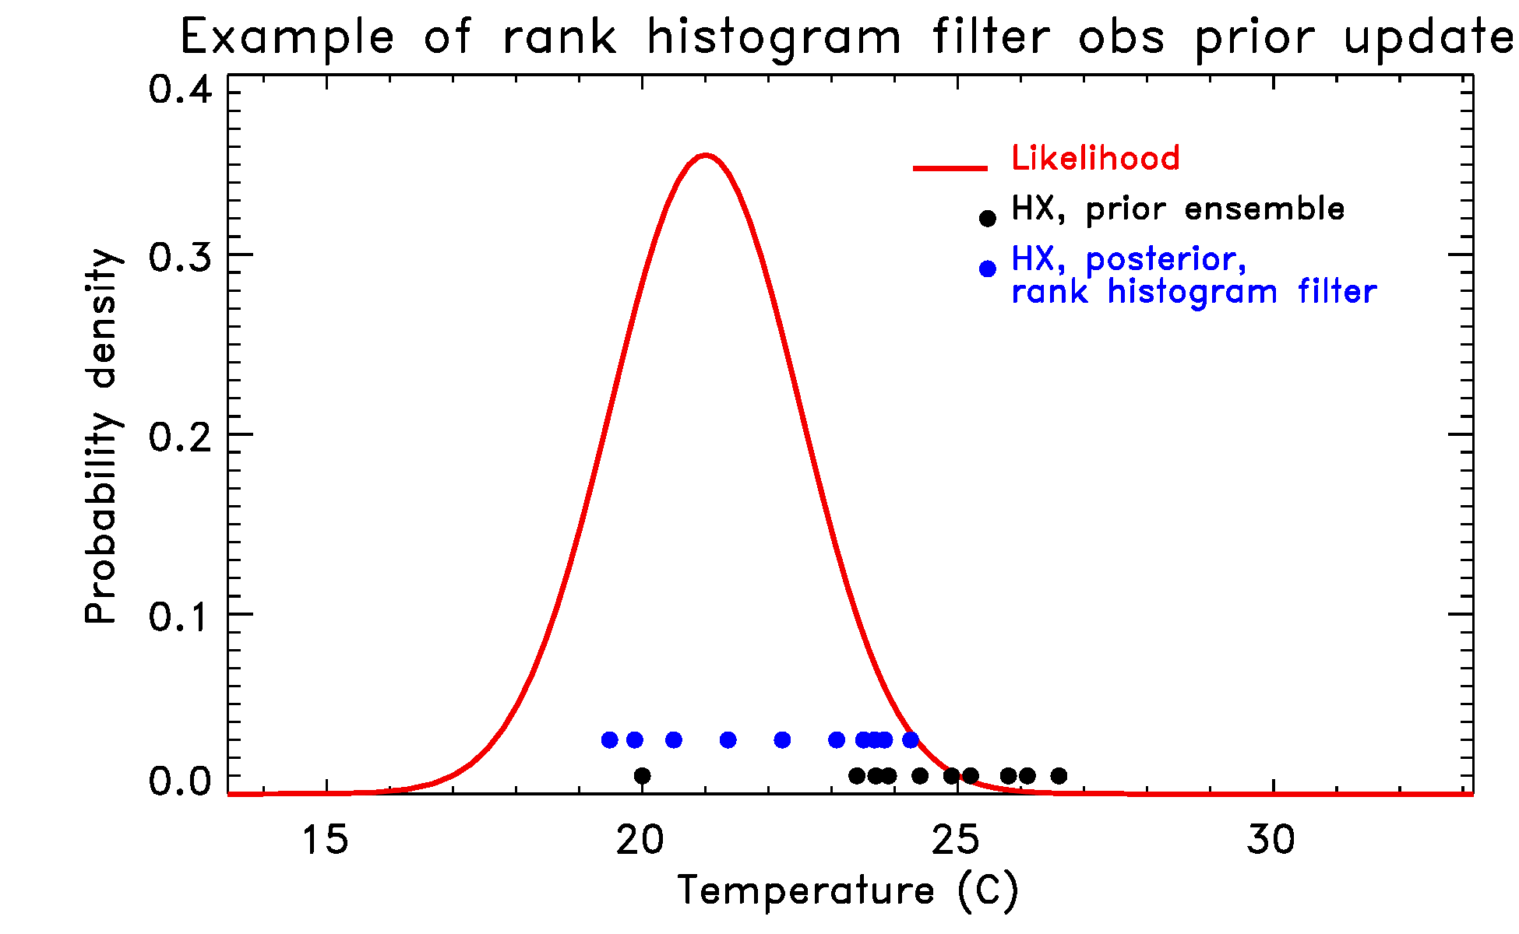
Surprisingly, the gap between the 1st and 2nd ensemble member in the prior
is obliterated with the rank histogram filter.

Slide 12
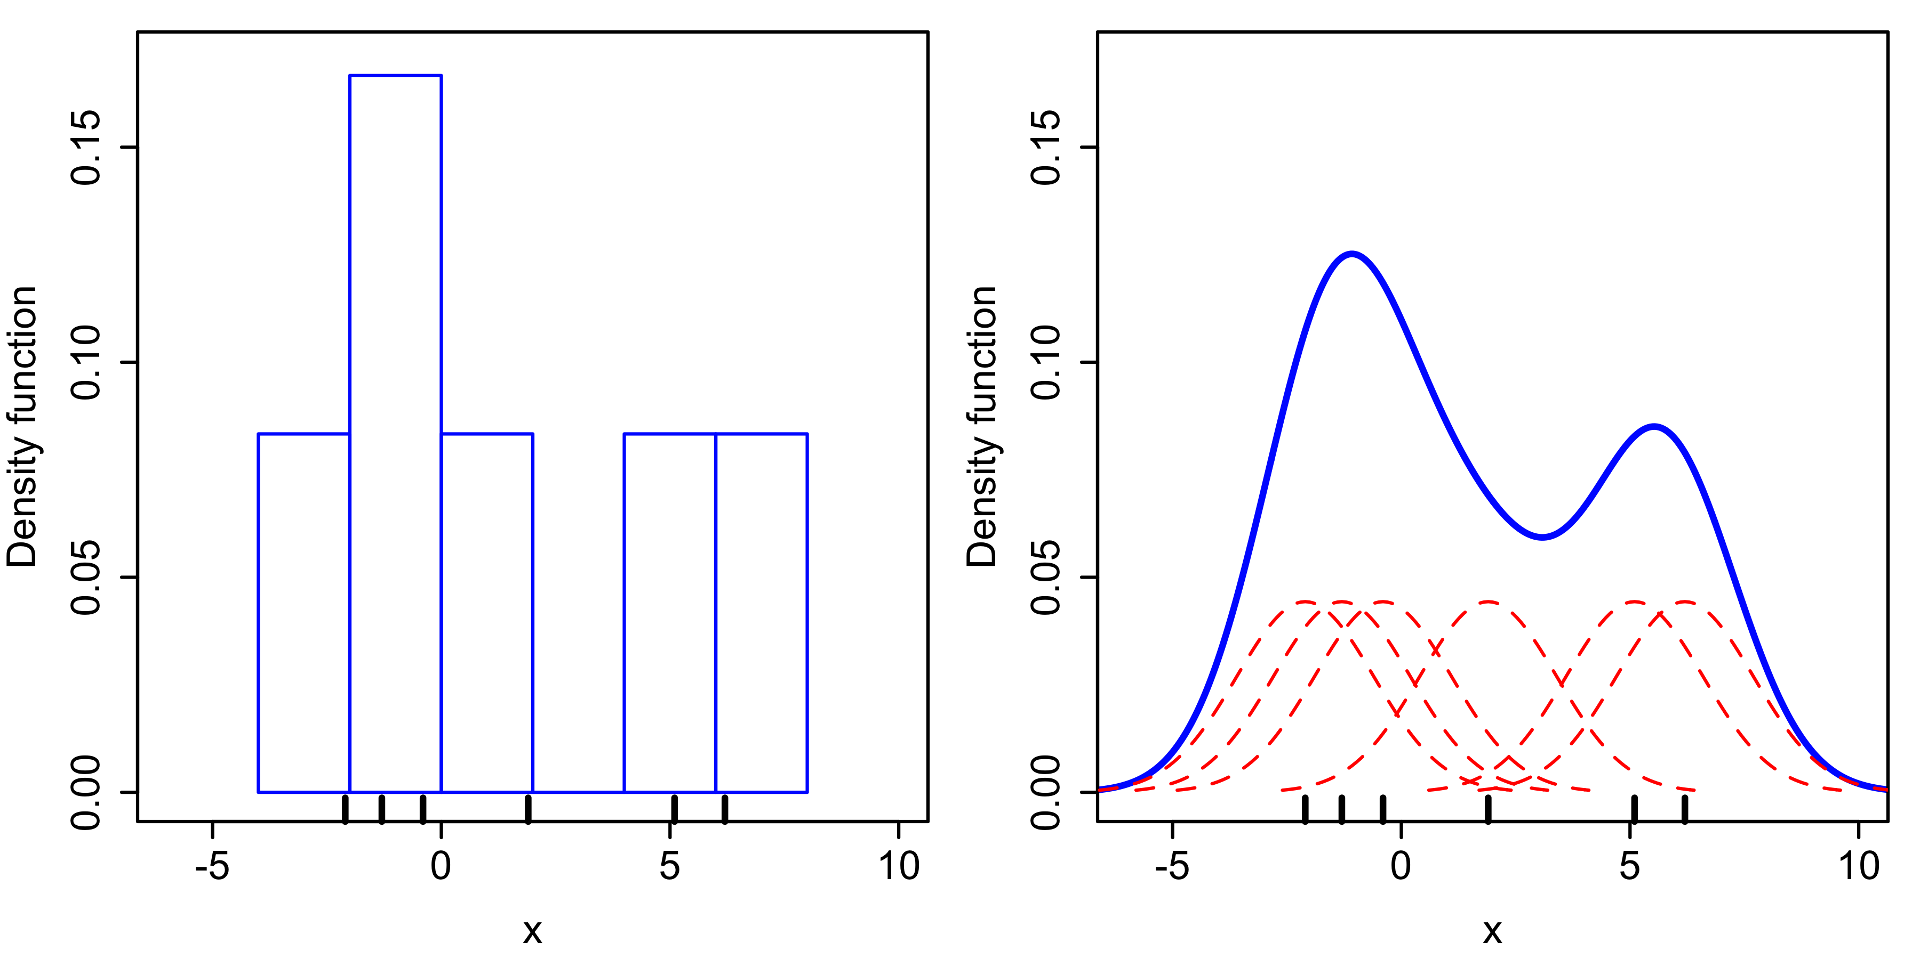
Kernel density approach?
Model observation prior with kernel density estimation techniques.
source: Wikipedia, “kernel density estimation.”

Slide 13
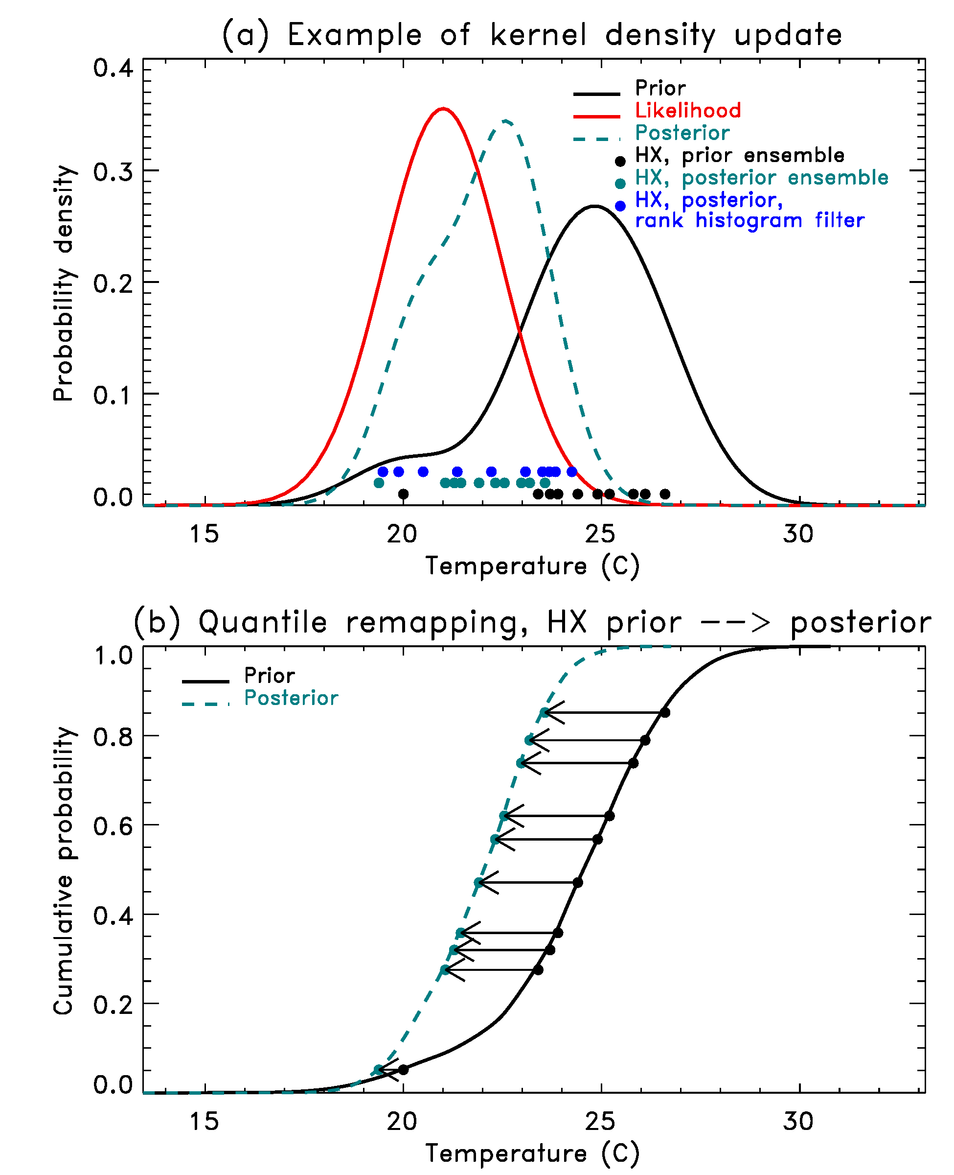
Example of observation prior update with “kernel density filter” (KDF)
If prior ensemble is significantly
non-Gaussian (as determined
through Kolmogorov-Smirnov test)
then replace standard ensemble
filter’s obs prior update with KDF
update. Model the observation
prior (black lines, panel a) with
kernel density estimation. Construct
posterior as product of prior and
likelihood (panel a). Generate
posterior members by finding the
ensemble members’ quantiles in the
prior cdf. Posterior members
are the values associated with those
quantiles in posterior cdf (panel b).

Slide 14
When to apply KDF
It’s much more expensive than EnKF, EnSRF, EnAF for updating obs prior.
My choice: use only when observation prior is statistically significantly non-Gaussian (Kolmogorov-Smirnov test, α=0.05)
Departures from Gaussianity more commonly determined to be significant with large ensemble sizes than with small.

Slide 15
Testing in Lorenz ’96 model
Classic L96 model, 40 variables, perfect model, F=8.0, dt = 0.05, cycle for 10 years after spinup.
Test EnKF, EnSRF, EnAF/KDF, EnAF/RHF over range of localization length scales, ensemble sizes.
Covariance inflation : 1 + 1./nanals^{0.96}

Slide 16
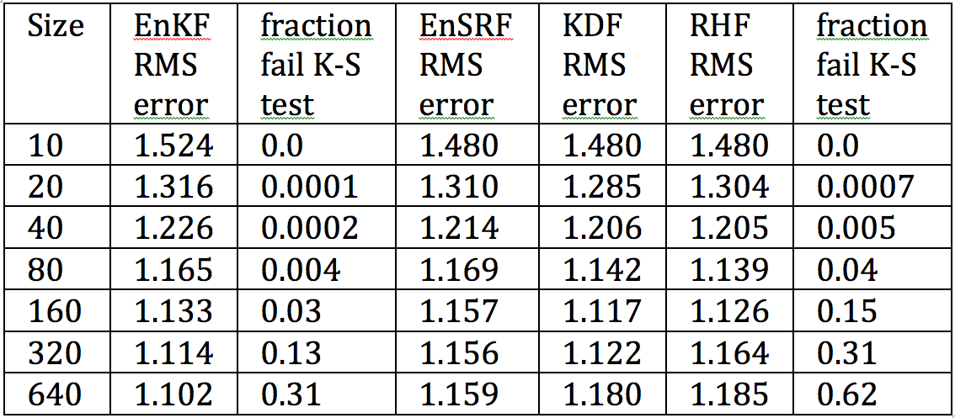
Lorenz ‘96, perfect model (obs σ=5.0, 6 h between obs, obs every grid point)
RHF/EAKF and KDF/EAKF not employed at smallest ensemble sizes since
departures from Gaussianity not detected. Same error as EnSRF.
(2) Surprisingly, benefit of RHF/EAKF & KDF/EAKF over EnSRF is at moderate ensemble
sizes, with degradation at large ensemble sizes.

Slide 17
Lorenz ‘96, perfect model (obs σ=5.0, 6 h between obs, obs every grid point)
EnKF detects non-Gaussianity less frequently than deterministic filters.
For typical 50-100 members, non-Gaussian conditions virtually never
diagnosed.

Slide 18
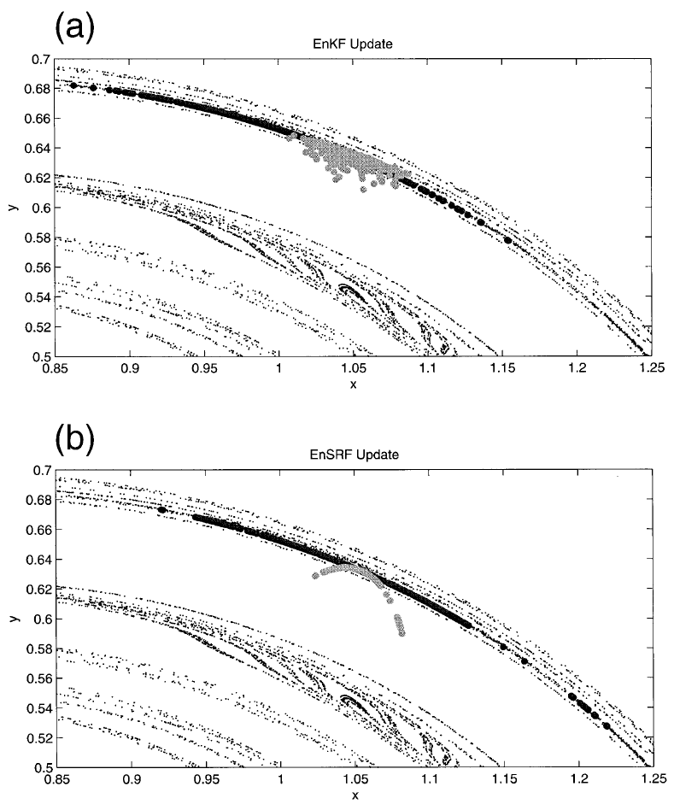
Lawson & Hansen’s insight using Ikeda Map
black dots = prior ensemble
grey dots = posterior ensemble
EnKF & effect of perturbed
observations creates more
normally distributed posterior,
while EnSRF compresses but
keeps curved prior shape.
(EnAF/KDF or EnAF/RHF would
do something similar).
Lawson & Hansen,
MWR, 2004.

Slide 19
Tests of KDF in global primitive equation model
Tested in 2-level dry global PE model recently used in Hamill and Whitaker (2011 MWR). Same uniform observation network. Imperfect model assumption.
Bottom line: effectively no change from using EnSRF data assimilation to using EnSRF/KDF data assimilation.
Reason is that KDF is virtually never invoked, since only invoked when prior is significantly non-Gaussian. EnSRF consistently used.
Admittedly, it’s still a toy model w/o moisture, other complicating aspects.

Slide 20
Why is non-Gaussianity actually more rare than one might think?
(1) In practical NWP applications, we often account for model error or sampling variability through additive noise with Gaussian properties.
P^{b} = MPªM^{T} + Q
x^{b} = Mxª + e, e ~ N(0,Q)

Slide 21
Why is non-Gaussianity actually more rare than one might think?
(2) Ensemble forecast members in more complex models may project onto several modes, some growing, some decaying. This may randomize the perturbation structures.
overall perturbation, superposition of
old decaying structures and new growing ones
old perturbation,
slowly decaying
new, rapidly
growing perturbation

Slide 22
Conclusions
Many previous researchers have dashed themselves to pieces trying to surf the reef that is non-Gaussian data assimilation (me too).
Some oldies but goodies, like perturbed-obs EnKF & deterministic filters with noise to account for model and sampling error, continue to be hard to beat for NWP applications.
Possible increased relevance of non-Gaussian techniques as ensemble filters begin to deal with moisture-related variables.

Slide 23
KDF technical detail.
Q: How does one determine the kernel type and width used?
A: Gaussian kernel used, but may not be a critical detail. Optimal width is a function of ensemble size, smaller for large sizes. The optimal width estimated by repeatedly:
creating an ensemble drawn from standard normal.
choosing kernel width, creating pdf estimate.
evaluating the integrated square error (ISE) of the estimated to the analytical cdf.
finally, for a given ensemble size, choose the width “w” that has the lowest average integrated square error.
width that’s actually used for an ensemble with a spread of s is s*w.

