Slide 1


Statistical post-processing using reforecasts to improve medium-range renewable energy forecasts
NOAA Earth System
Research Laboratory
Tom Hamill and Jeff Whitaker
NOAA Earth System Research Lab,
Physical Sciences Division
tom.hamill@noaa.gov

Slide 2
Wind energy decisions based on weather forecasts
Most consequential decisions are “unit commitments” (~ 1 day) and then updates using very short-range forecasts to adjust.
Less consequential O&M decisions might be based on longer-lead forecasts.
Questions:
  Can we improve long-lead forecasts to support, say, maintenance decisions?
  Can we make, say, 2-day forecasts as well as we make current 1-day forecasts so that unit commitment decisions might be made further in advance?
  What new data sets and approaches might be tried to improve these longer-lead forecasts?

Slide 3
Current assimilation/forecast process
Forecast valid 12Z
12Z Obs
Data Assimilation
Analysis valid 12Z
Forecast Model
Forecast valid 13Z
Forecast valid 14Z
Forecast valid 15Z
…
13Z Obs
Data Assimilation
Analysis valid 12Z
…

Slide 4
Current assimilation/forecast process
Forecast valid 12Z
These forecasts used to help make
decisions about how much wind
energy can be provided. Sometimes
direct forecasts are used, sometimes
with statistical adjustment.
12Z Obs
Data Assimilation
Analysis valid 12Z
Forecast Model
Forecast valid 13Z
Forecast valid 14Z
Forecast valid 15Z
…
13Z Obs
Data Assimilation
Analysis valid 12Z
…

Slide 5
Challenges in directly using forecast guidance
Forecast
Analyzed
Wind power
12Z
13Z
14Z
15Z
16Z
17Z
18Z

Slide 6
Challenges in directly using forecast guidance
Forecast
F minus A
Analyzed
Wind power
12Z
13Z
14Z
15Z
16Z
17Z
18Z

Slide 7
Challenges in directly using forecast guidance
F minus A
Wind power
12Z
13Z
14Z
15Z
16Z
17Z
18Z
Errors are some mix of systematic errors due to the forecast model deficiencies
and random errors due to the chaotic growth from small analysis errors.

Slide 8
Challenges in directly using forecast guidance
F minus A

Slide 9
Challenges in directly using forecast guidance
F minus A
0

Slide 10
Challenges in directly using forecast guidance
an overall bias correction should
result in a modest improvement
in the forecasts
F minus A
F - A
0

Slide 11
Challenges in directly using forecast guidance
What if we had additional information
such as the wind direction? Then
perhaps a more sophisticated statistical
correction could be attempted.
N
N
F minus A
E
E
E
F - A
0
W

Slide 12
Challenges in directly using forecast guidance
S
S
S
S
S
S
What if we had additional information
such as the wind direction? Then
perhaps a more sophisticated statistical
correction could be attempted.
What if we had further additional
information such as static stability “S” ?
N
N
F minus A
E
E
E
F - A
0
W

Slide 13
Challenges in directly using forecast guidance
S
S
S
S
S
S
What if we had additional information
such as the wind direction? Then
perhaps a more sophisticated statistical
correction could be attempted.
What if we had further additional
information such as static stability “S” ?
N
N
F minus A
E
E
E
F - A
0
W
The more additional predictors you may wish to include in some statistical correction model, the longer the time series of forecasts and observations you are going to need.

Slide 14
Reforecasts (hindcasts)
Numerical simulations of the past weather (or climate) using the same forecast model and assimilation system that (ideally) is used operationally.
  Very common with climate, still uncommon with weather models.
Reforecasts may be initialized from reanalyses, but reforecasts ≠ reanalyses

Slide 15
GEFS reforecast v2 details
Seeks to mimic GEFS (NCEP Global Ensemble Forecast System) operational configuration as of February 2012.
Each 00Z, 11-member forecast, 1 control + 10 perturbed.
Reforecasts produced every day, for 1984120100 to current (actually, working on finishing late 2012 now).
CFSR (NCEP’s Climate Forecast System Reanalysis) initial conditions (3D-Var) + ETR perturbations (cycled with 10 perturbed members). After ~ 22 May 2012, initial conditions from hybrid EnKF/3D-Var.
Resolution: T254L42 to day 8, T190L42 from days 7.5 to day 16.
Fast data archive at ESRL of 99 variables, 28 of which stored at original ~1/2-degree resolution during week 1. All stored at 1 degree. Also: mean and spread to be stored.
Full archive at DOE/Lawrence Berkeley Lab, where data set was created under DOE grant.

Slide 16
Status
00Z reforecasts 1985-late 2012 completed and publicly available.
Within a month or two, we will be pulling real-time GEFS data over from NCEP and putting it in our archive.
Web sites are open to you now:
  NOAA/ESRL site: fast access, limited data (99 fields).
  US Department of Energy: slow access, but full data set
Soon: experimental probabilistic precipitation forecast graphics in real time.

Slide 17
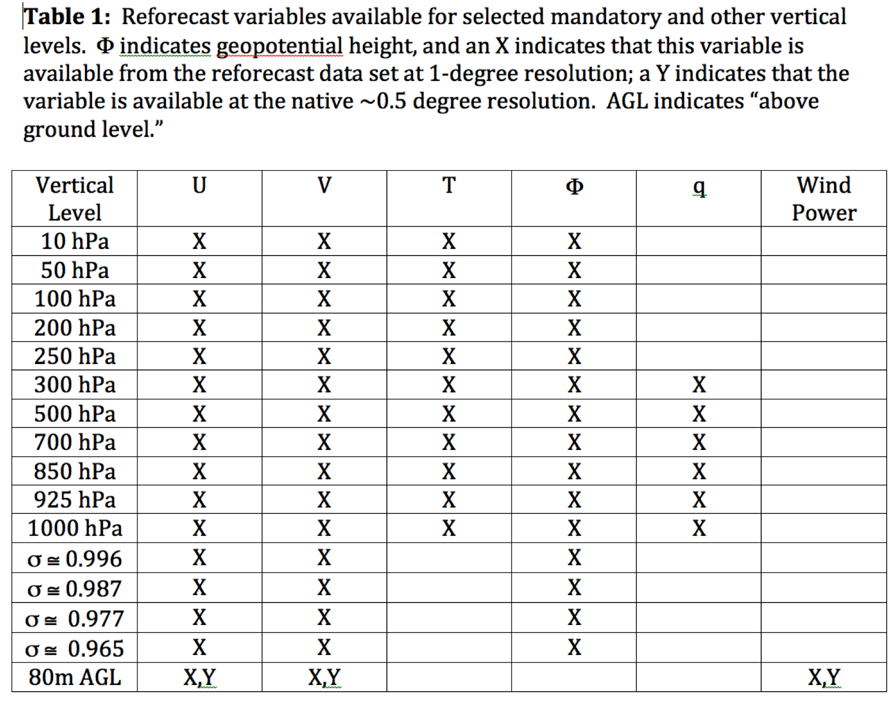
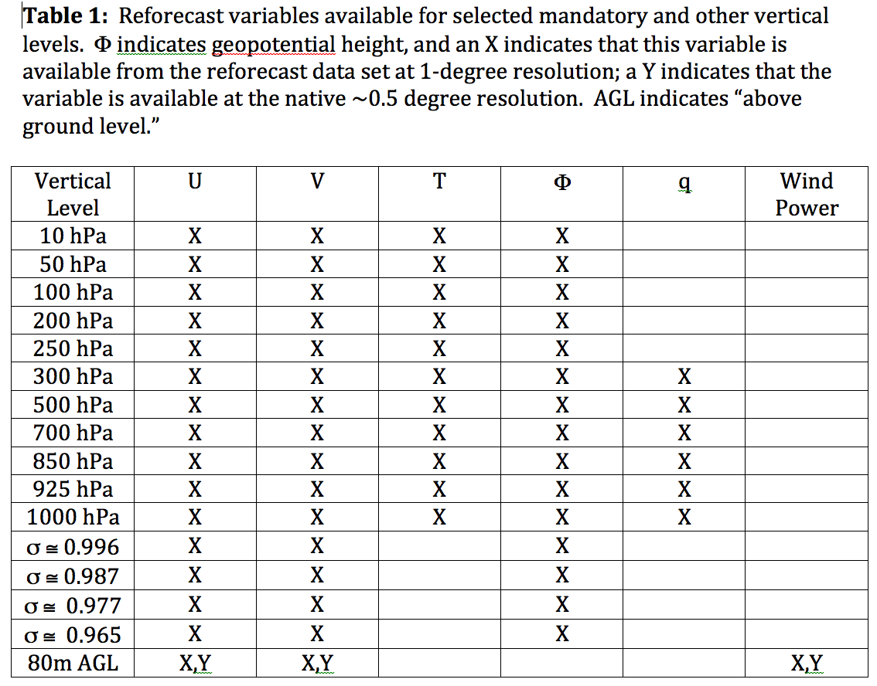
Data to be readily available from ESRL
Also: hurricane track files

Slide 18
Data to be readily available from ESRL
useful
for wind
energy?
Also: hurricane track files

Slide 19
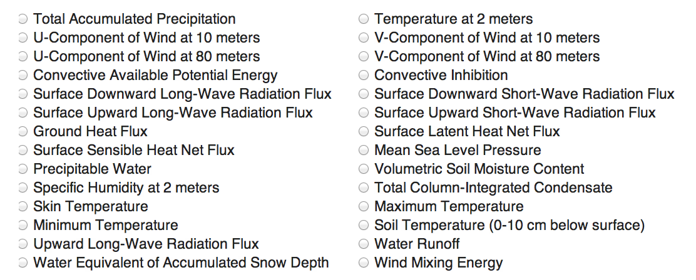
Data to be readily available from ESRL at native resolution (~0.5 degree in week 1, ~0.7 degree in week 2)

Slide 20
Data to be readily available from ESRL at native resolution (~0.5 degree in week 1, ~0.7 degree in week 2)
of particular relevance for hydro, wind, and solar renewable-energy forecasting

Slide 21
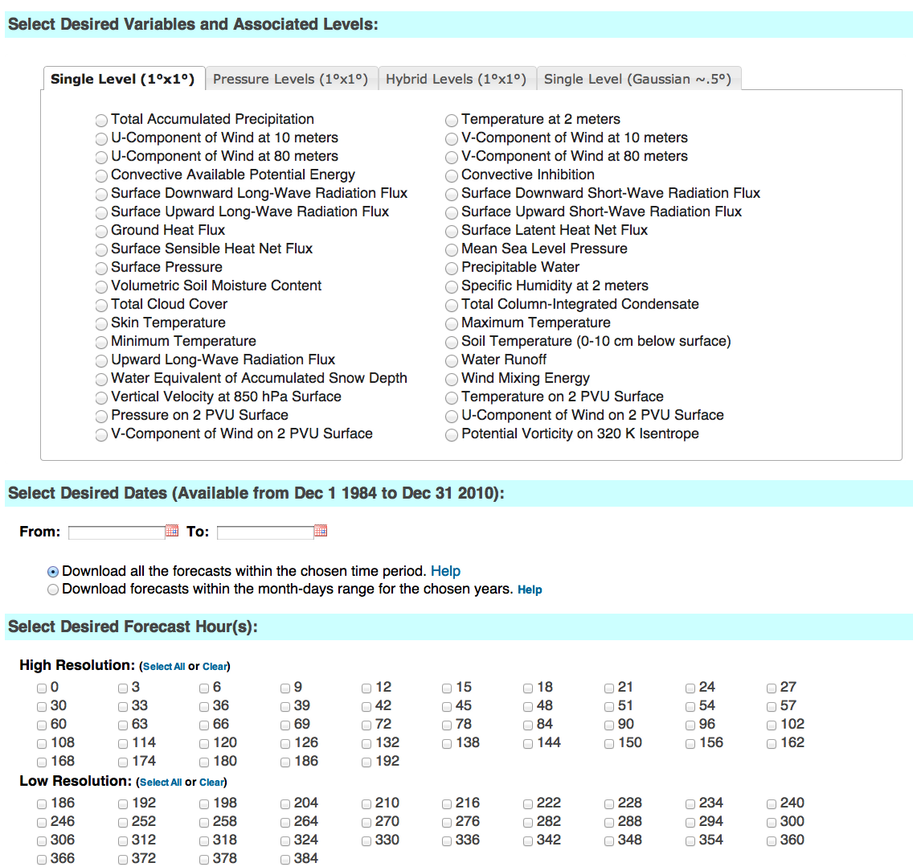
esrl.noaa.gov/psd/forecasts/reforecast2/download.html
Your point-and-
click gateway
to the reforecast
archive.
Produces
netCDF files.
Also: direct
ftp access to
allow you to
read the raw
grib files.

Slide 22
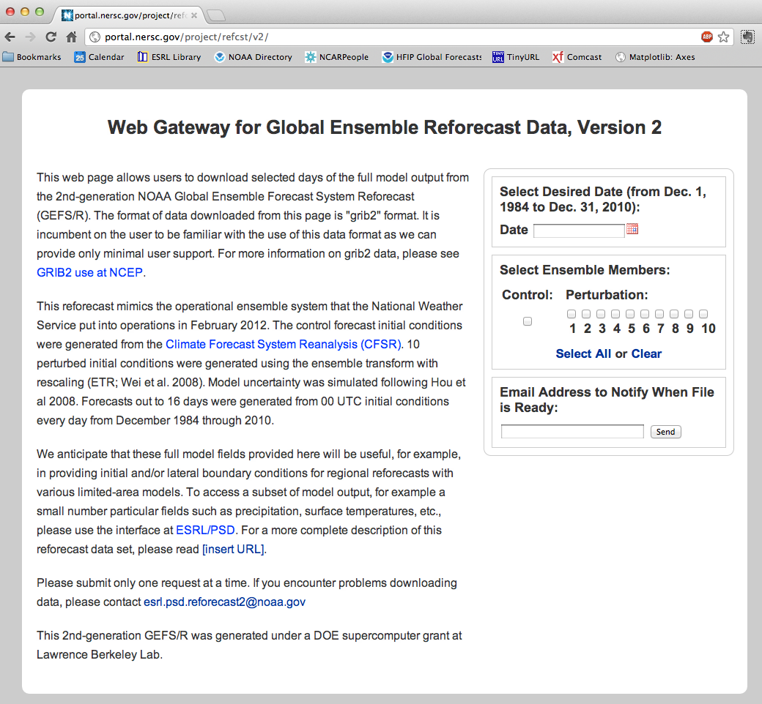
This DOE
site will be
ready for
access to
tape storage
of full data
(slower).
Use this to
access full
model state.

Slide 23
Skill of raw reforecasts
(no post-processing)

Slide 24
500 hPa Z anomaly correlation
(from deterministic control)
Lines w/o filled colors
for second–generation
reforecast (2012, T254)
Lines with filled colors
for first-generation
reforecast (1998, T62).
Perhaps a 1.5-2.5 day
improvement.
Some change in skill
over period of reforecast.

Slide 25
Statistical post-processing using reforecasts

Slide 26
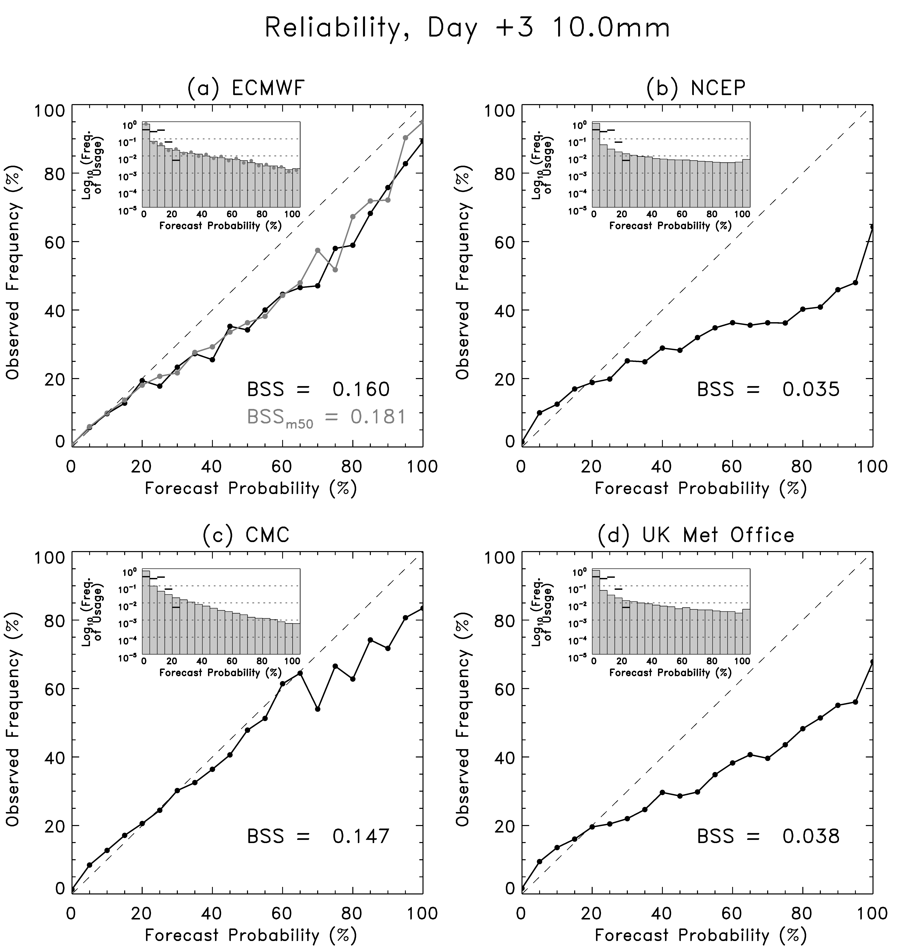
Statistical post-processing of precipitation forecasts
Probabilities directly estimated from ensemble prediction systems are often unreliable.
This is data from Jul-Oct 2010,
when the GEFS was T190.
Can we statistically post-process the current GEFS using reforecasts and improve reliability and skill?

Slide 27
Reliability, > 10 mm precipitation 24 h⁻¹
Day +0-1
Day +2-3
Day +4-5
Version 2 (2012 GEFS)
Almost perfect reliability, greatly improved skill with
a very simple statistical post-processing algorithm
leveraging the long reforecast data set.

Slide 28
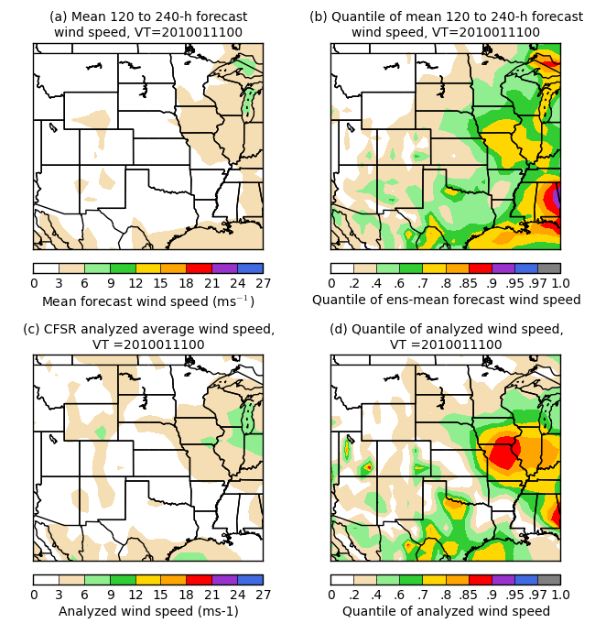
Application to wind energy: what if there’s no time series of observed data?
Say you don’t have observational
or analysis data widely available
for statistical post-processing.
How can you leverage reforecasts
to tell you whether or not today’s
weather is unusual?
Here’s an example quantifying
how unusual the forecast wind
speed is relative to past model
forecasts of wind speed for a
similar time of the year.
This might be useful for making
decisions for wind energy, for
example.

Slide 29
Conclusions
Reforecast data set has been created for current operational NCEP GEFS.
Reforecast data and real-time forecasts available now, or will be soon.
May be useful for statistical calibration and developing improved products for renewable-energy forecasts.

Slide 30
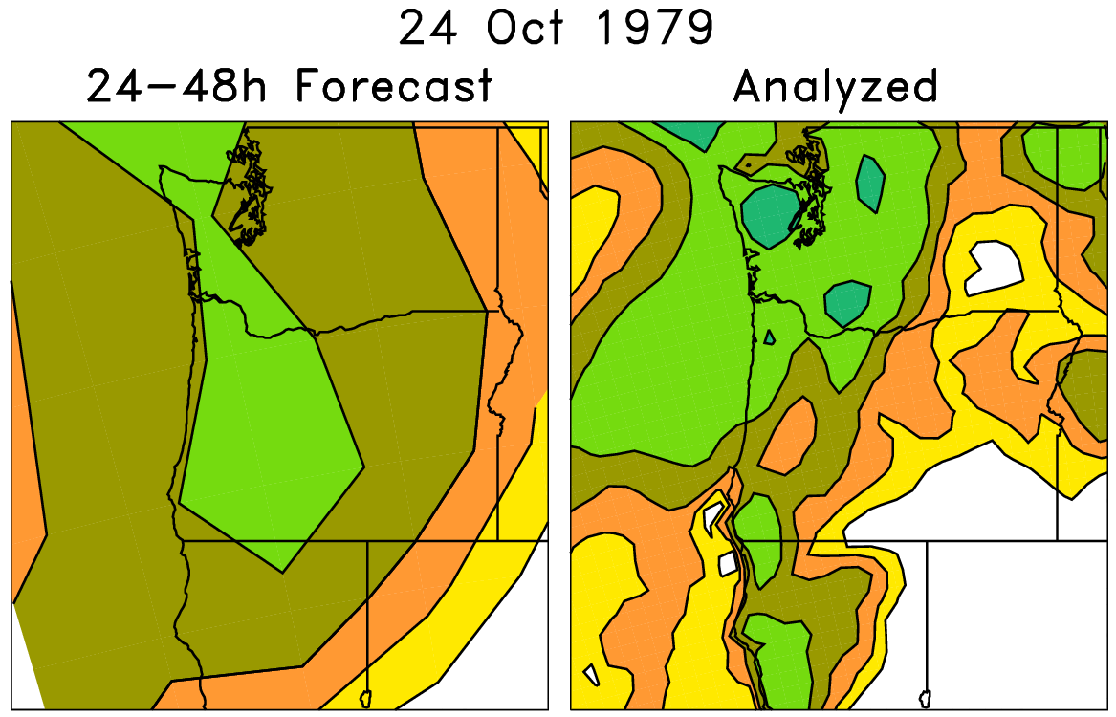
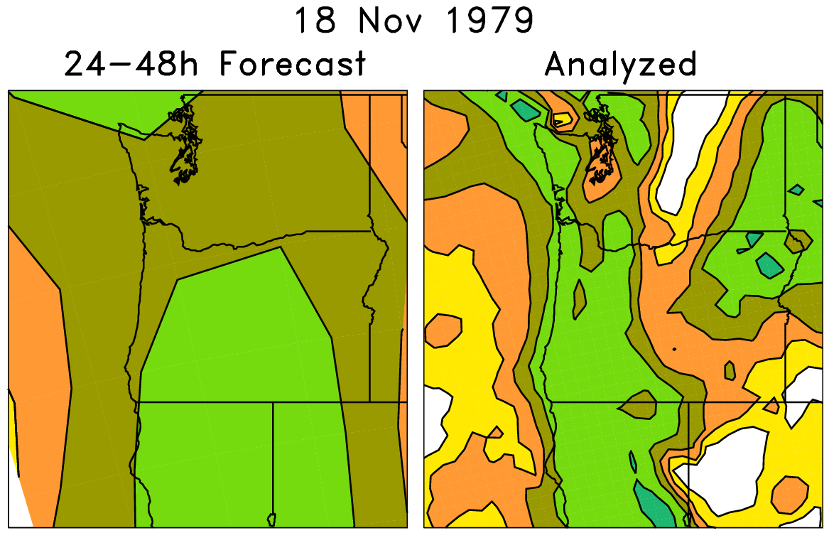
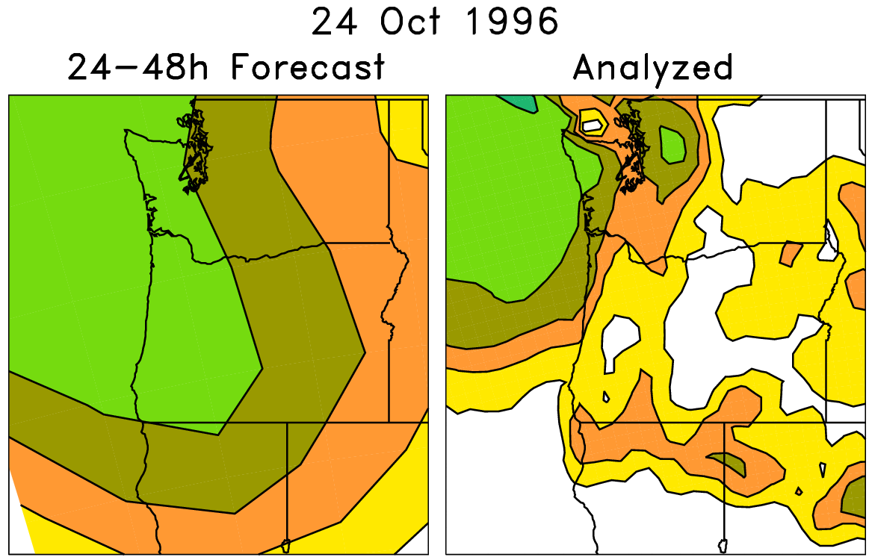
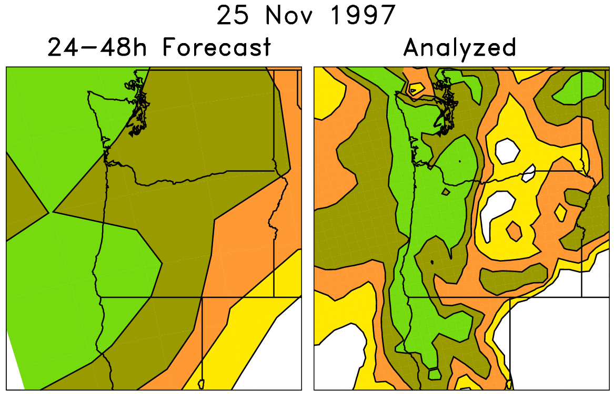
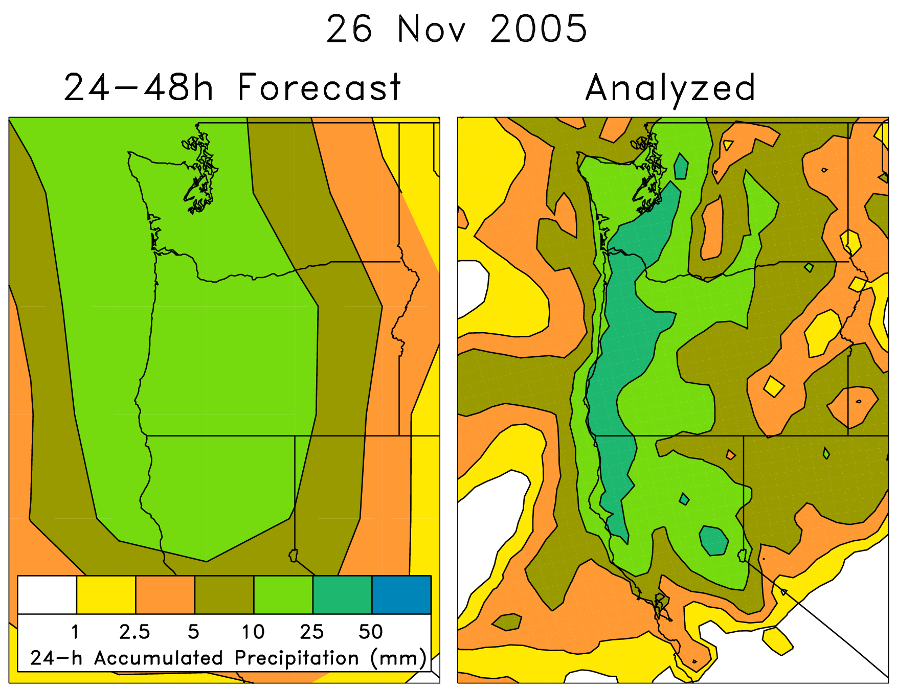
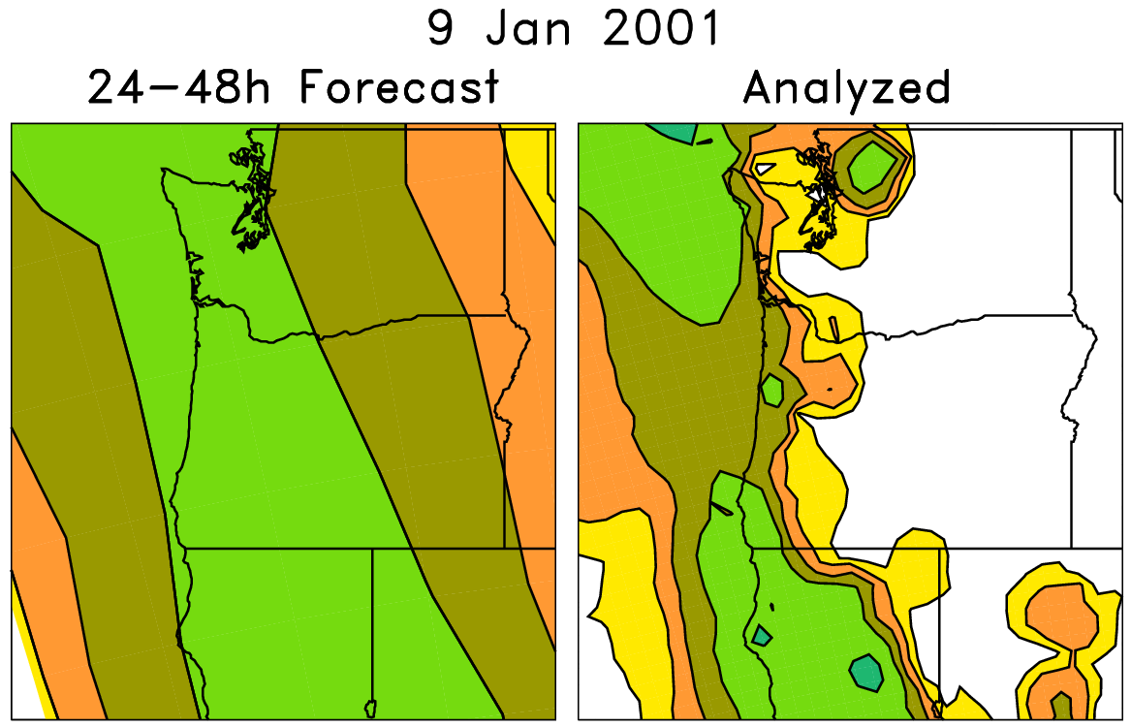
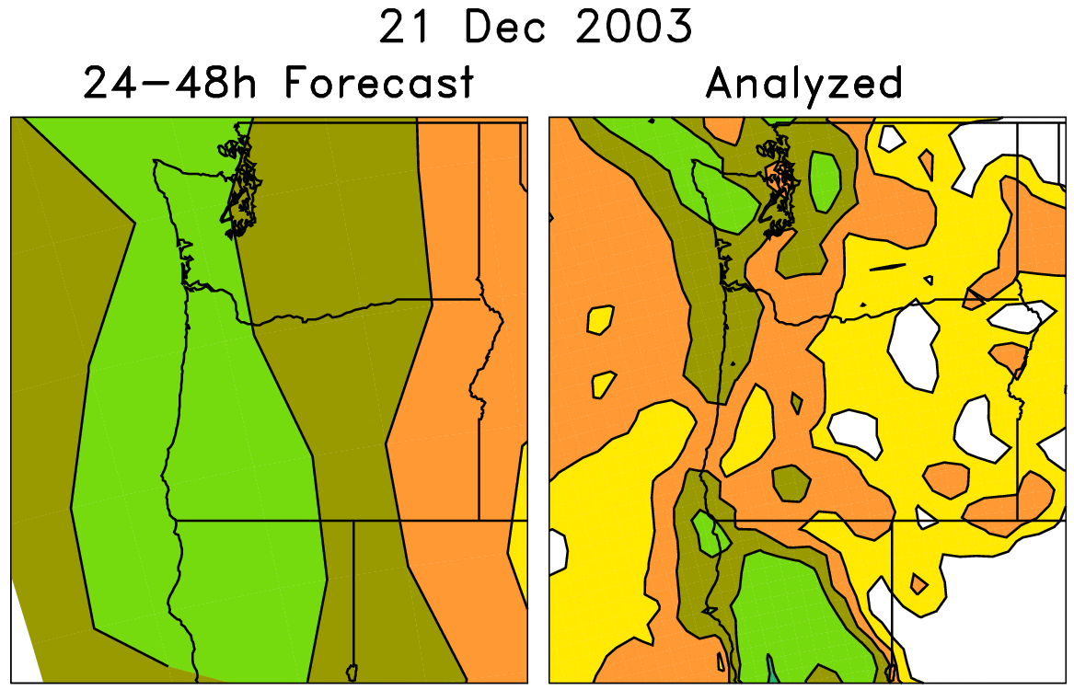
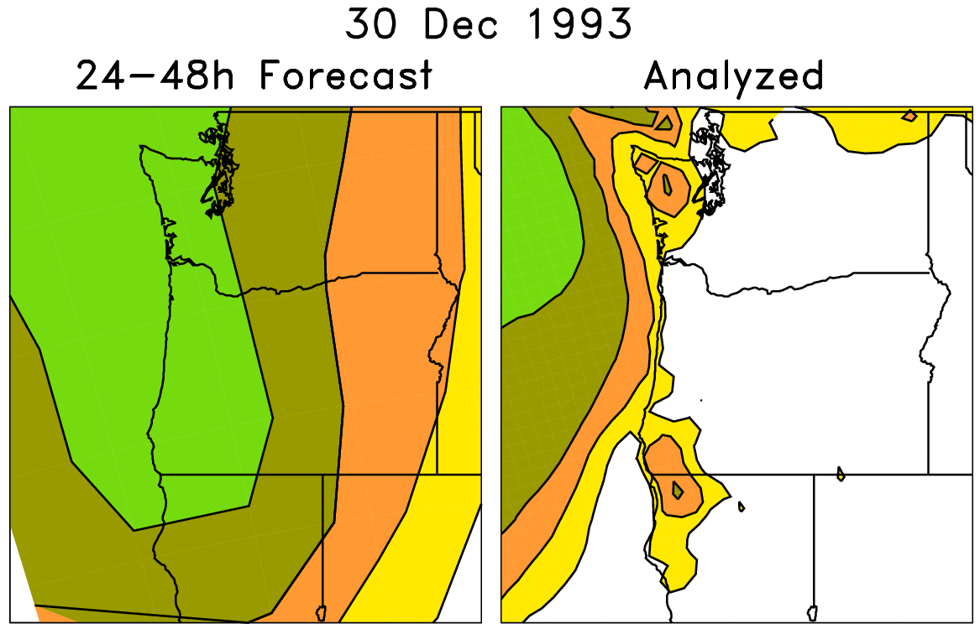
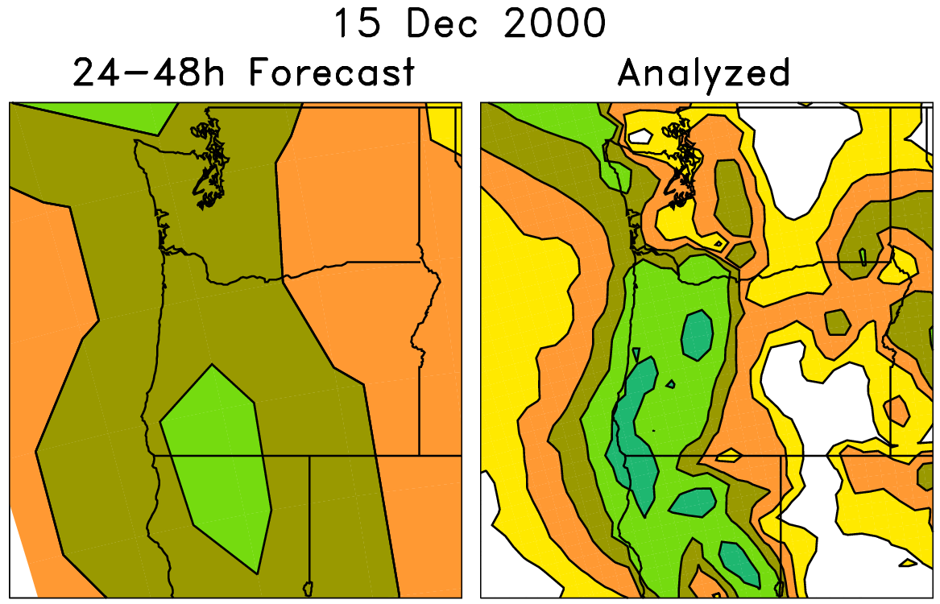
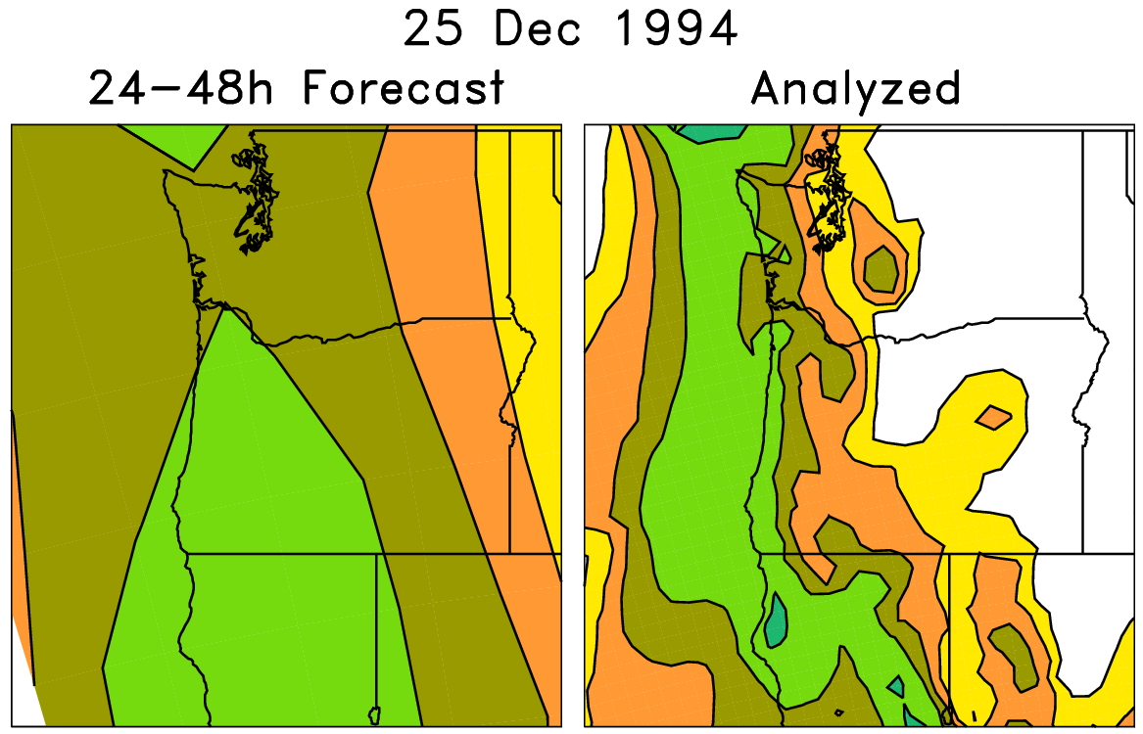
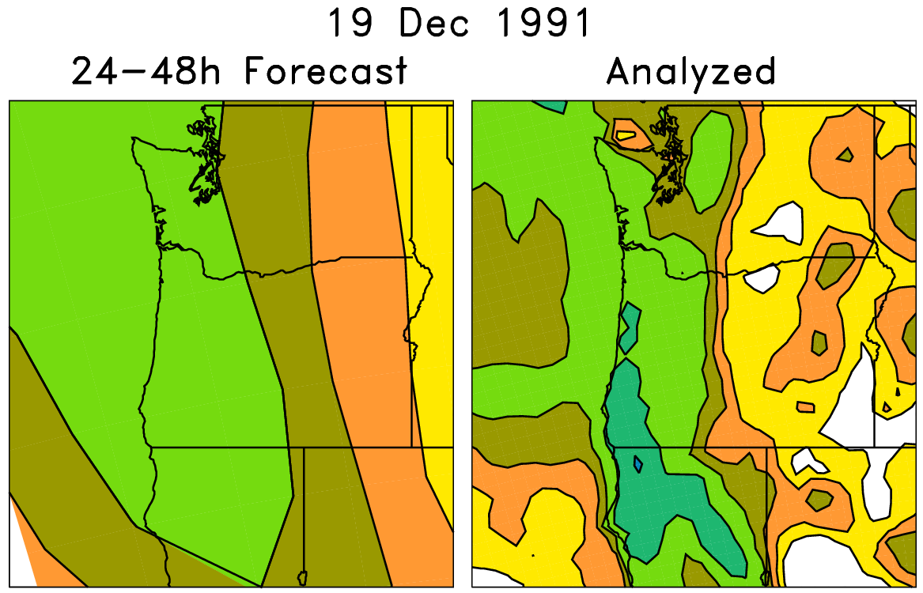
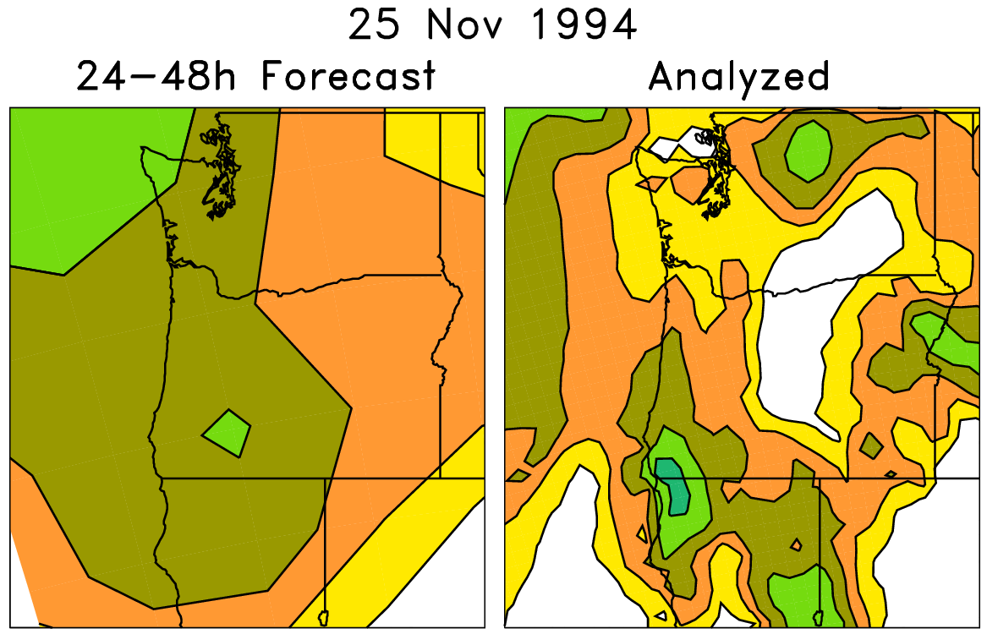
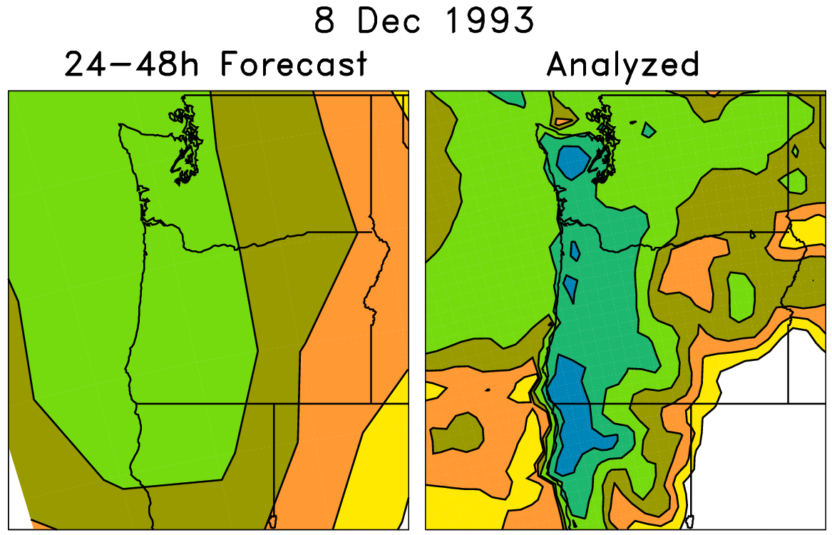
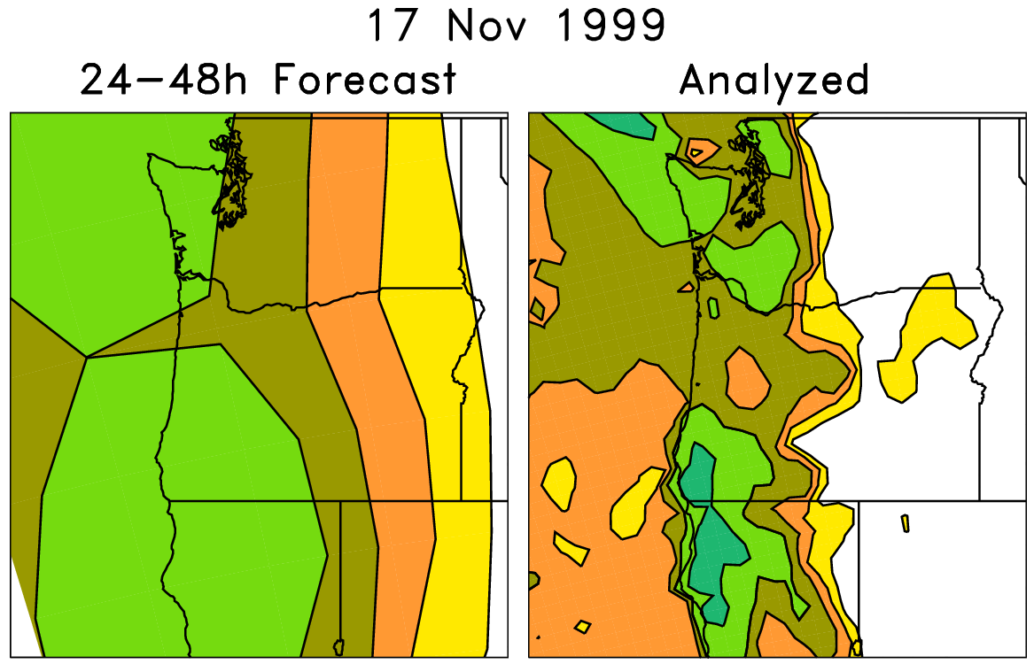
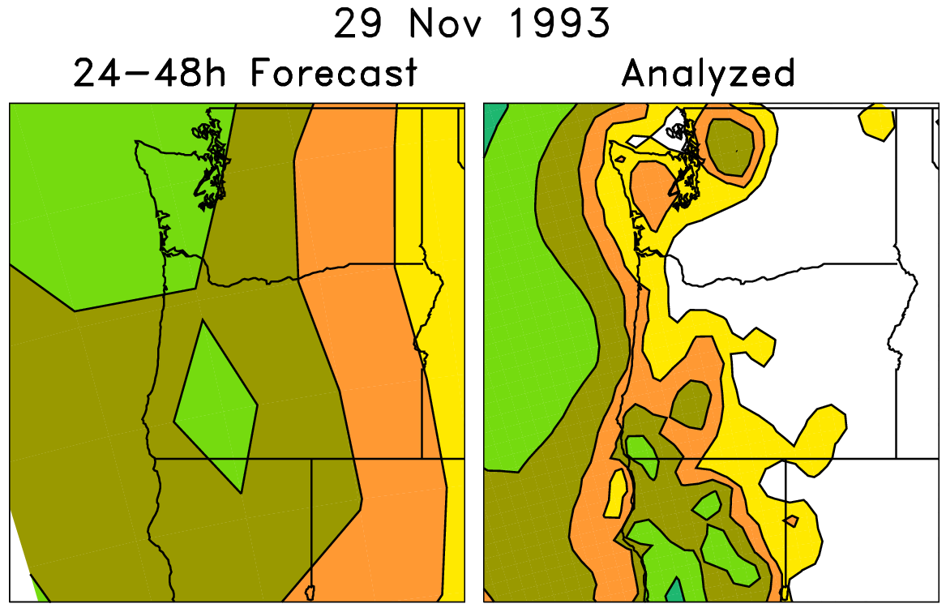
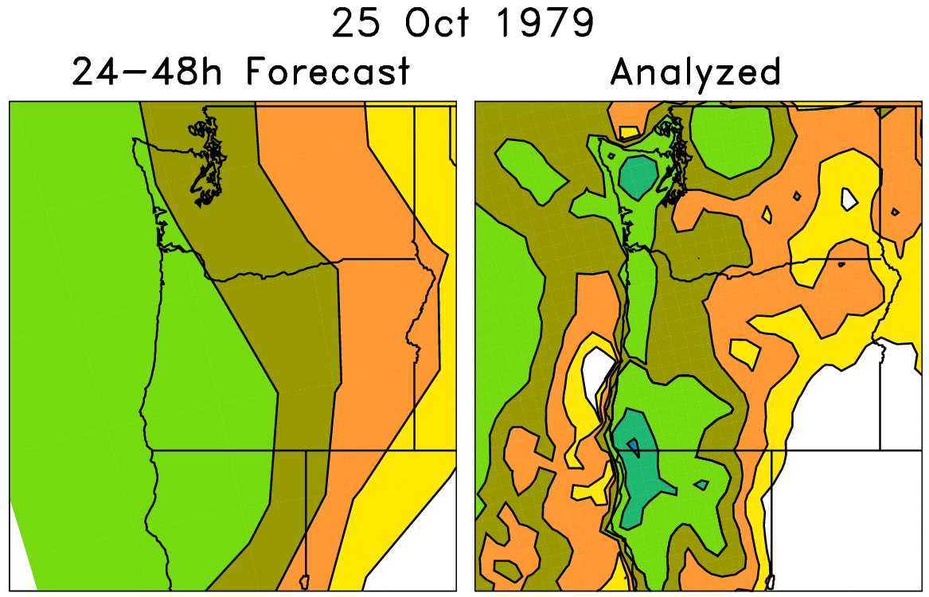
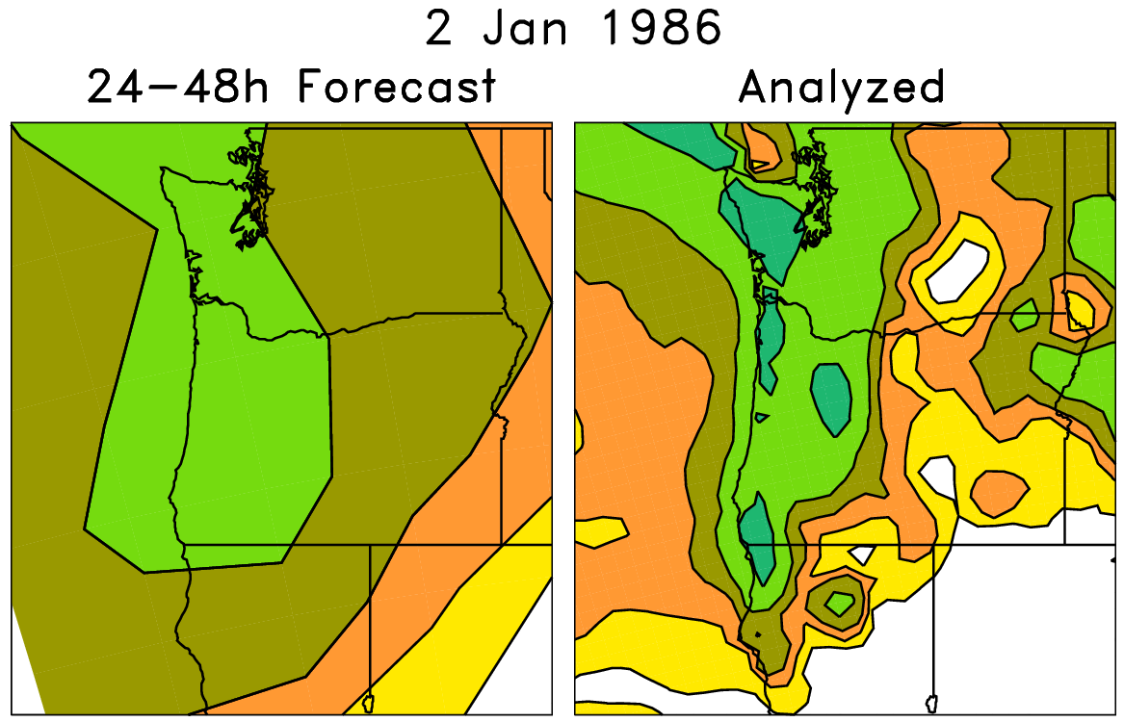
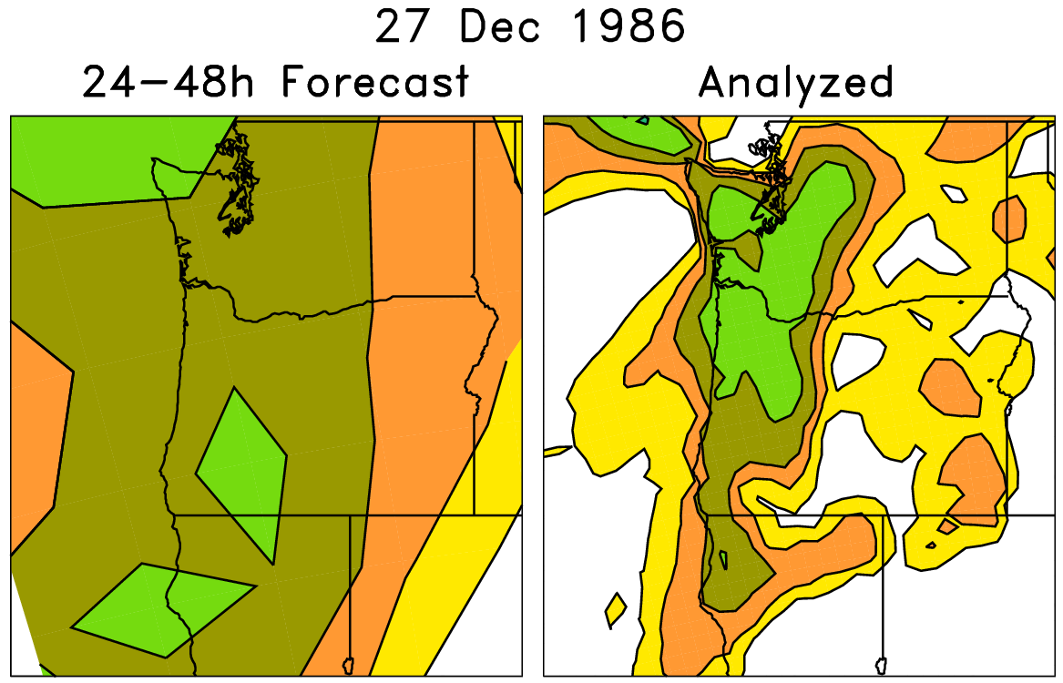
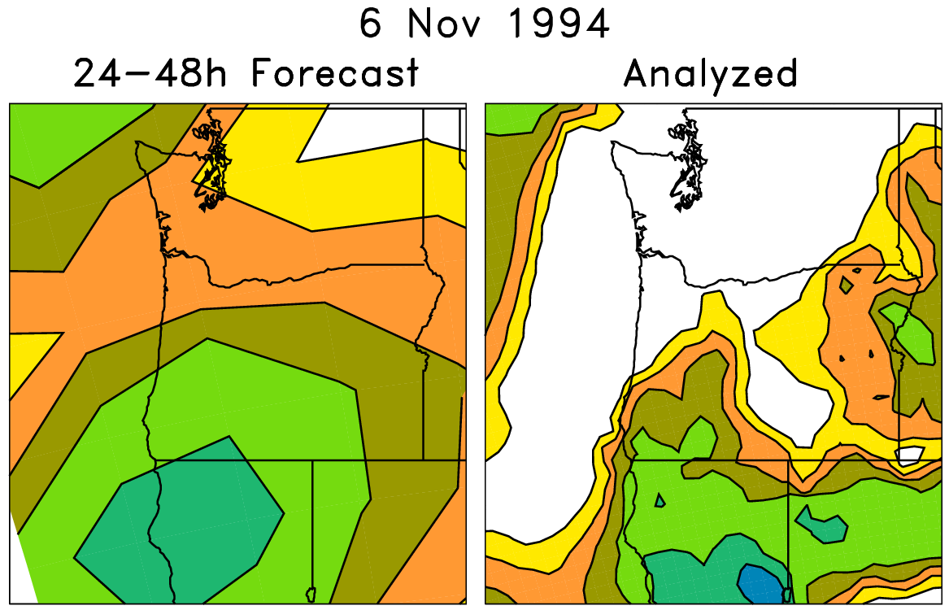
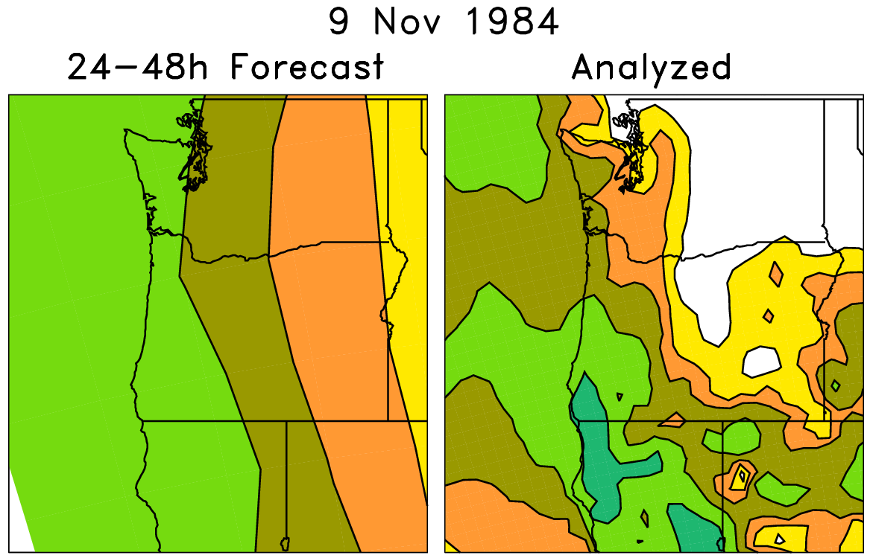
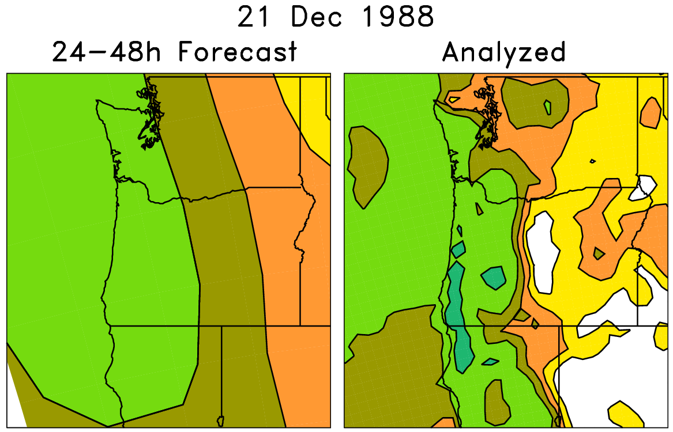
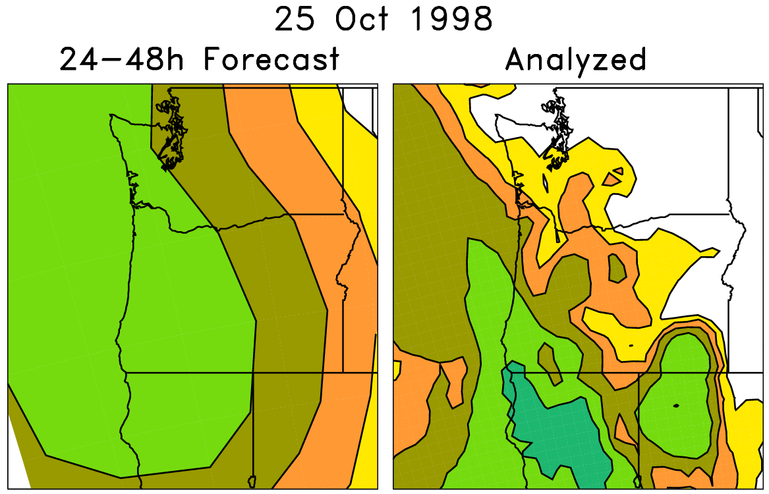
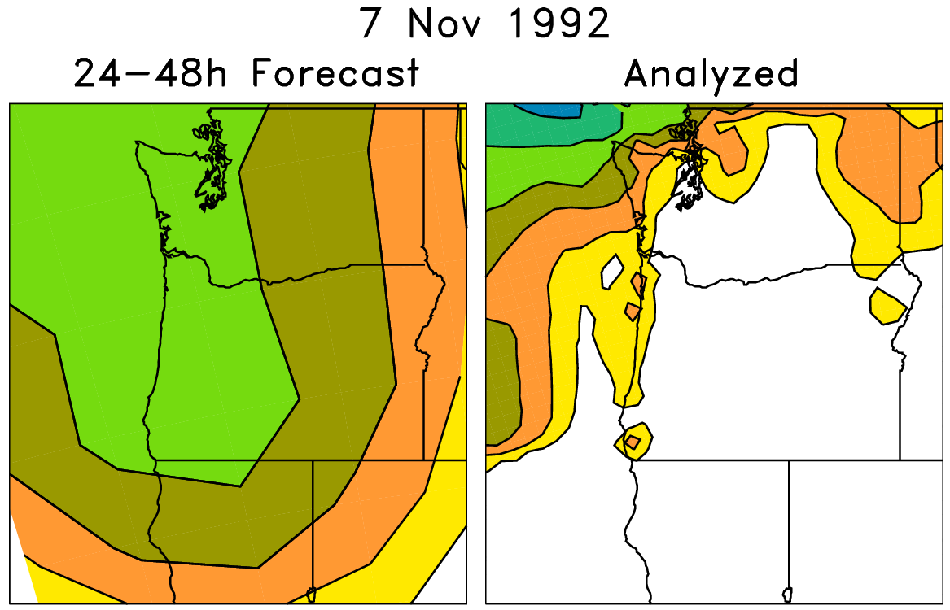
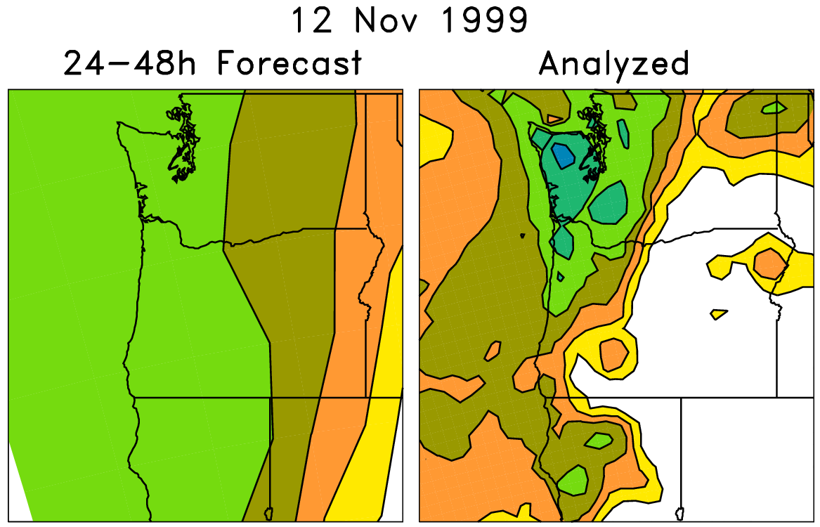
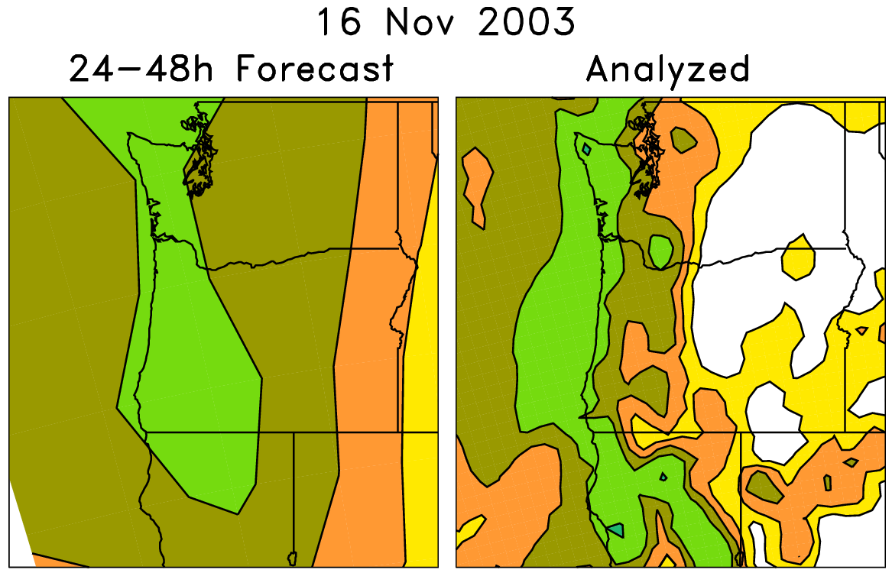
An example of a statistical correction technique using those reforecasts
Today’s forecast (& observed)
For each pair (e.g. red box), on the left are old forecasts that are somewhat similar to this day’s ensemble-mean forecast. The boxed data on the right, the analyzed precipitation for the same dates as the chosen analog forecasts, can be used to
statistically adjust and downscale the forecast.
Analog approaches like this
may be particularly useful for
hydrologic ensemble applications, where an ensemble of weather realizations is needed as inputs to a hydrologic ensemble streamflow system.

Slide 31
Skill of calibrated precipitation forecasts
(over US, 1985-2010, “rank analog” calibration method)
Verification here against 32-km North American Regional Reanalysis (tougher).
Verification in previous plot against 1-degree NCEP precipitation analysis (easier).

