Slide 1
Changes to quantile mapping and weighting for PQPF using ECMWF reforecast data
Tom Hamill, NOAA ESRL/PSD

Slide 2
Review of key results from previous work.
Quantile mapping appears to dramatically improve skill and reliability of light precipitation forecasts, where precipitation over-forecast bias is the primary problem.
Variable weighting of sorted ensemble members improves heavier precipitation forecasts, where apparently under-spread is the major issue.

Slide 3
Closest-member histograms suggest that after quantile mapping, the ensemble is still under-spread. Objective weights applied to various sorted members depend on precipitation amounts (the three panels).
From Hamill and Scheuerer 2018 MWR conditionally accepted, here.

Slide 4
Light precipitation skill
Ref: ibid

Slide 5
Heavier precipitation skill

Slide 6
Work completed
Speeding up the quantile mapping code.
New procedure for weighting ensemble to deal with the issue of varying ensemble size.
  Reforecast: 11 members.
  Real-time: 51 members.
New procedure for synthetically generating a 51-member ensemble that are equally likely and preserve rank correlation structure of original ensemble.

Slide 7
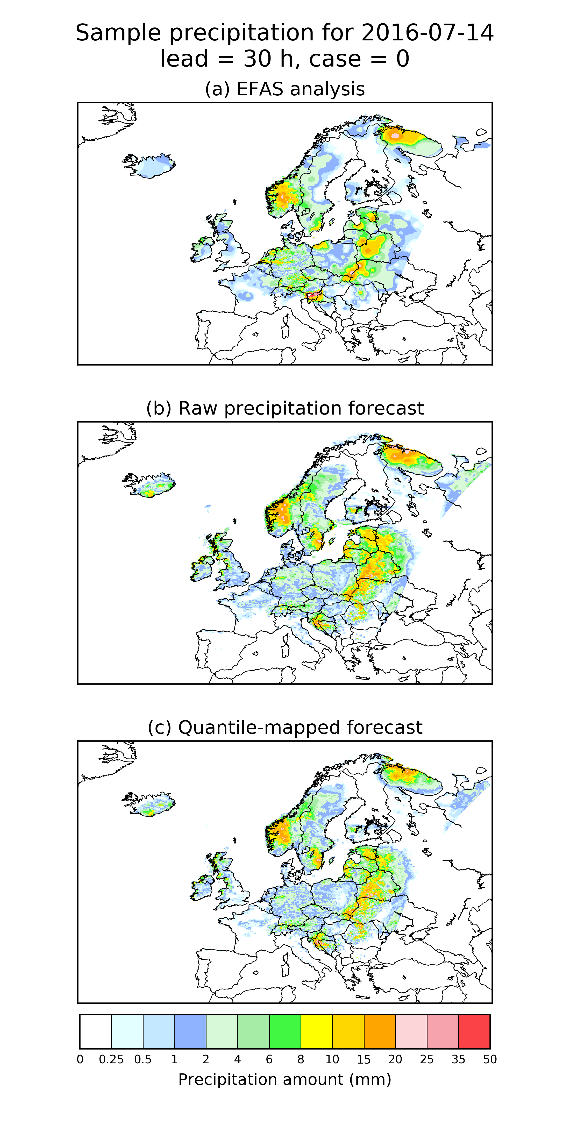
Example: verifying that quantile mapping works after speed-up
The first thing I worked on was speeding up the
quantile mapping so that I could perform code
development and debugging more rapidly.
I achieved this largely by designing Fortran routines
to do the computationally intensive
calculations, called from python scripts.
Here’s a sample plot of analyzed, a raw member,
and a quantile-mapped member, showing the
quantile mapping makes qualitatively minor
modifications to the forecast. Notice decrease in
area of light precipitation.

Slide 8
Determining closest-member histogram weights.
Definition of these weights follows discussion in Hamill and Scheuerer (2018), here.
  Vectors of weights were determined separately for light (0.01 – 2.0 mm) quantile-mapped ensemble-mean precipitation, moderate (2.0 – 6.0 mm), and heavy (> 6.0 mm)
Test data set of weights were accumulated over a set of 9 reforecast dates centered on 14 July, 20 years, and all grid points with valid data.
A cross-validation procedure was applied, whereby:
  For year i of m=20 years, the ith year of training data was withheld for determining the CDFs for quantile mapping. Then the quantile mapping was applied to that ith year with CDFs built using the remaining 19 years x 9 case days x 50 supplemental locations.
I also fitted a Beta distribution and estimated weights from that, reason to be explained in next slides.

Slide 9
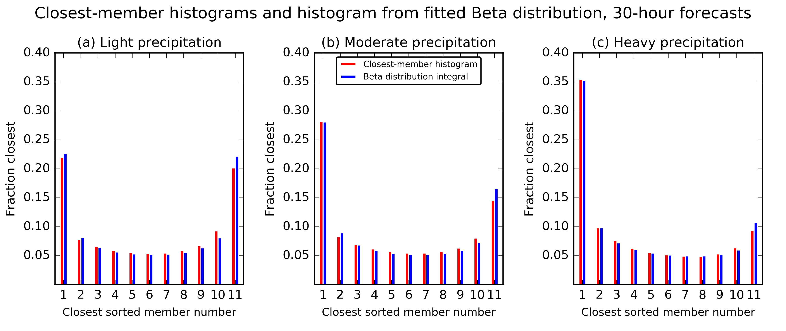
Closest-histogram weights.
Example here calculated from 6-h to 30-h forecasts.
The histograms estimated from fitted beta distributions look fairly accurate.

Slide 10
Finding closest-member histogram weights for a
51-member ensemble
So, we now have:
  Closest histogram weights appropriate to an 11-member reforecast ensemble.
  A fitted beta distribution.
We want:
  Closest-histogram weights appropriate to a 51-member ensemble.
Get this by integrating the beta distribution (next slide).

Slide 11
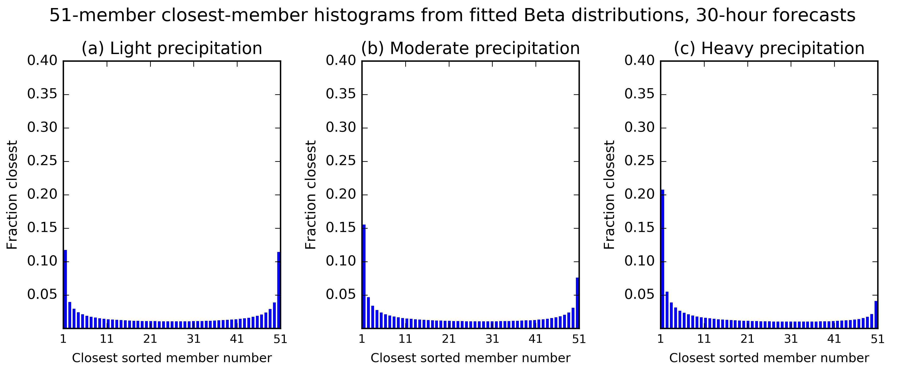
51-member weights
These histograms were calculated by integrating the same Beta distributions as in slide 9; the difference now are the differences in the bounds of the integration are narrower. For example, to get the closest-member histogram for the lowest sorted member, one integrates the beta distribution from 0/51 to 1/51. See the Wilks text for more information on Beta distributions.

Slide 12
Creating equally likely ensemble members
What we have now:
  The ability to quantile map the 51-member real-time ensemble using the reforecast training data.
  The ability to estimate the weights to apply to that 51-member ensemble.
What I think the hydrologists want: a 51-member precipitation ensemble that:
  Is postprocessed to be skillful, reliable
  For lack of better information, the postprocessed ensemble will preserve the rank correlation structure of the raw data.

Slide 13
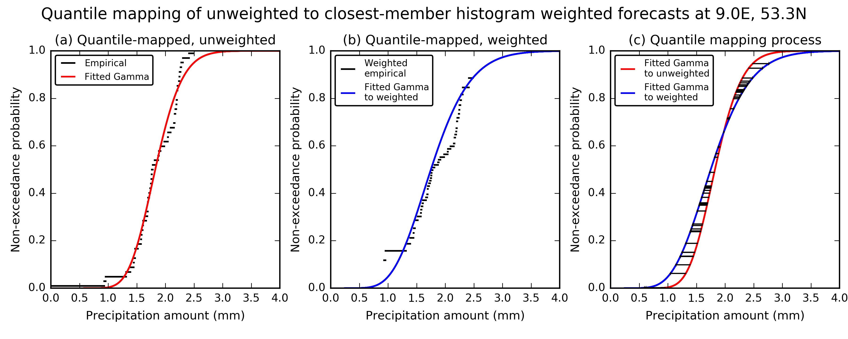
Another quantile mapping, now from the unweighted to weighted ensemble.
A quantile mapping of a quantile mapping (confusing?). We fit Gamma-distributed CDFs to
the unweighted ensemble (left) and weighted ensemble (middle) and use these to further
map the previously quantile-mapped members. Uses Thom estimators from Wilks text.

Slide 14
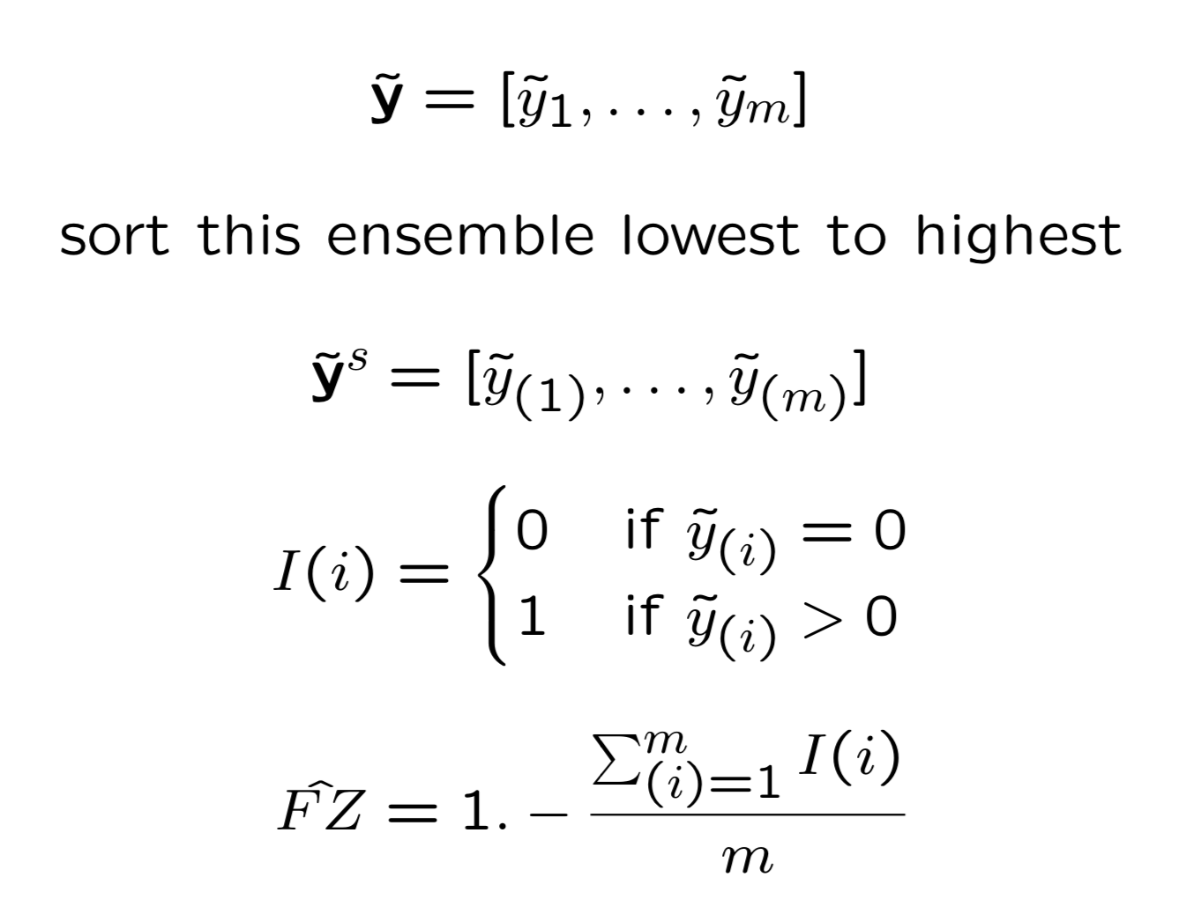
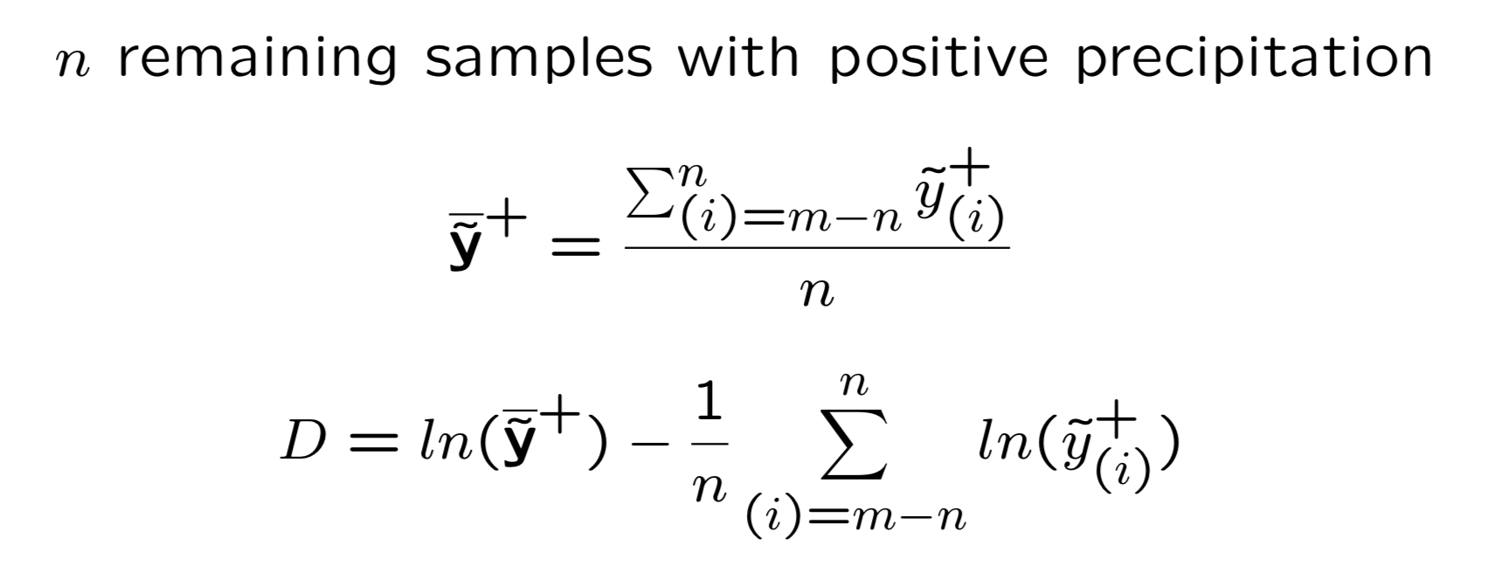
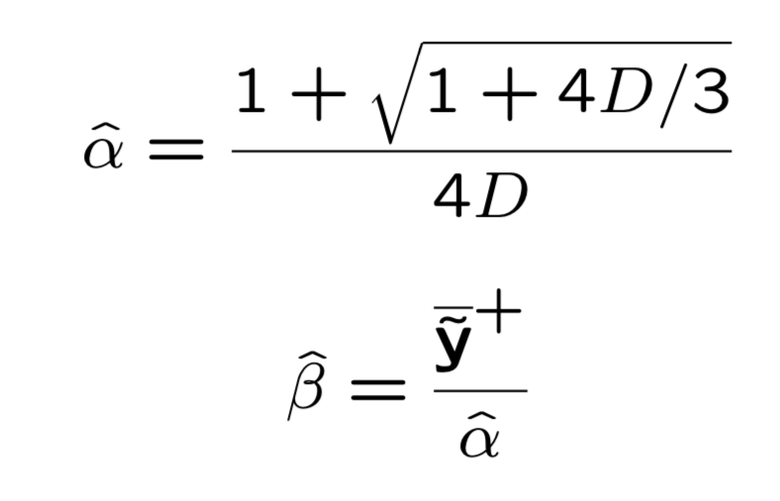
Estimating
parameters
of Gamma
distribution
(unweighted).

Slide 15
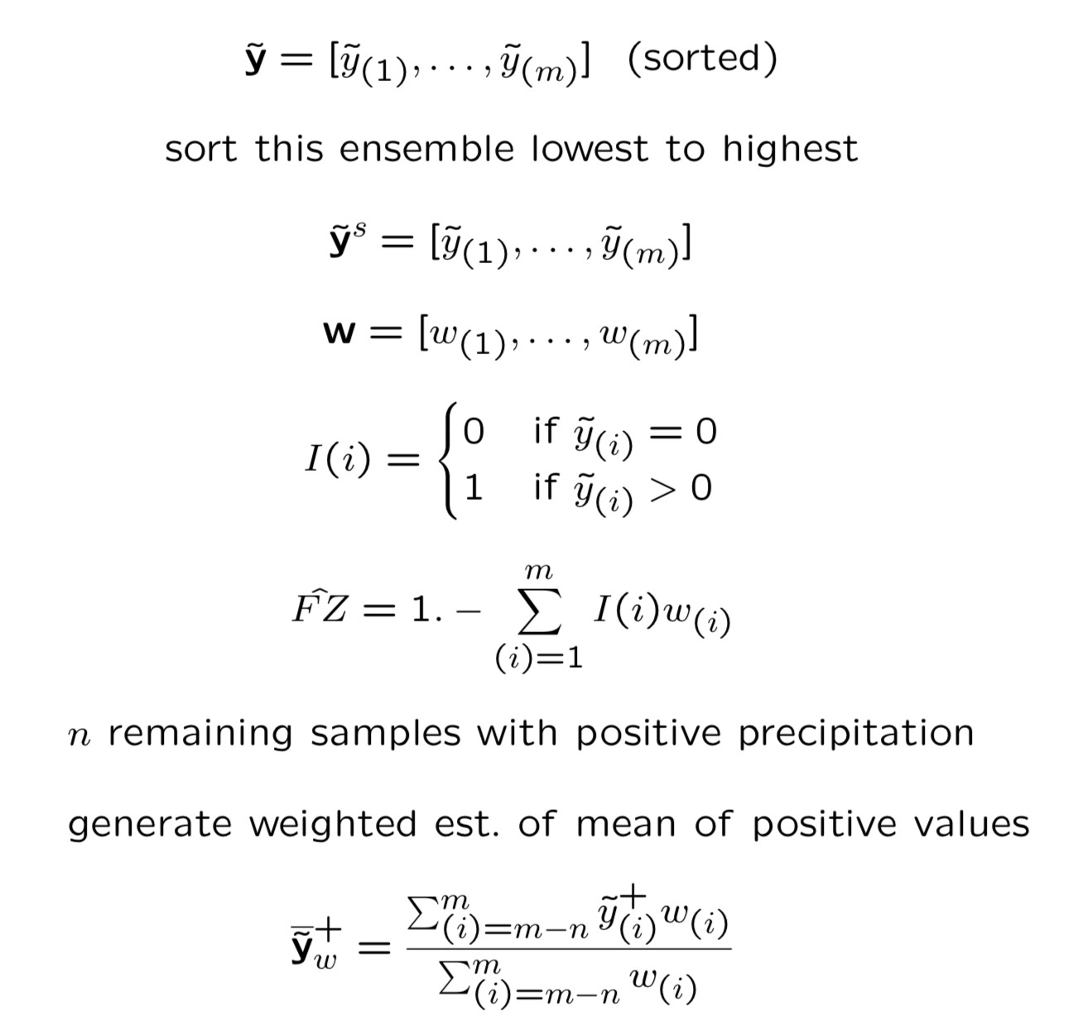
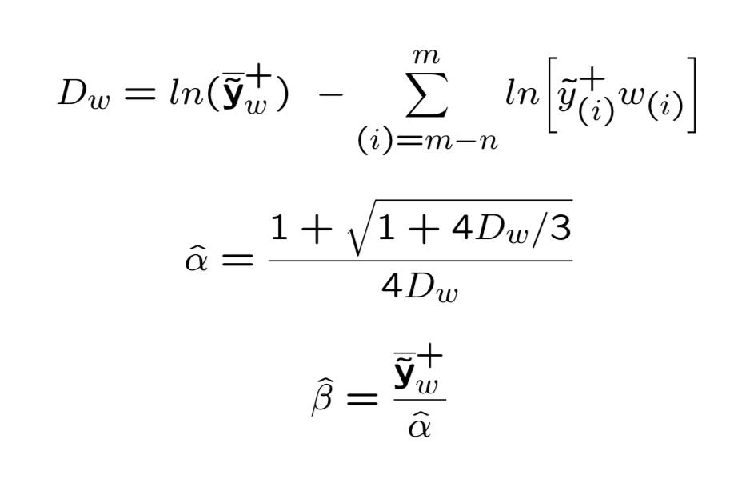
Estimating
parameters
of Gamma
distribution
(weighted).

Slide 16
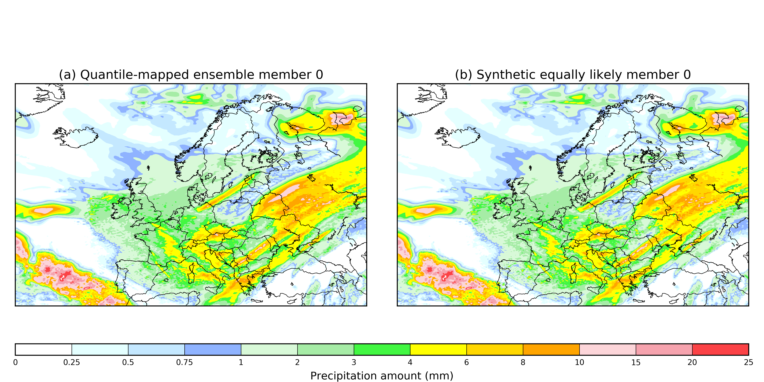
Example of a single member, before vs. after quantile mapping of unweighted to weighted
It is hard to see any difference for one particular member. Let’s look at the ensemble
for one point in the center of the domain.

Slide 17
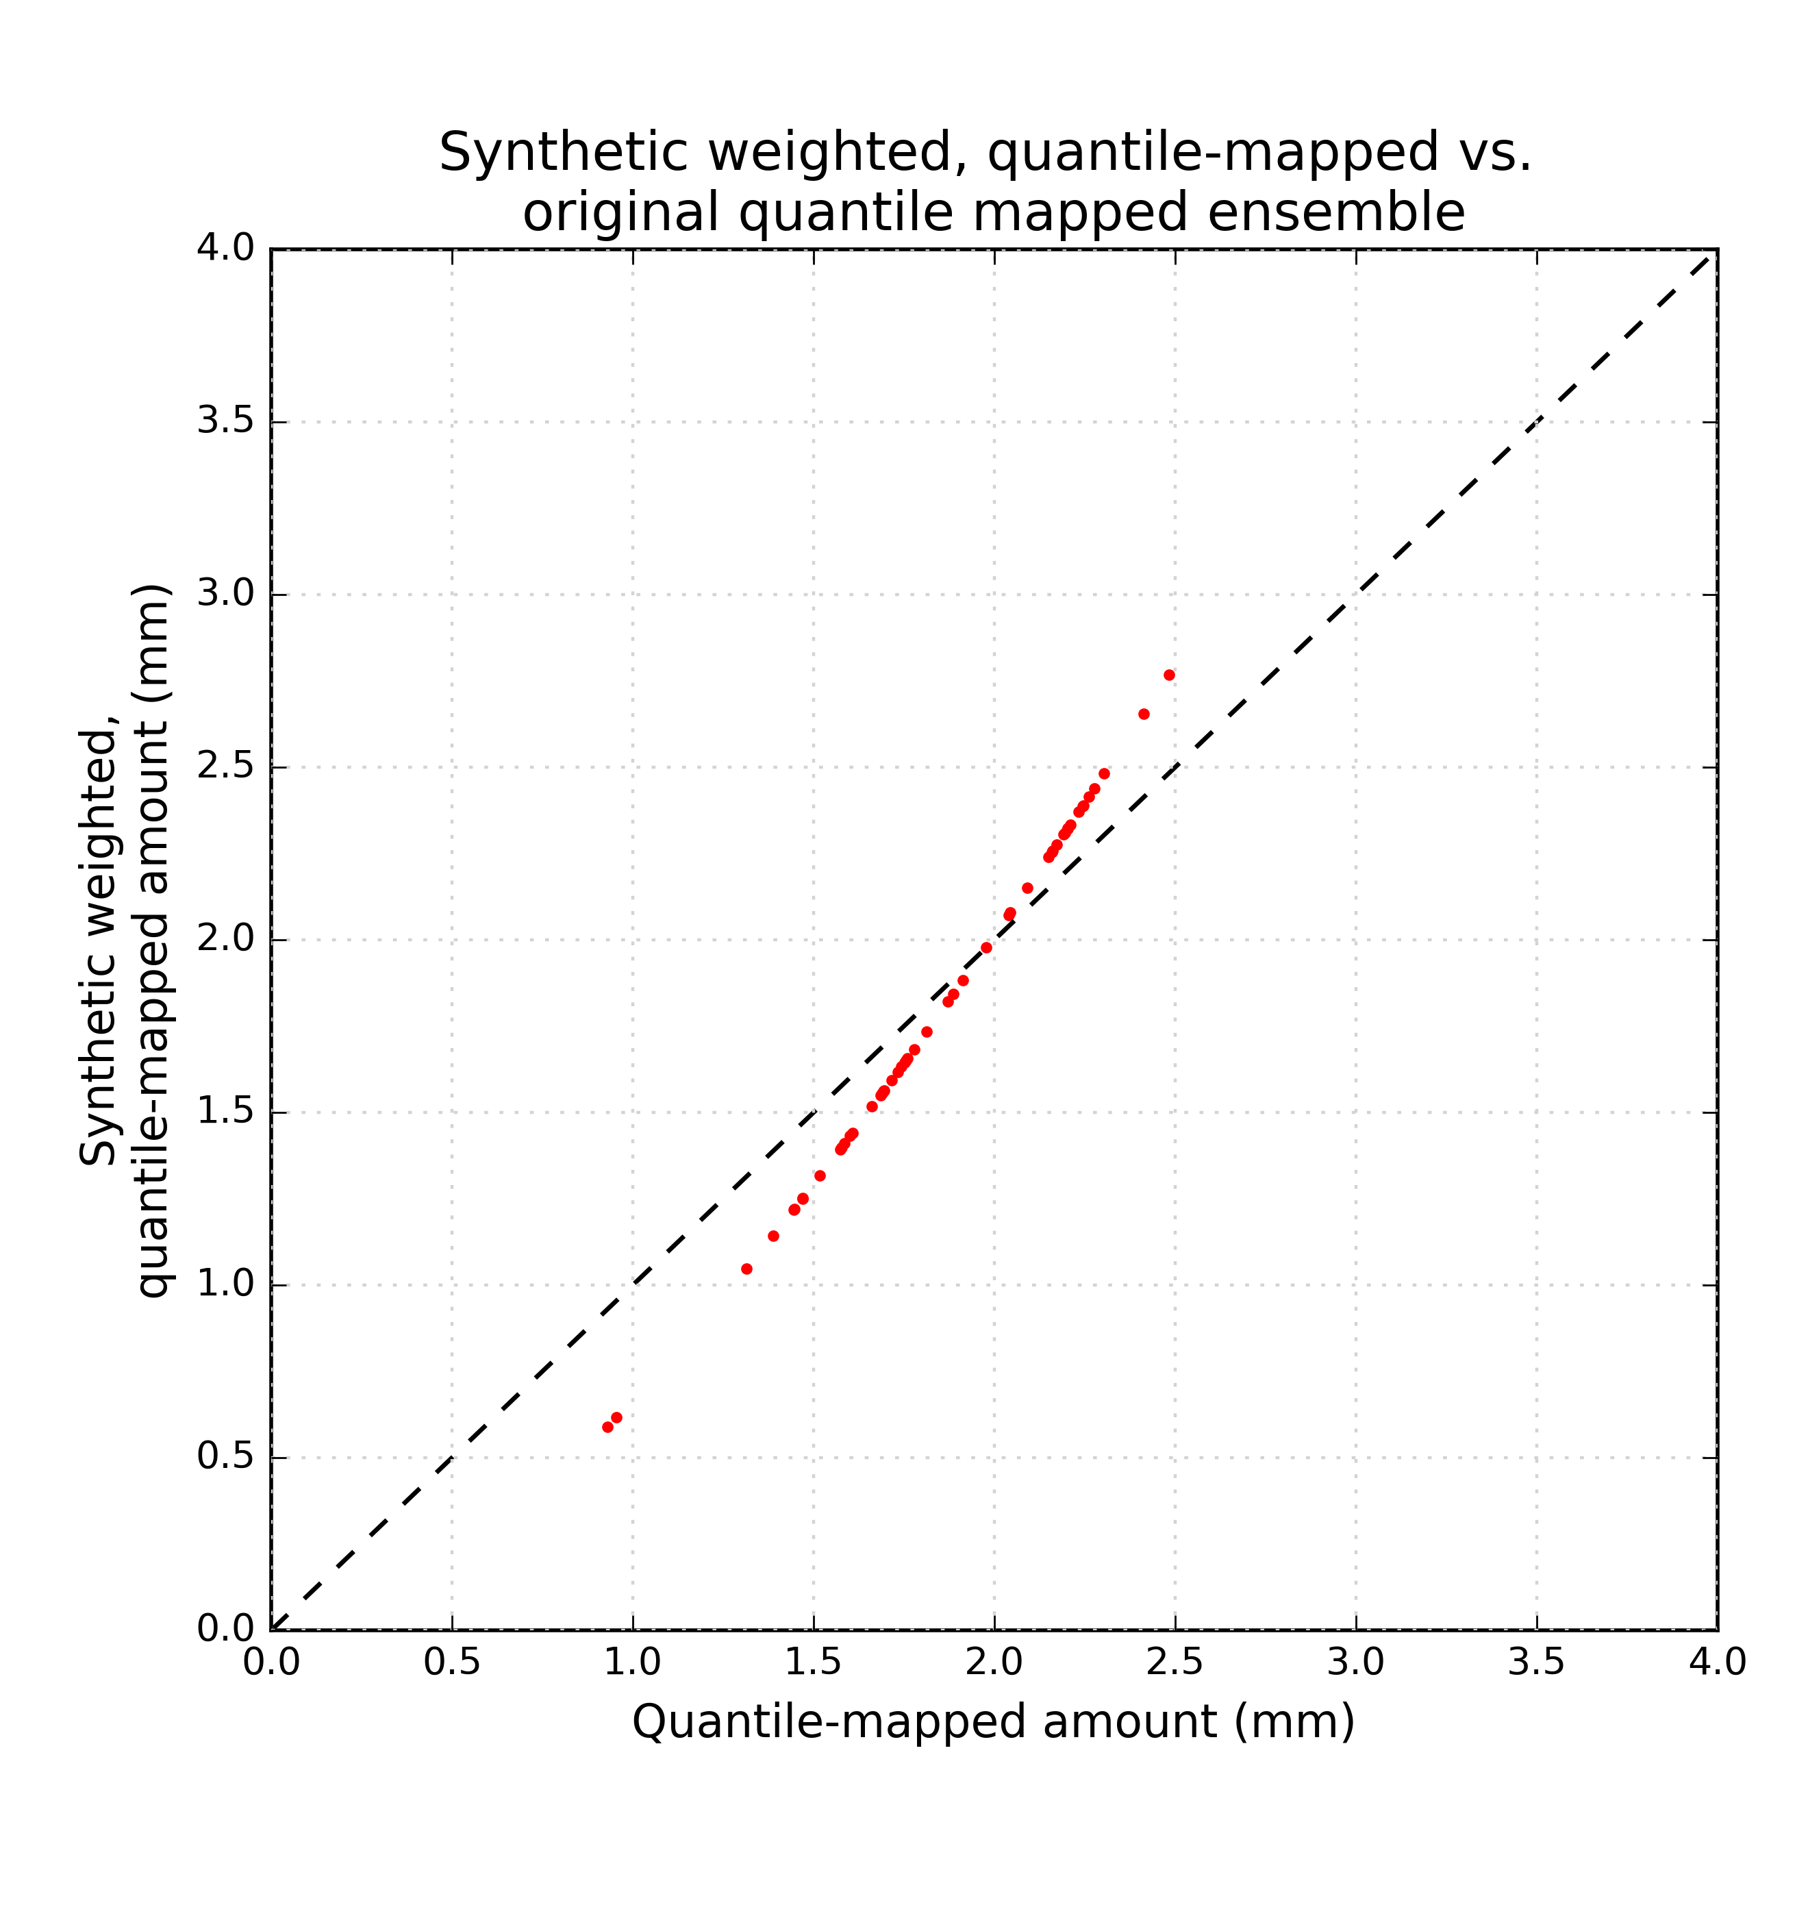
Original vs. weighted for ensemble at center of domain.
Unweighted quantile-mapped ensemble extended from 0.9 to 2.5 mm.
The reconstructed, synthetic ensemble extends between 0.6 and 2.75 mm (increase in spread).
Rank structure preserved.

Slide 18
Example of a single member, before vs. after quantile mapping of unweighted to weighted
What about the rank structure between two grid points, before vs. after weighting?

Slide 19
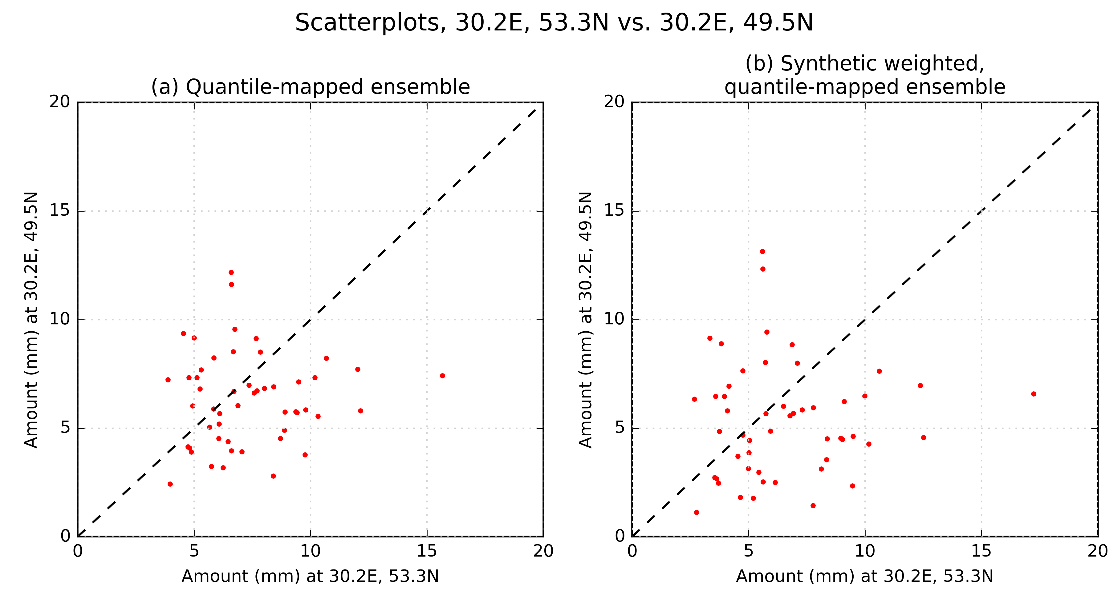
Scatterplots
Rank-order structure preserved with the additional postprocessing step,
i.e, it continues to let the quantile-mapped ensemble set the copula structure.

Slide 20
Conclusions
I think I have some code elements that can be adapted to provide high-quality post-processed precipitation ensembles to drive EFAS.
Any further work you’d like to see me complete before my departure?
  Will try to continue to help from Boulder, but obviously much easier now.

Slide 21
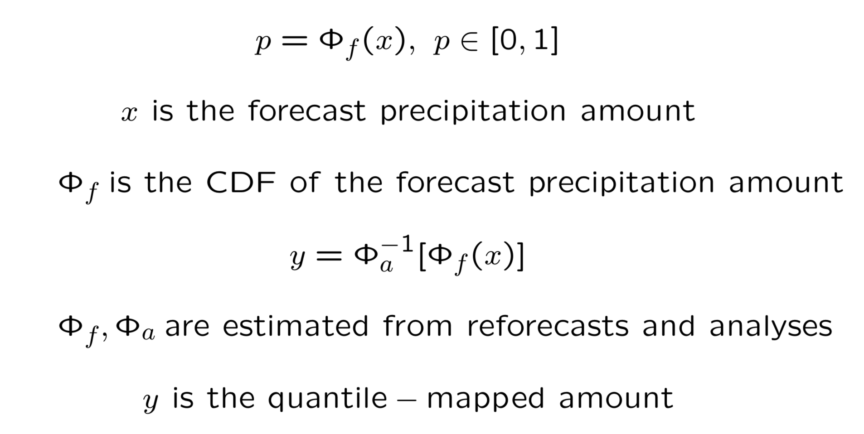
Quantile mapping

