Slide 1
Treating model uncertainty in sub-seasonal ensemble predictions: current practices and future directions
Tom Hamill
NOAA Earth System Research Lab, Physical Sciences Division
Boulder, CO USA
tom.hamill@noaa.gov +1 (303) 497-3060
presentation at “Model dependence and sampling strategies in climate model ensemble prediction” workshop, NCAR, Boulder, December 8-9, 2016

Slide 2
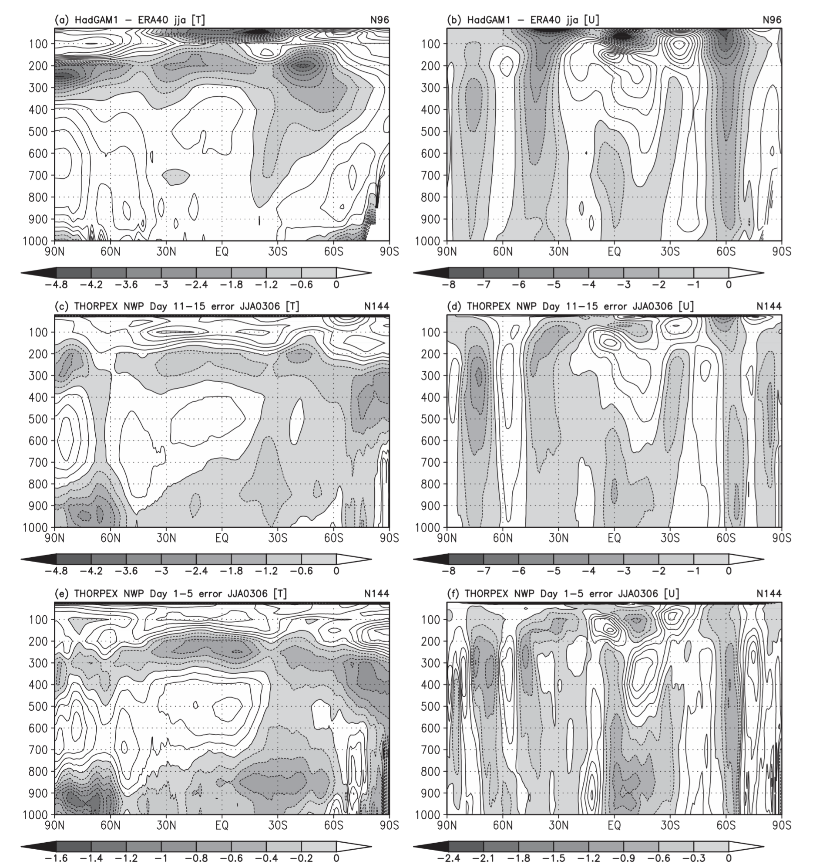
Why bother with examinations of model uncertainty at weather-climate time scales?
Systematic errors that are bugaboos for climate
projections are similar in weather predictions.
Weather prediction can be a test bed for examination of climate projection issues, I believe including issues of simulating the prediction/projection uncertainty.
Martin et al. 2010 J Climate, (WGNE’s Transpose AMIP)
http://journals.ametsoc.org/doi/abs/10.1175/2010JCLI3541.1

Slide 3
Sources of potential predictive information about weather-climate variability.
 | 1 day | 1 week | 1 month | 1 year | 10-100 years
Forecast evolution from atmospheric initial state | very large | moderate | very small | zero | zero
Forecast evolution from land/ocean/ice state | small | small | small | very small | near zero
Anthropogenic forcing | very small | very small | very small | very small | small
As one predicts/projects for longer leads, averaging time periods increase.
Focus of this talk is on prediction issues for lead times to 1 month. This period sees a diminishment of predictive skill due to atmospheric initial condition, leaving only a smaller remnant that is attributable to slower evolution from land/ocean/ice condition perturbations. AGW not a player, but as we shall see, common issues with model uncertainty.

Slide 4
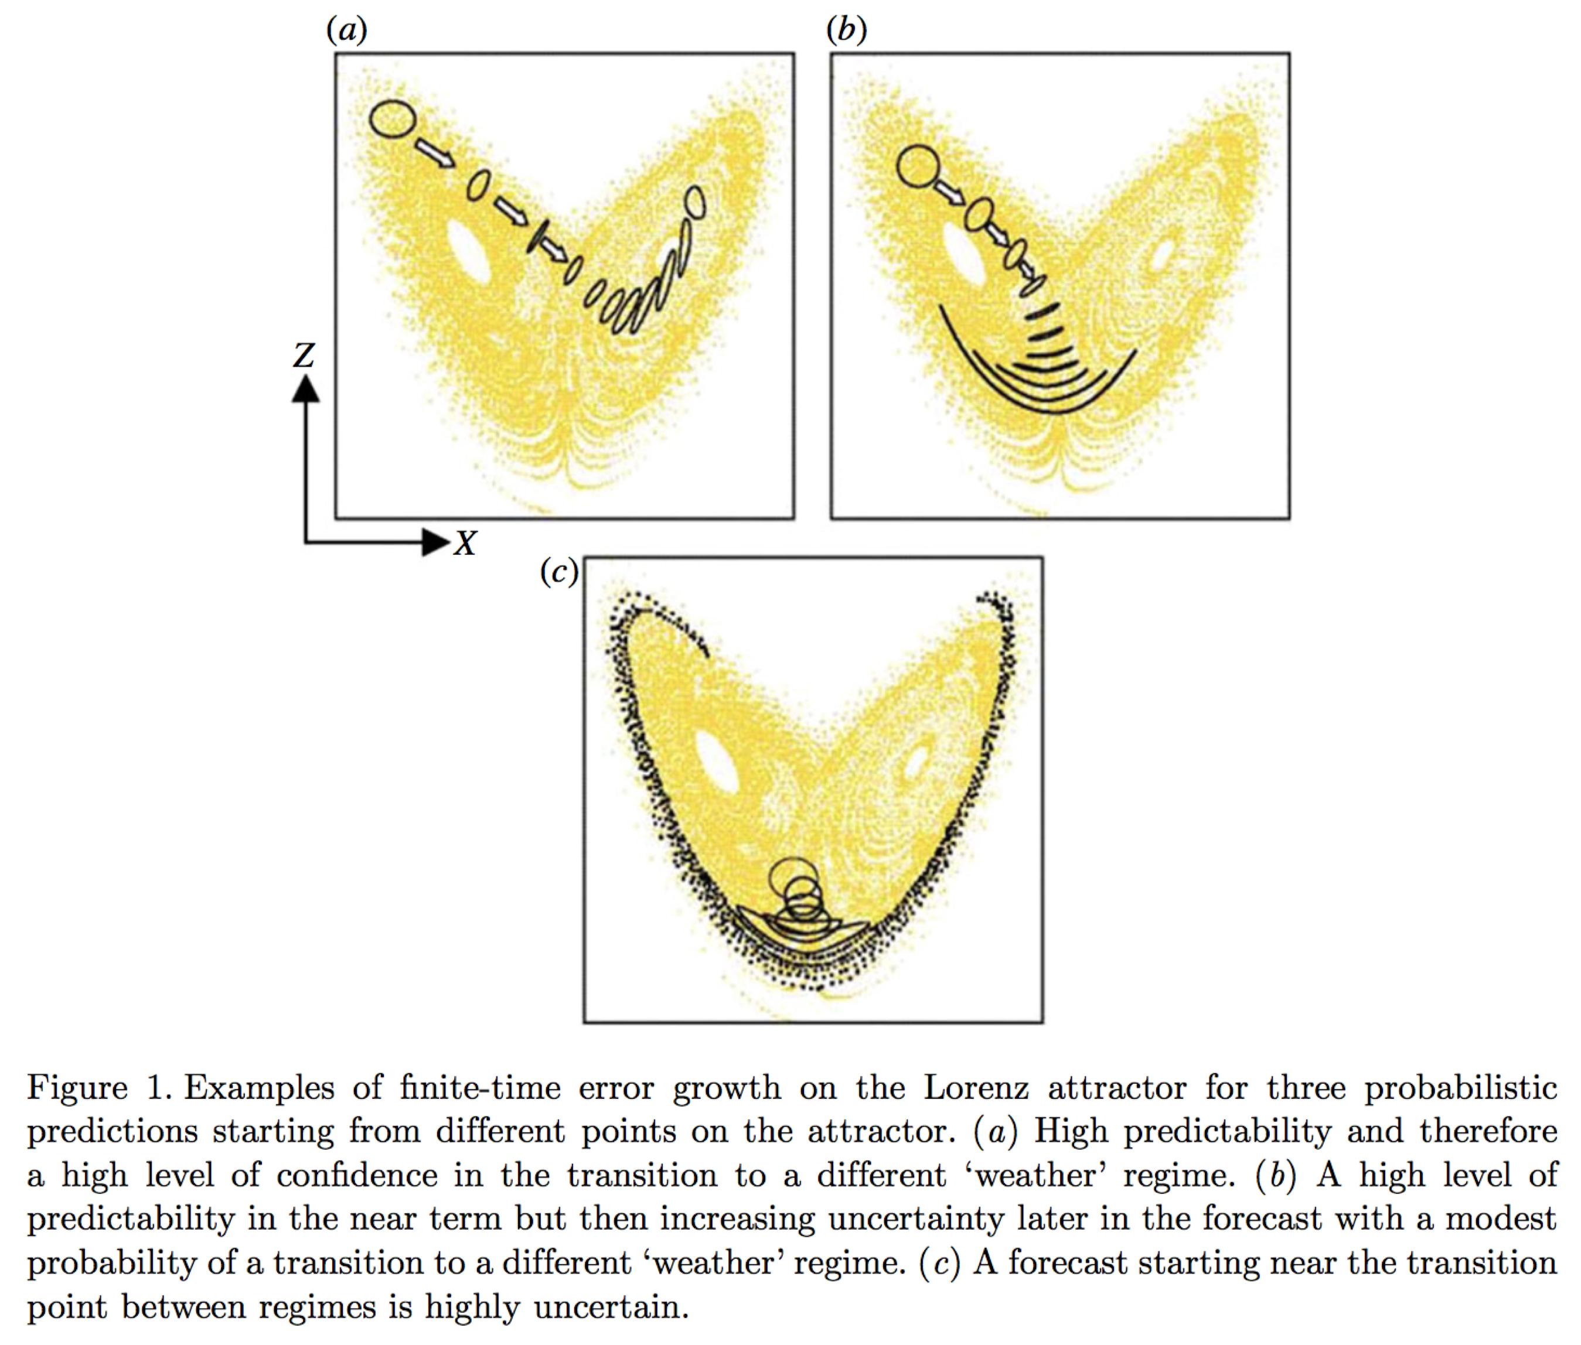
What is objective for weather-climate predictions?
Probabilistic forecasts with maximum forecast “sharpness” but subject to reliability (Gneiting 2007).
Situationally dependent estimates of forecast uncertainty.
This and subsequent 2 figures from Slingo and Palmer 2011, Phil. Trans. Royal. Soc A., 369, 4751-4767

Slide 5
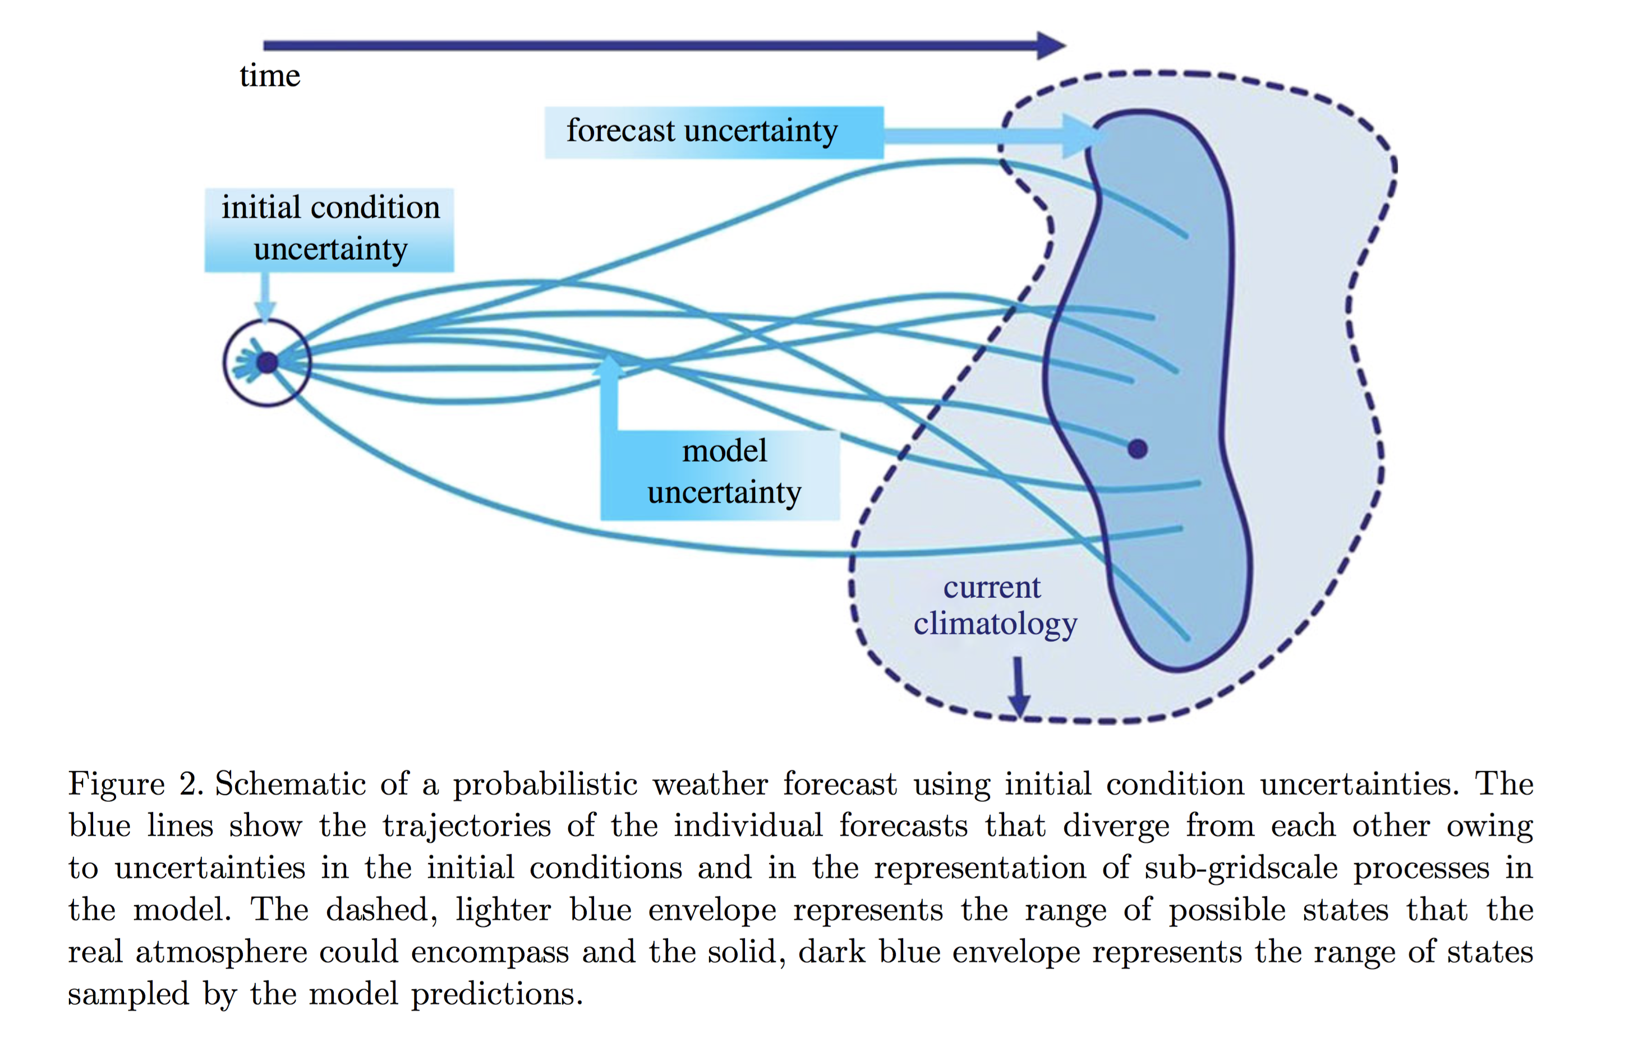
Initial-condition and model uncertainty key for this problem.
Expectation is that with a high-quality
forecast model(s), an accurate estimate
of the range of initial states, and an
accurate quantification of model
uncertainty, we can provide the probabilistic predictions that provide as much specificity as possible while still being reliable.
Much hinges on the treatment of model uncertainty, of course.

Slide 6
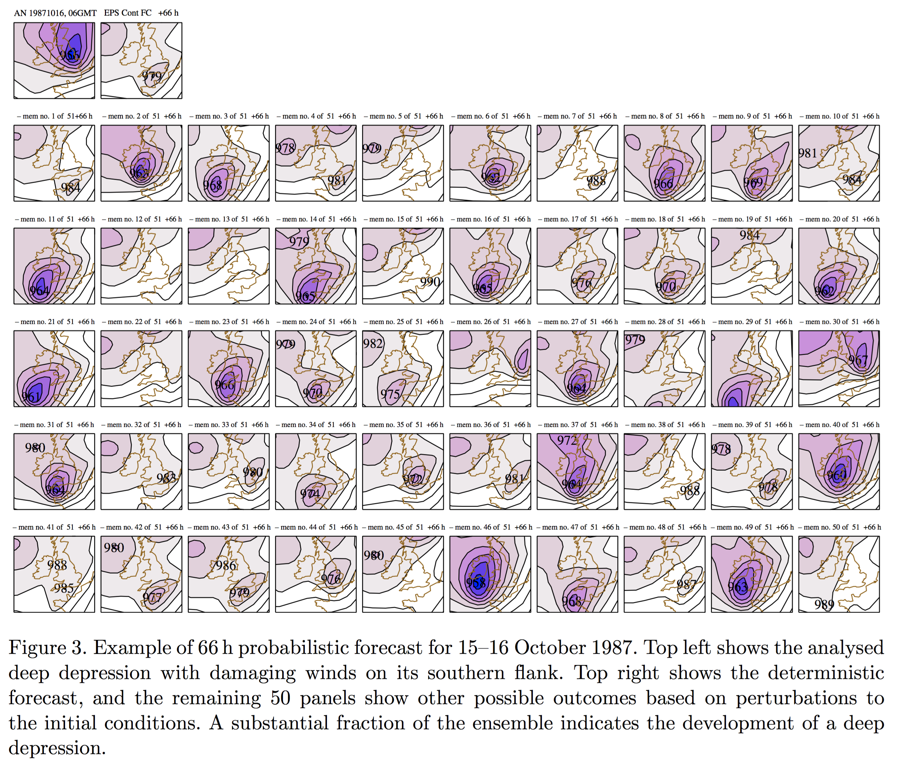
In a few exceptional circumstances, initial-condition uncertainty grows very rapidly, making deterministic forecasts untenable.
Note that though many simulations
forecast a deep low-pressure system, those that do forecast this are commonly mis-forecasting the position, with member 30 being the exception.
Suggestive that model error plays
a role even in these short-lead
forecasts.

Slide 7
Current paths forward for improving probabilistic predictions at sub-seasonal time scales.
Improve the underlying deterministic forecast model(s).
Improve the representation of uncertainty (and coupled state uncertainty) in the ensemble prediction systems.
Let’s consider each of these.

Slide 8
Improving the deterministic forecast model: What work is happening?
Higher-resolution (and effective resolution) forecast models.
Improved numerics.
Hydrostatic → non-hydrostatic dynamics.
Improved coupling of state components.
Improved parameterization.
And so forth.

Slide 9
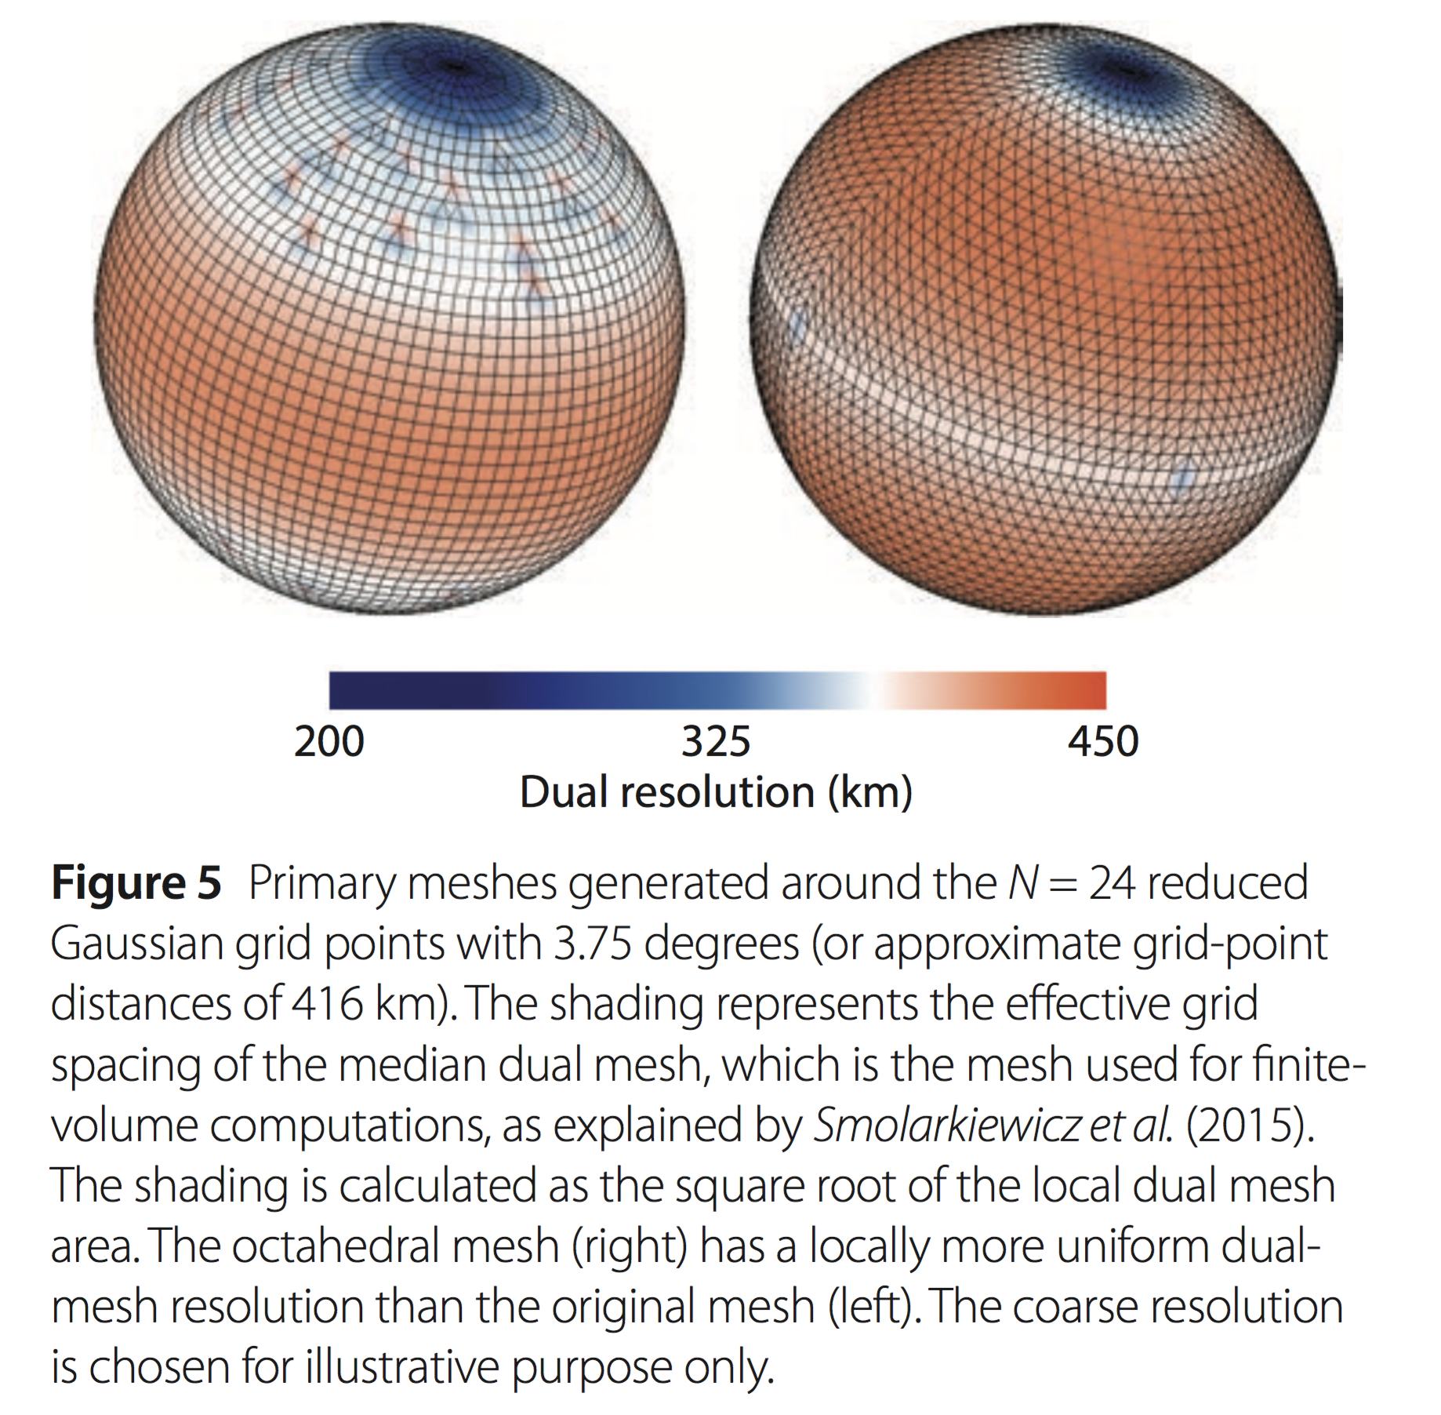
Example: ECMWF’s change in grid structure and order of transforms from spectral to grid.
ECMWF also recently changed the spectral transform from
“linear” to “cubic” grid.
Ref: ECMWF Newsletter 146

Slide 10
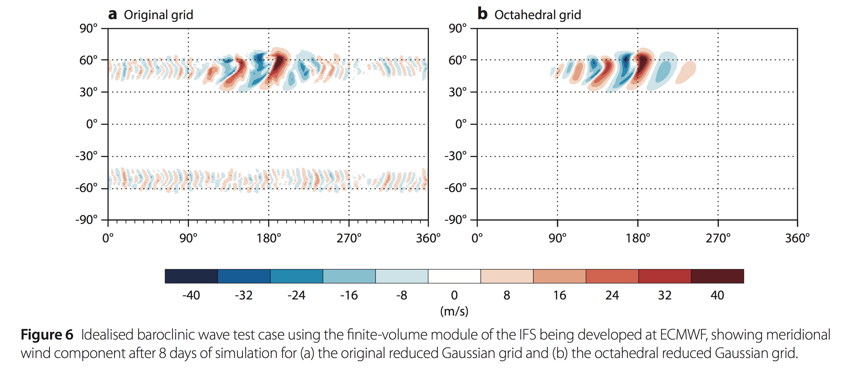
ECMWF’s effects of change of grid and order of transforms.
Ref: ibid.

Slide 11
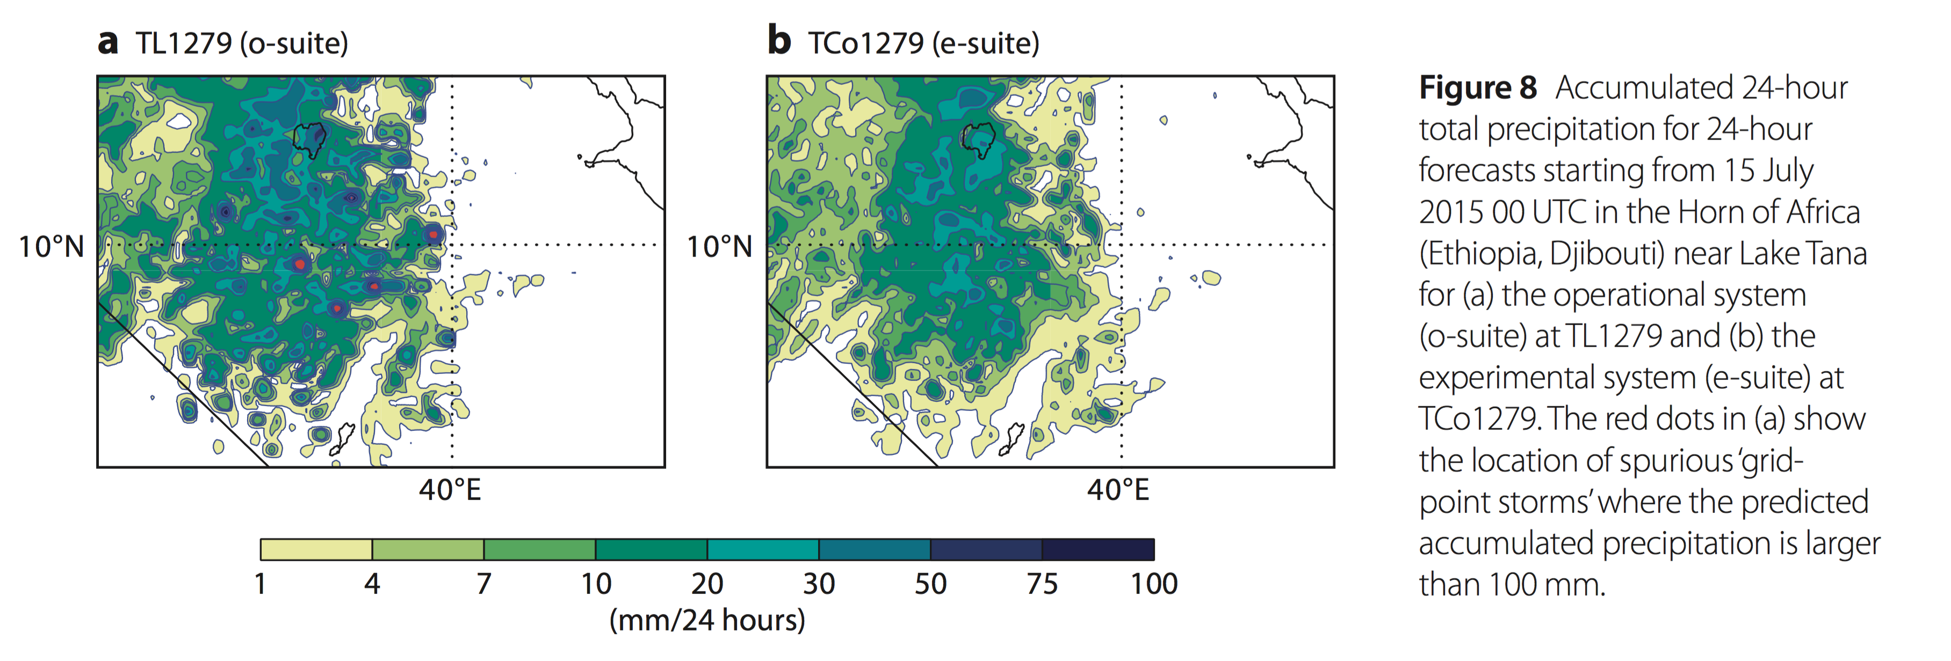
Reduction in spurious numerical “grid-point storms” in the ECMWF system.
Ref: ibid.

Slide 12
What major systematic errors remain?
Lots. A few examples of tough ones for weather-climate below.
Surface temperature biases at leads of hours.
Tropical convective precipitation propagation bias.
ENSO mis-modeling and effects on climate variability.

Slide 13
Model bias can be significant at forecast lead times of 1 hour.
Suppose we have very carefully estimated the thermodynamic
profile of the atmospheric state, and the analyzed temperature
near the ground is 15C (error ~ 1C).
Suppose the ground temperature is not well quantified,
possibly with significant bias, due to lack of observations and significant model error in the land-surface model.
In a very short amount of time, the near-surface atmospheric
temperature equilibrates to be more consistent with the (biased) soil temperature, with its much greater thermal energy storage.
This is a large problem for near-surface predictions at short leads. The answer to such problems is probably better addressed more directly (by improving the LSM) than by designing ways to introduce several K of ensemble spread in the first few hours of the forecast. This isn’t uncertainty, it’s systematic bias, and is better addressed as such.
Time = 0 hour
Time = 1 hour
T=15C
T=18C
T=18C
(ground)
T=18C
(ground)

Slide 14
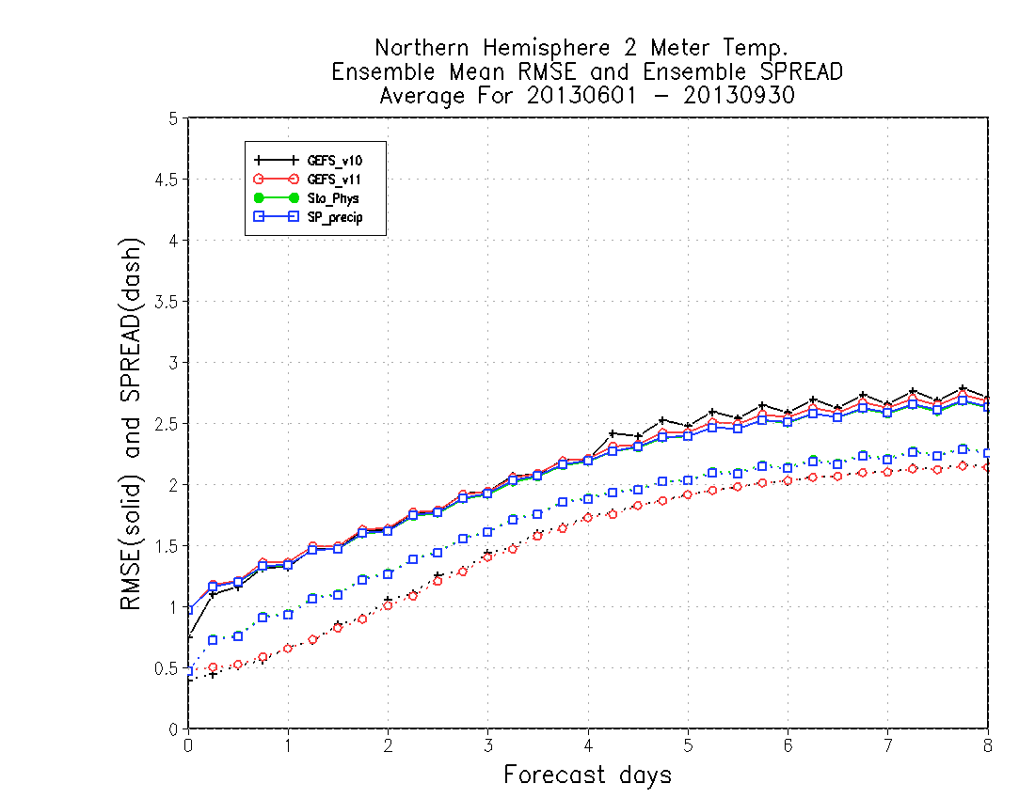
Recent results with 2-meter temperature spread in NCEP Global Ensemble Forecast System
Even with relatively modern
atmospheric stochastic
parameterization package
(blue curve; discussed in greater depth later), 2-meter temperature
spread is much smaller than
RMS error. Consistency of the
two over many samples is necessary but not sufficient for reliability.
c/o Walt Kolczynski, NCEP/EMC

Slide 15
Error in tropical variability estimates with current-generation NWP models.
Analyzed precipitation
GFS forecast precipitation
Kelvin waves well simulated with current National Weather Service global forecast system (GFS). These tropical convective clusters can force extratropical wave trains.
Combinations of several models with poor propagation of Kelvin waves and MJO will not result in high-quality prediction.
c/o Juliana Dias, U. Colorado

Slide 16
Shin and Sardeshmukh (2011): Model error in ENSO → unrealistic seasonal-decadal-centennial variability.
Ref: www.esrl.noaa.gov/psd/people/prashant.d.sardeshmukh/Sardeshmukh_talk_B1.pdf and doi:10.1007/s00382-009-0732-3

Slide 17
Shin and Sardeshmukh, continued.

Slide 18
Improving the representation of uncertainty in weather-climate ensemble prediction systems.
Improved representation of initial-condition uncertainty.
Multi-model ensemble combination.
Multiple physical parameterizations, or perturbed parameters.
First-generation stochastically perturbed physics.
Physically based stochastic parameterizations.
Statistical postprocessing.

Slide 19
Improving the representation of uncertainty in weather-climate ensemble prediction systems.
Improved representation of initial-condition uncertainty.
Multi-model ensemble combination.
Multiple physical parameterizations or perturbed parameters.
First-generation stochastically perturbed physics.
Physically based stochastic parameterizations.
Statistical postprocessing.

Slide 20
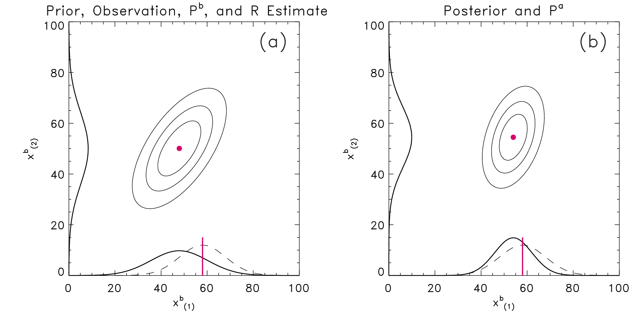
Initial-state uncertainty: more widespread use of ensemble-based data assimilation methods.
EnKF (see reviews here and here) provides a vehicle for estimation of initial-condition uncertainty. Initial state reflects contribution of uncertainty from forecast (solid lines, left panel) and observation (purple vertical line, with associated dashed line representing observation uncertainty). Solid lines in right panel denote distribution of analysis uncertainty.

Slide 21
Increasingly, we realize we need to estimate the soil (and ocean, ice) state carefully as well.
Suppose we have very carefully estimated the thermodynamic
profile of the atmospheric state, and the analyzed temperature
near the ground is 15C (error < 1C).
Suppose the ground temperature is not well quantified,
with significant bias, due to lack of observations and significant
model error in the land-surface model.
In a very short amount of time, the near-surface atmospheric
temperature equilibrates to be more consistent with the soil
temperature, with its much greater thermal energy storage.
This is a large problem for near-surface predictions at short leads.
Time = 0 hour
Time = 1 hour
T=15C
T=18C
T=18C
(ground)
T=18C
(ground)

Slide 22
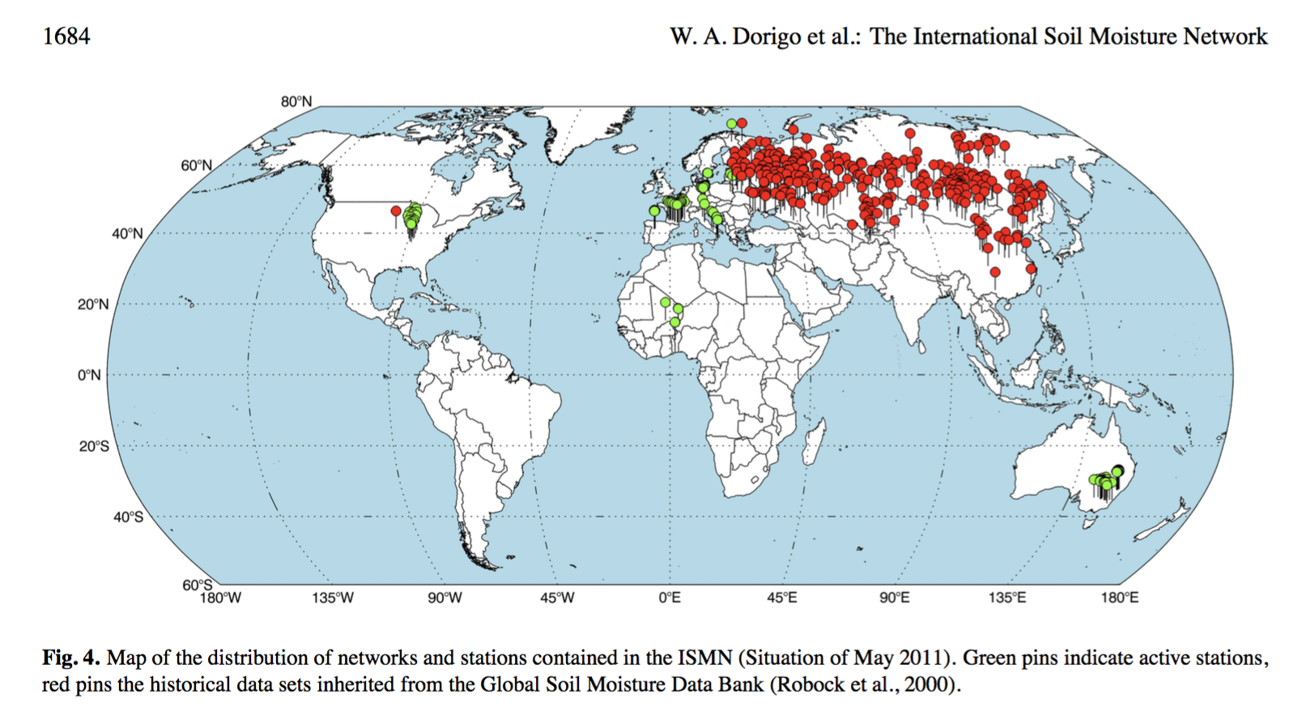
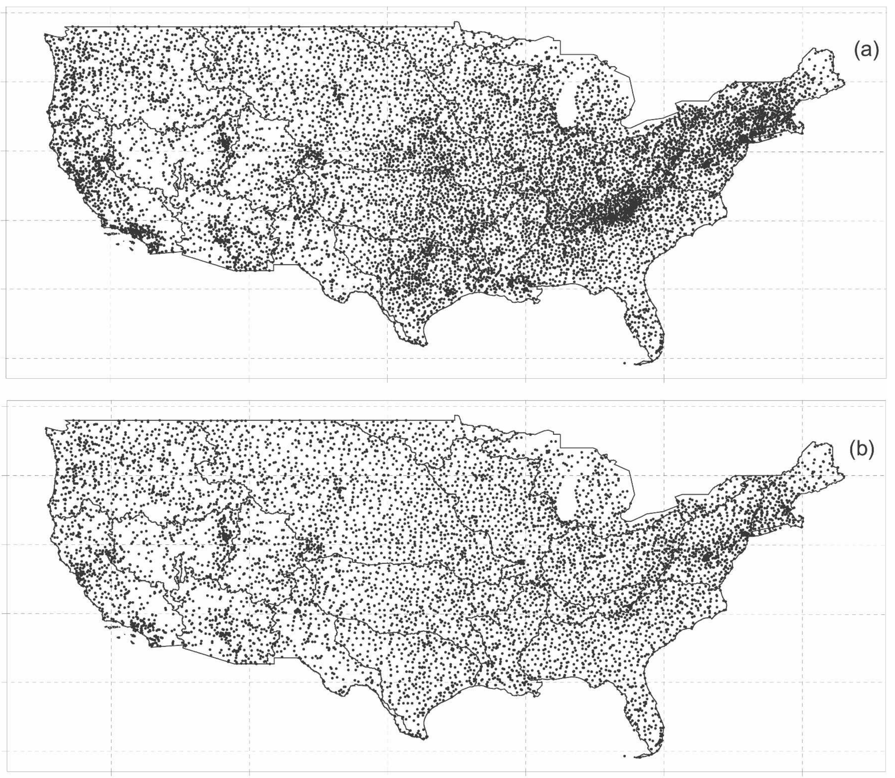
Research frontier is in part coupled ensemble-based data assimilation.
Soil
Precipitation network
With high-quality coupled DA algorithms, the
comparatively rich atmospheric temperature
and precipitation observations can be leveraged
to make increments (adjustments) to the soil
state.
Other DA issues include non-Gaussian errors (moist
processes, dealing with displacement errors, more.)
Surface temperature
ref: DiLuzio et al. 2008, http://prism.oregonstate.edu/documents/pubs/2008jappclim_retrospectiveDaily_diluzio.pdf

Slide 23
Improving the representation of uncertainty in weather-climate ensemble prediction systems.
Improved representation of initial-condition uncertainty.
Multi-model ensemble combination.
Multiple physical parameterizations or perturbed parameters.
First-generation stochastically perturbed physics.
Physically based stochastic parameterizations.
Statistical postprocessing.

Slide 24
Multi-model ensemble combination: the good and the bad for weather-climate.
Good:
Does provide some improvement over single-model systems, though overall skill can be driven by the best model if that is clearly superior.
Convenient; multiple centers already producing data, products can be had for the cost of sharing them.
Bad:
Similar biases across MMEs results in less skill improvement than you might expect, as you realize.
Weather-climate simulations provide a way of demonstrating this for dec-cen climate, btw.
Significant data wrangling, and MME forecasts arrive at different times.
In US, at least, developmental resources have been spread across many prediction systems. Consequently, none individually are anywhere near as good as ECMWF, developed with pooled resources.
Post-processing of single model can achieve many of the gains one can get from MMEs.

Slide 25
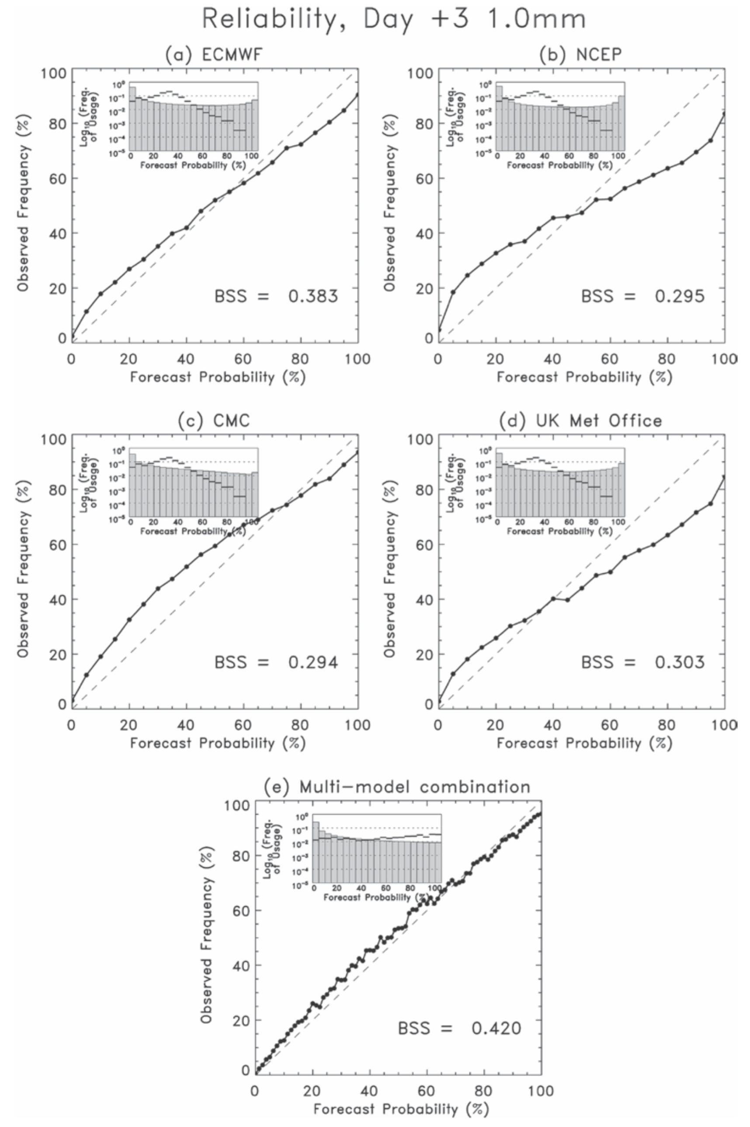
The good in MMEs: improvement over individual systems in some circumstances.
But notice the improvement over the ECMWF system alone is
somewhat modest.
Ref: Swinbank et al. 2016, BAMS, http://journals.ametsoc.org/doi/abs/10.1175/BAMS-D-13-00191.1

Slide 26
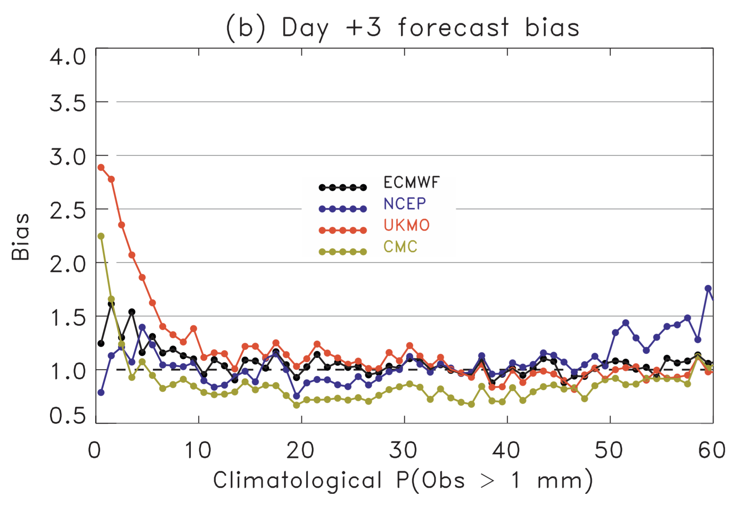
The bad (example): over-forecasting of light precipitation common across prediction systems.
In this figure I’ve taken grid points from
across the CONUS, with a wide variety of
climatological probabilities of precipitation
> 1 mm. The forecast models tend to
over-forecast the probability of this light
precipitation in the climatologically drier regions.
Note: models have changed since, e.g., UKMO
doesn’t over-forecast as much as it used to.
Ref: Hamill 2012 MWR, http://onlinelibrary.wiley.com/doi/10.1002/qj.1895/pdf

Slide 27
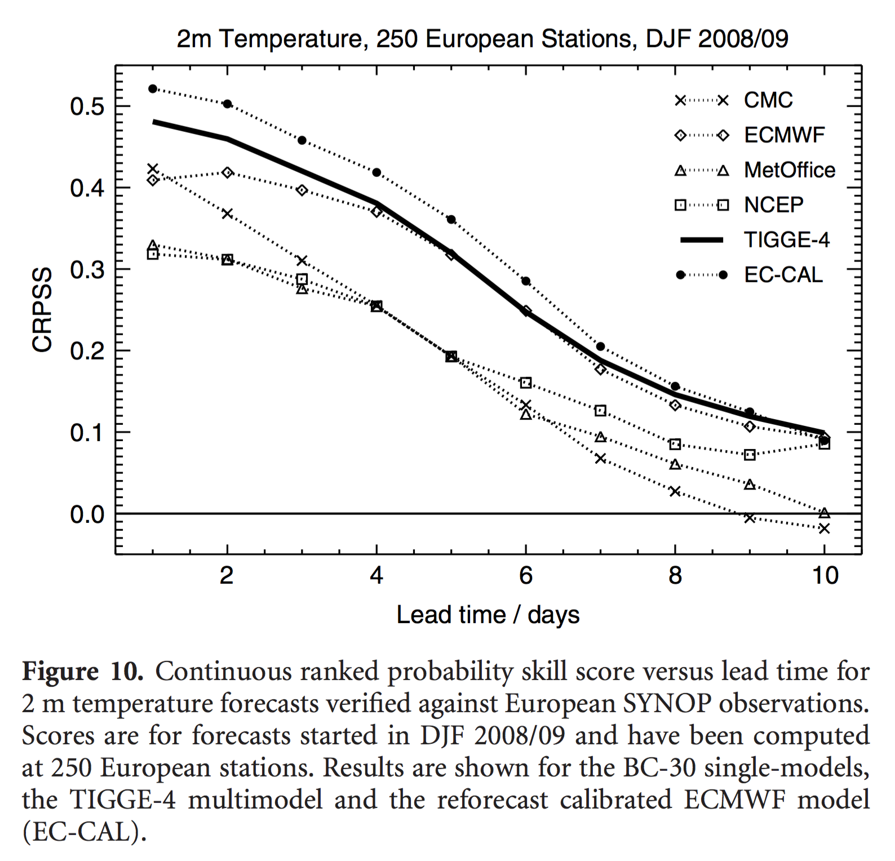
High-quality ensemble prediction system + postprocessing can be hard for MME to beat.
More on statistical post-processing later.
Ref: Hagedorn, R., Buizza, R., Hamill, T. M., Leutbecher, M., and T. N. Palmer, 2012: Comparing TIGGE multi-model forecasts with reforecast-calibrated ECMWF ensemble forecasts. Quart J. Royal Meteor Soc., 138, 1814-1827.

Slide 28
Evolving NOAA philosophy regarding MMEs for weather-climate timescales.
There is still tension between MME advocates and skeptics.
Emerging policy in NOAA:
Use them if they are available, especially those from trusted international partners willing to share, and who produce data on time reliably.
However, don’t disperse NOAA funding to develop a wide variety of ensemble prediction systems; instead concentrate that funding to develop one especially high-quality, ensemble system (following ECMWF, UK Met Office best practice).
In the future, offer this model up as community resource so tech transitions to operations easier.

Slide 29
Improving the representation of uncertainty in weather-climate ensemble prediction systems.
Improved representation of initial-condition uncertainty.
Multi-model ensemble combination.
Multiple physical parameterizations or perturbed parameters.
First-generation stochastically perturbed physics.
Physically based stochastic parameterizations.
Statistical postprocessing.

Slide 30
Multiple physical parameterizations or perturbed parameters: a few thoughts.
Many experiments showing some benefit to this approach.
Canadian global medium-range ensemble uses this, and this system has large spread relative to international competitors.
Multi-parameterization means that a wider set of parameterization software must be maintained.
Suppose two convective parameterizations are in the ensemble system currently. One is improved significantly. Do we keep the unimproved one for ensemble diversity?

Slide 31
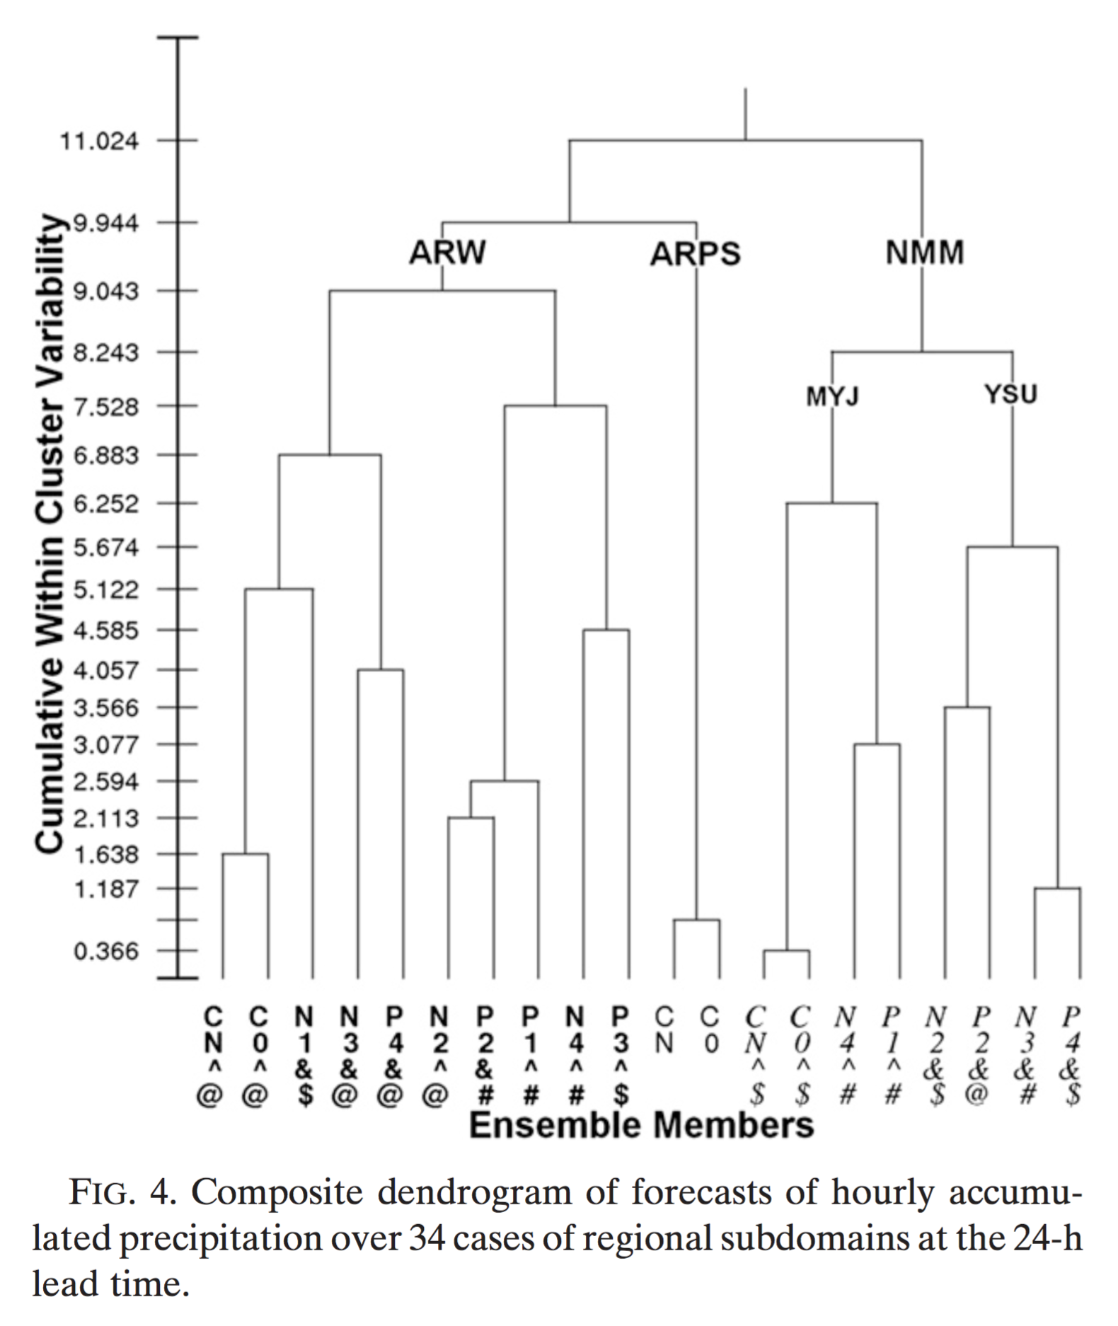
Clustering of multi-model, multi-parameterization ensembles.
A great amount of the variability in the MME is explained by
different dycores, and also by different choices of parameterization.
Glass half full: stimulates variability!
Glass half empty: reflective of differing systematic errors rather than quantifying natural variability.
Ref: Johnson et al, MWR, 2011: http://journals.ametsoc.org/doi/abs/10.1175/MWR-D-11-00016.1

Slide 32
First-generation stochastic parameterizations.
SPPT (Stochastically perturbed physical tendencies; ECMWF). References here, here. Separate the tendency into dynamics + physics. Perturb physics tendency with spatially, temporally correlated random noise.
SKEB (Stochastic kinetic-energy backscatter; ECMWF, UK Met Office). Hyperdiffusion in numerical models is a sink of energy, and in ensemble systems works against the upscale energy cascade that seeds error growth. “Backscatter” this energy to the resolved scales once again.
SHUM (Stochastically perturbed boundary-layer RH, NOAA): boundary-layer humidity tendencies perturbed with spatially, temporally correlated random noise. Intended to stimulate convective variability.

Slide 33
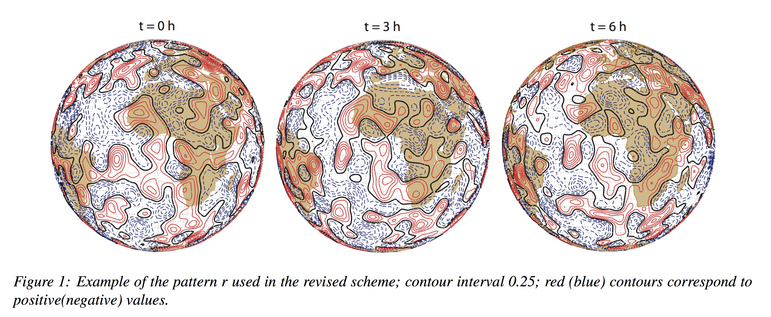
ECMWF’s SPPT: spatially, temporally correlated noise patterns.
Hypothesis: deterministic formulation of parameterizations are inappropriate, do not represent structural errors, fixed
parameters, sub-grid variability.
dx/dt = (1 +ru) * total parameterized tendency + deterministic tendency; u∈ [0,1]; u lower near surface for example.
Ref: Palmer et al. 2009, ECMWF Tech Memo 69

Slide 34
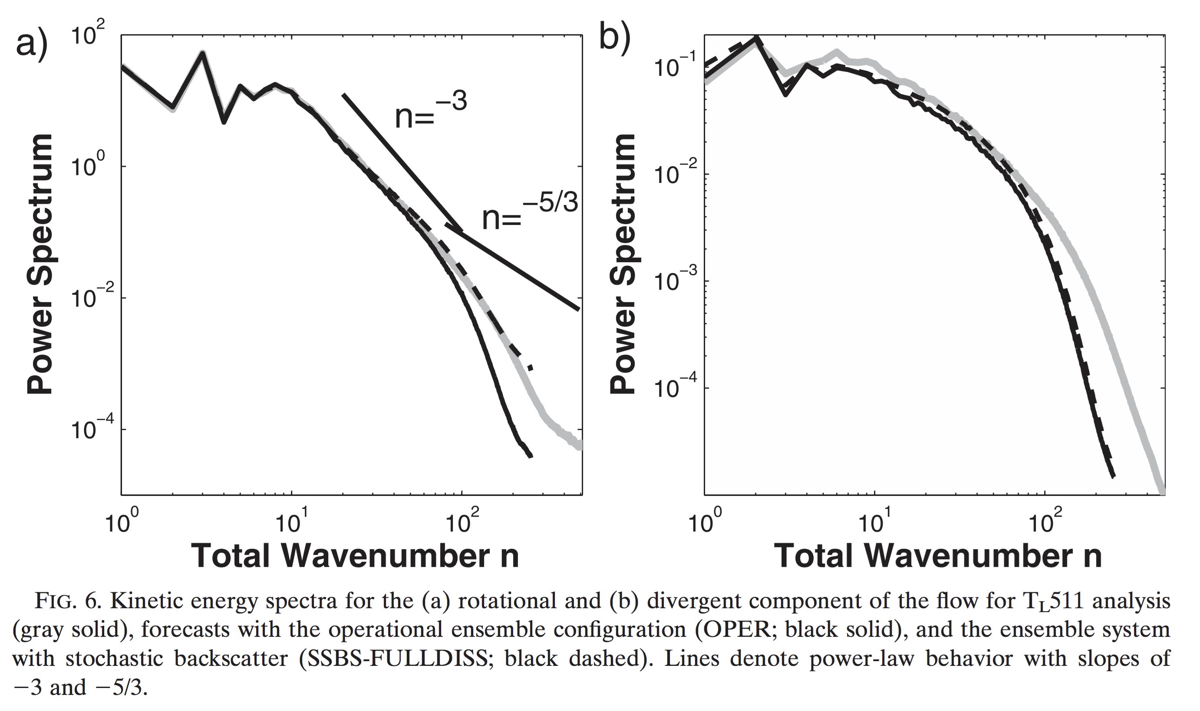
ECMWF and UK Met Office Stochastic Kinetic-Energy Backscatter.
Kinetic-energy spectrum generally
follows k-5/3 at mesoscale and below.
Analyses (gray) have more power
at small scale than forecasts (black),
but to minimize error damp out
some of the small-scale variability.
With SKEB, forecast kinetic-energy
spectra for rotational component
at least more closely resembles
analysis spectrum.
Ongoing work on this to add physical realism, e.g., here.
Ref: Berner et al. 2009 JAS and references therein; http://journals.ametsoc.org/doi/abs/10.1175/2008JAS2677.1

Slide 35
Stochastically perturbed boundary-layer RH (NOAA/ESRL/PSD)
dq/dt = (1+r)*model tendency
r is a very small number with spatially correlated random noise generated with ECMWF’s SPPT pattern generator.
r decays to zero quickly above surface.
reflects ongoing work by Jeff Whitaker, Phil Pegion, ESRL/PSD

Slide 36
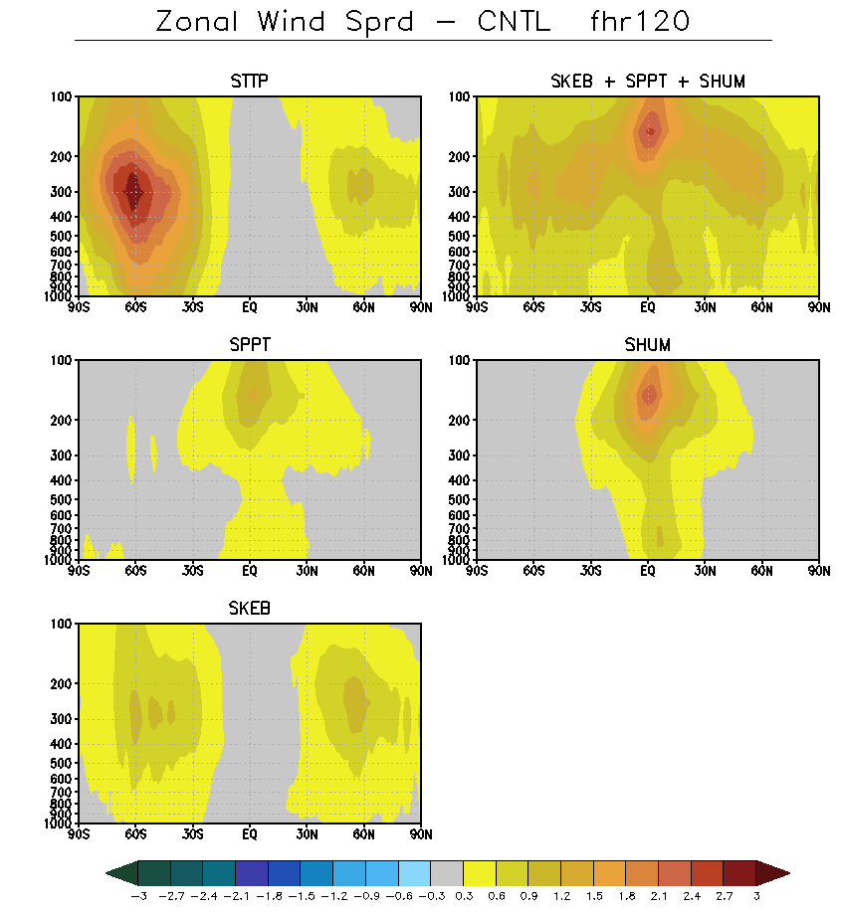
Cumulative effects of SPPT, SKEB, and SHUM.
Current NCEP procedure in GEFS
Current NCEP procedure used linear combinations
of differences in tendencies between members
to stimulate variability. It tends to add tendency
spread where it’s already large, in storm tracks.
SPPT, SKEB, and SHUM have different characters
and together increase spread over most of the globe.
This combination will go into NCEP operations
in a few years, after change of dycore to GFDL FV3.
ms-1

Slide 37
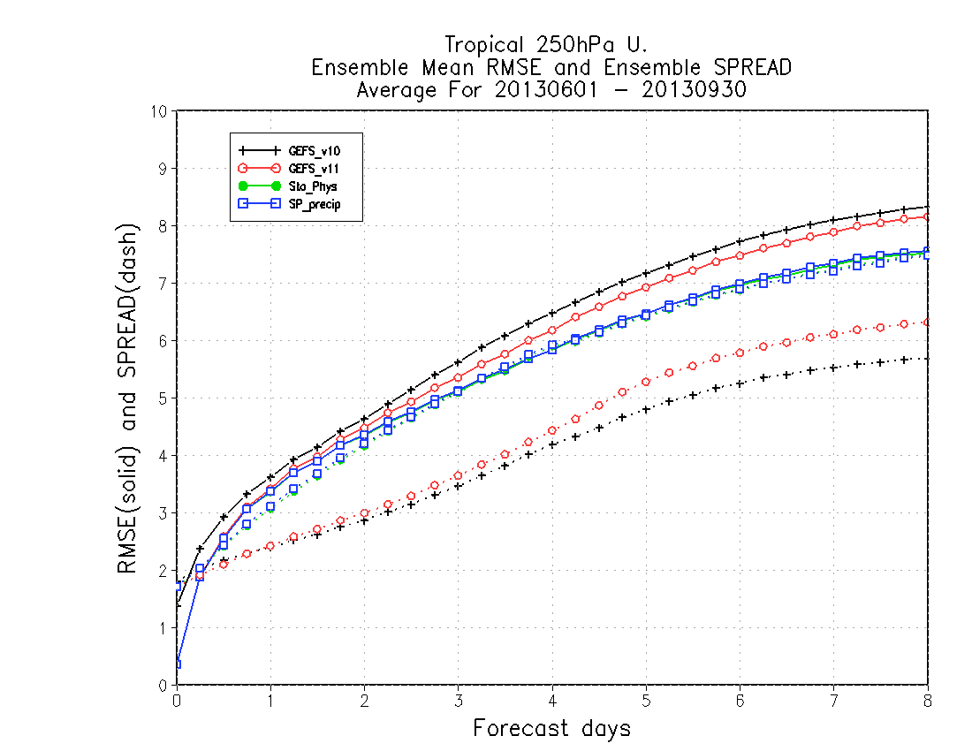
Spread vs. error relationships, tropical 200 hPa U.
Solid: RMSE; dashed: spread
Tropical tropopause winds were
dramatically improved, lowering
RMSE and increasing spread.
circa 2012 model
early 2016 model
stochastic physics suite
including closure of precipitation budget
c/o Walt Kolczynski (NCEP/EMC)

Slide 38
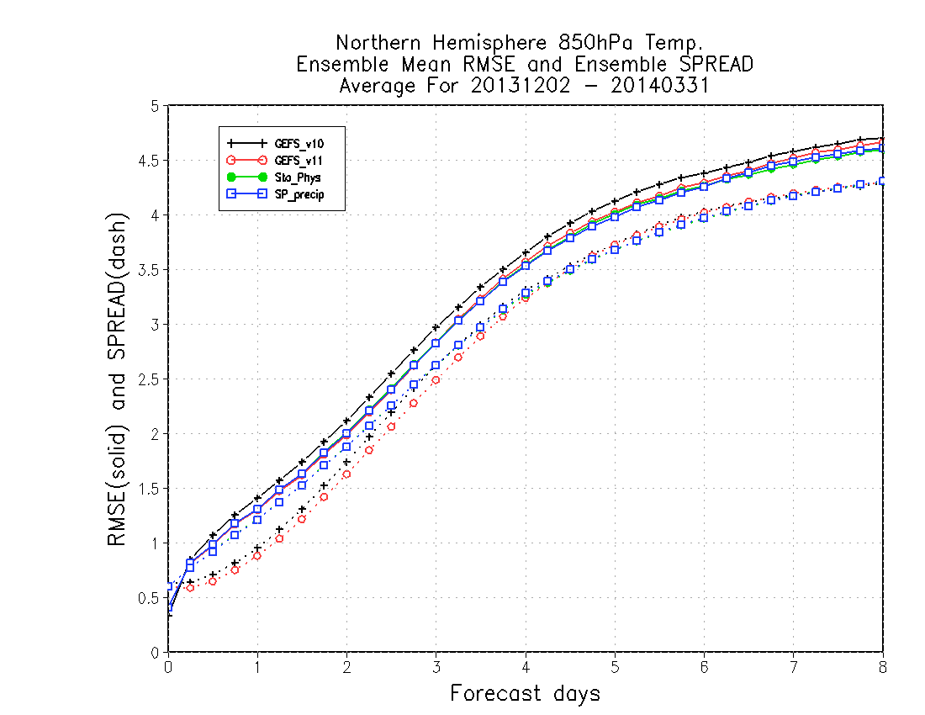
Spread vs. error relationships, N. Hem. 850 hPa T
Some remaining inconsistency
(spread deficiency).
circa 2012 model
early 2016 model
stochastic physics suite
including closure of
precipitation budget
Summer: http://www.emc.ncep.noaa.gov/gmb/Walter.Kolczynski/SP_precip_s13/ Winter: http://www.emc.ncep.noaa.gov/gmb/Walter.Kolczynski/SP_precip_w14/

Slide 39
Weisheimer results

Slide 40
Physically based stochastic parameterization.
A developing field. Stay tuned.

Slide 41
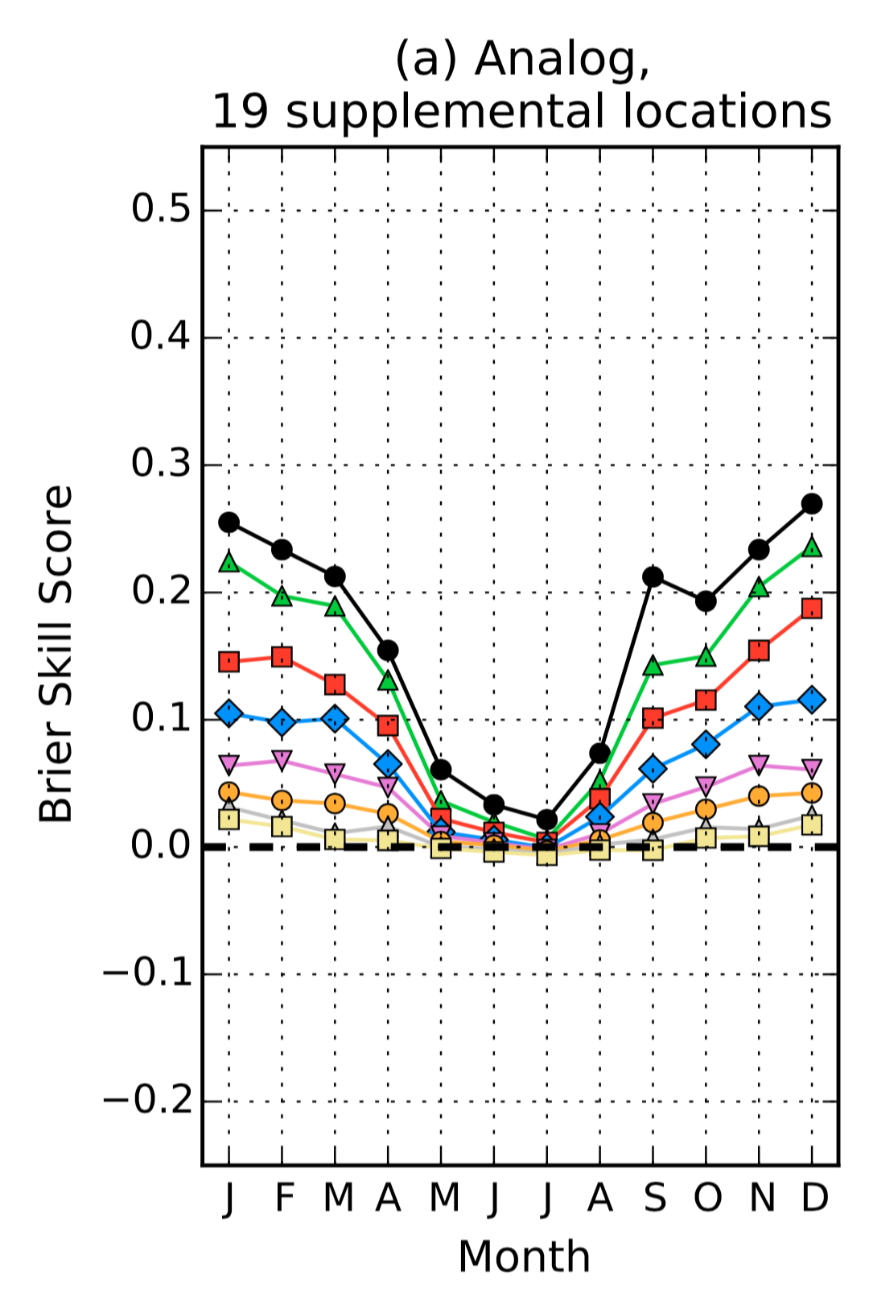
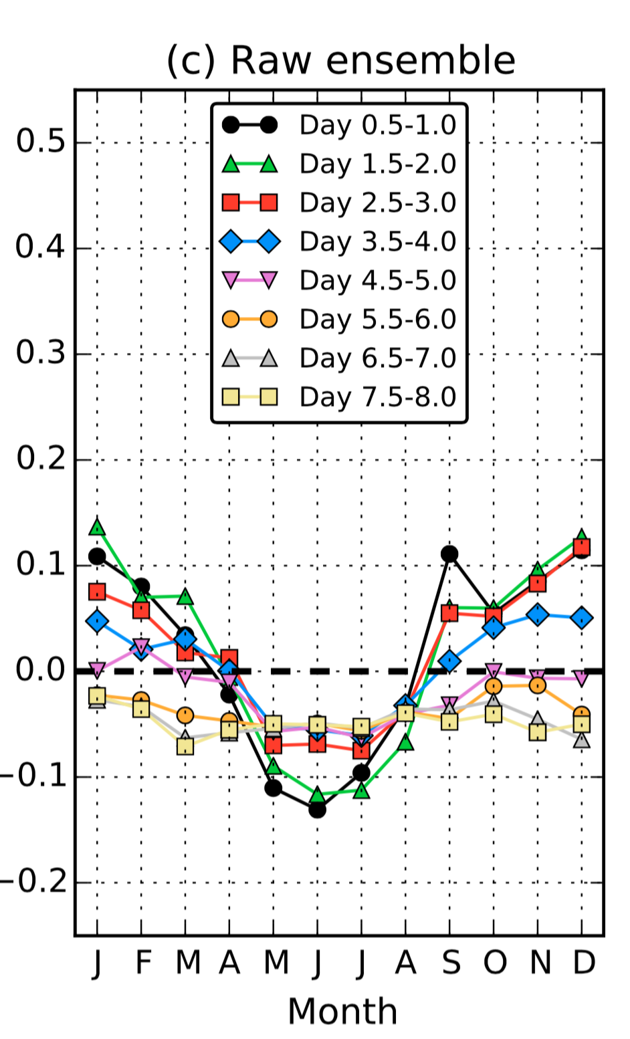
Statistical postprocessing.
Lots of work on this with weather prediction.
Direct application to climate projections? Not so confident.
Stationarity of model errors from 20 th century (train) to 21st (project).
Many errors (like ENSO) produce complicated spatial patterns of bias.
Ref: Hamill et al 2015 MWR, here.

Slide 42
Conclusions
Issues related to multi-model usage are have commonalities across time scales of hours to centuries.
Some of the alternatives to MMEs developed for weather-climate might be worth considering with decadal-centennial projections.
Weather-climate is heading toward physically based stochastic parameterization (i.e., getting right answer for right reason, addressing model uncertainty at process level).

