Slide 1

Improving statistical postprocessing at Meteo France: 2016 workshop recommendations and insights from recent research.
Tom Hamill
NOAA Earth System Research Lab, Physical Sciences Division (Boulder Colorado USA)
tom.hamill@noaa.gov +1 (303) 497-3060
With thanks to ~90 other participants from universities, foreign weather services, and private companies.

Slide 2

Workshop on statistical post-processing, held in College Park MD, USA, Jan 2016.
> 90 participants from NOAA, labs, universities, other met services, and corporations.

Slide 3
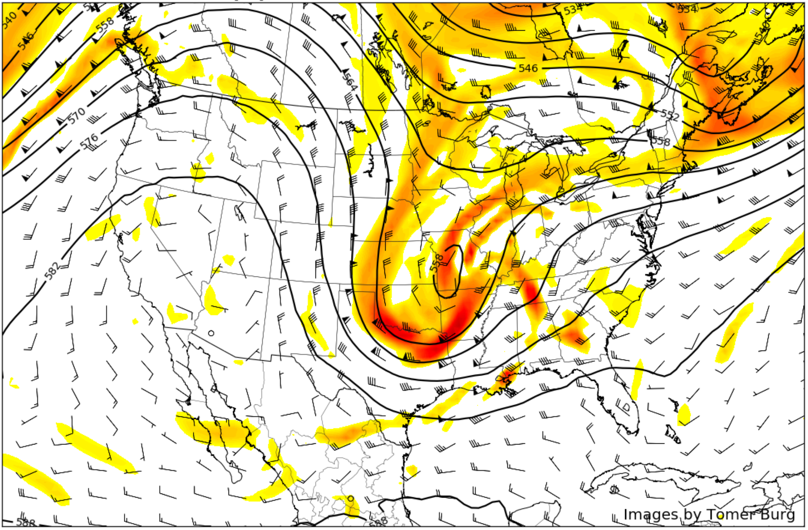
Assumed boundary conditions for postprocessing.
Stable, not radically increasing funding for postprocessing R&D in weather services.
Forecast
data will
continue
to be
easier to
produce
than it will
be to
archive
and
disseminate.
Different
users will
want
different
products,
prefer data
presented
in different
ways.
Community of postprocessing scientists spread across government, business, academia.

Slide 4
Assumed boundary conditions for postprocessing.
Stable, not radically increasing funding for postprocessing R&D in weather services.
Forecast
data will
continue
to be
easier to
produce
than it will
be to
archive
and
disseminate.
Different
users will
want
different
products,
prefer data
presented
in different
ways.
Are there ways to better leverage R&D
done by other weather services,
companies, and universities?
Community of postprocessing scientists spread across government, business, academia.

Slide 5
Assumed boundary conditions for postprocessing.
Stable, not radically increasing funding for postprocessing R&D in weather services.
Forecast
data will
continue
to be
easier to
produce
than it will
be to
archive
and
disseminate.
Different
users will
want
different
products,
prefer data
presented
in different
ways.
(a role for
both weather
services and
private
companies)
To facilitate product generation by outside partners, does it make sense to continue to ship
voluminous ensemble data
to each interested party? What alternative procedures might work better?
Community of postprocessing scientists spread across government, business, academia.

Slide 6
Assumed boundary conditions for postprocessing.
Stable, not radically increasing funding for postprocessing R&D in weather services.
Forecast
data will
continue
to be
easier to
produce
than it will
be to
archive
and
disseminate.
Different
users will
want
different
products,
prefer data
presented
in different
ways.
What should operational
centers produce themselves,
and what should they leave
to others to produce?
Community of postprocessing scientists spread across government, business, academia.

Slide 7
Post-processing challenges
Lack of community infrastructure
Organization
Note the
substantial
overlap.
Science
Getting the right data in place.

Slide 8
Post-processing challenges
Lack of community infrastructure
Organization
Science
Getting the right data in place.

Slide 9
Science challenges.
Product quality in part limited by quality of algorithm.
  Which method is best of current published alternatives for data at hand?
  Are we confident we have a near-optimal method? Methods probably were developed by meteorologists, not statisticians.
Product quality is limited by quality and quantity of training data.
  Reforecasts of high quality and statistical consistency are sometimes needed, but there are scientific as well as computational challenges. When are they worth the hassle?
  Post-processed skill is also limited by the quality of the observation/analysis data; higher-resolution, higher-quality reanalysis data needed for training and validation.
Interactions of data and method: some methods work well with large data sets, others appropriate to small ones.

Slide 10
Overlapping products, different methodologies. Which best?
In NOAA, and presumably in Meteo France and Europe, there may be different teams working in parallel, without structured inter-comparisons to help inform which method provides the best guidance.
This needs to change to improve product quality and consistency.

Slide 11
Training data issues.
Predictor:
  Sometimes not enough samples to quantify model systematic errors, especially location-dependent or state-dependent systematic errors.
  Prediction systems are often systematically biased. Data from independently developed prediction systems? (multi-centre, multi-model ensembles?)
  Additional model predictors (complete thermodynamic profiles for precipitation typing).
Predictand:
  Unbiased, accurate high-resolution gridded analyses.
  More observations.

Slide 12
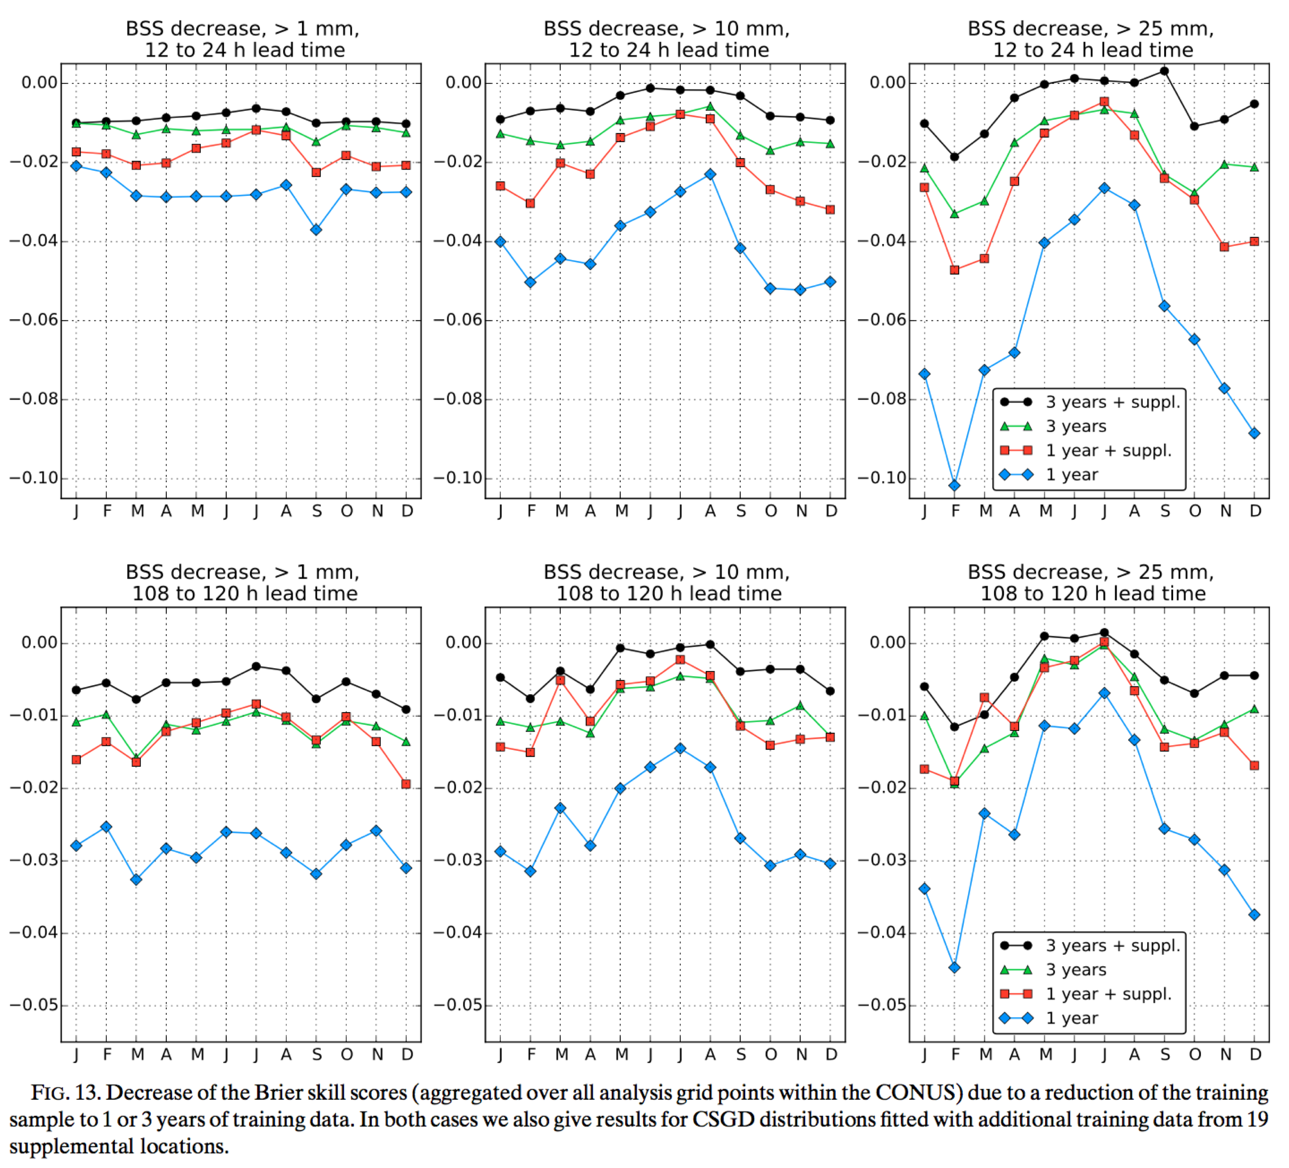
Reforecasts are expensive and a hassle to generate & archive.
When is their production justified? (a) extreme events.
Probabilistic QPF, from Scheuerer and Hamill (2015, MWR, here).
The reference post-processed skill (not shown) with 12 years training data is set to zero here. Curves
thus represent the decrease in skill relative to training with a full 12 years data.
“suppl” = supplemental locations, i.e., increasing
training data with additional locations that have
similar precipitation climatologies and terrain characteristics.
For successful postprocessing of rare events, you need a sufficient number of other rare events in the training sample. In part this is ameliorated through
the use of supplemental locations.

Slide 13
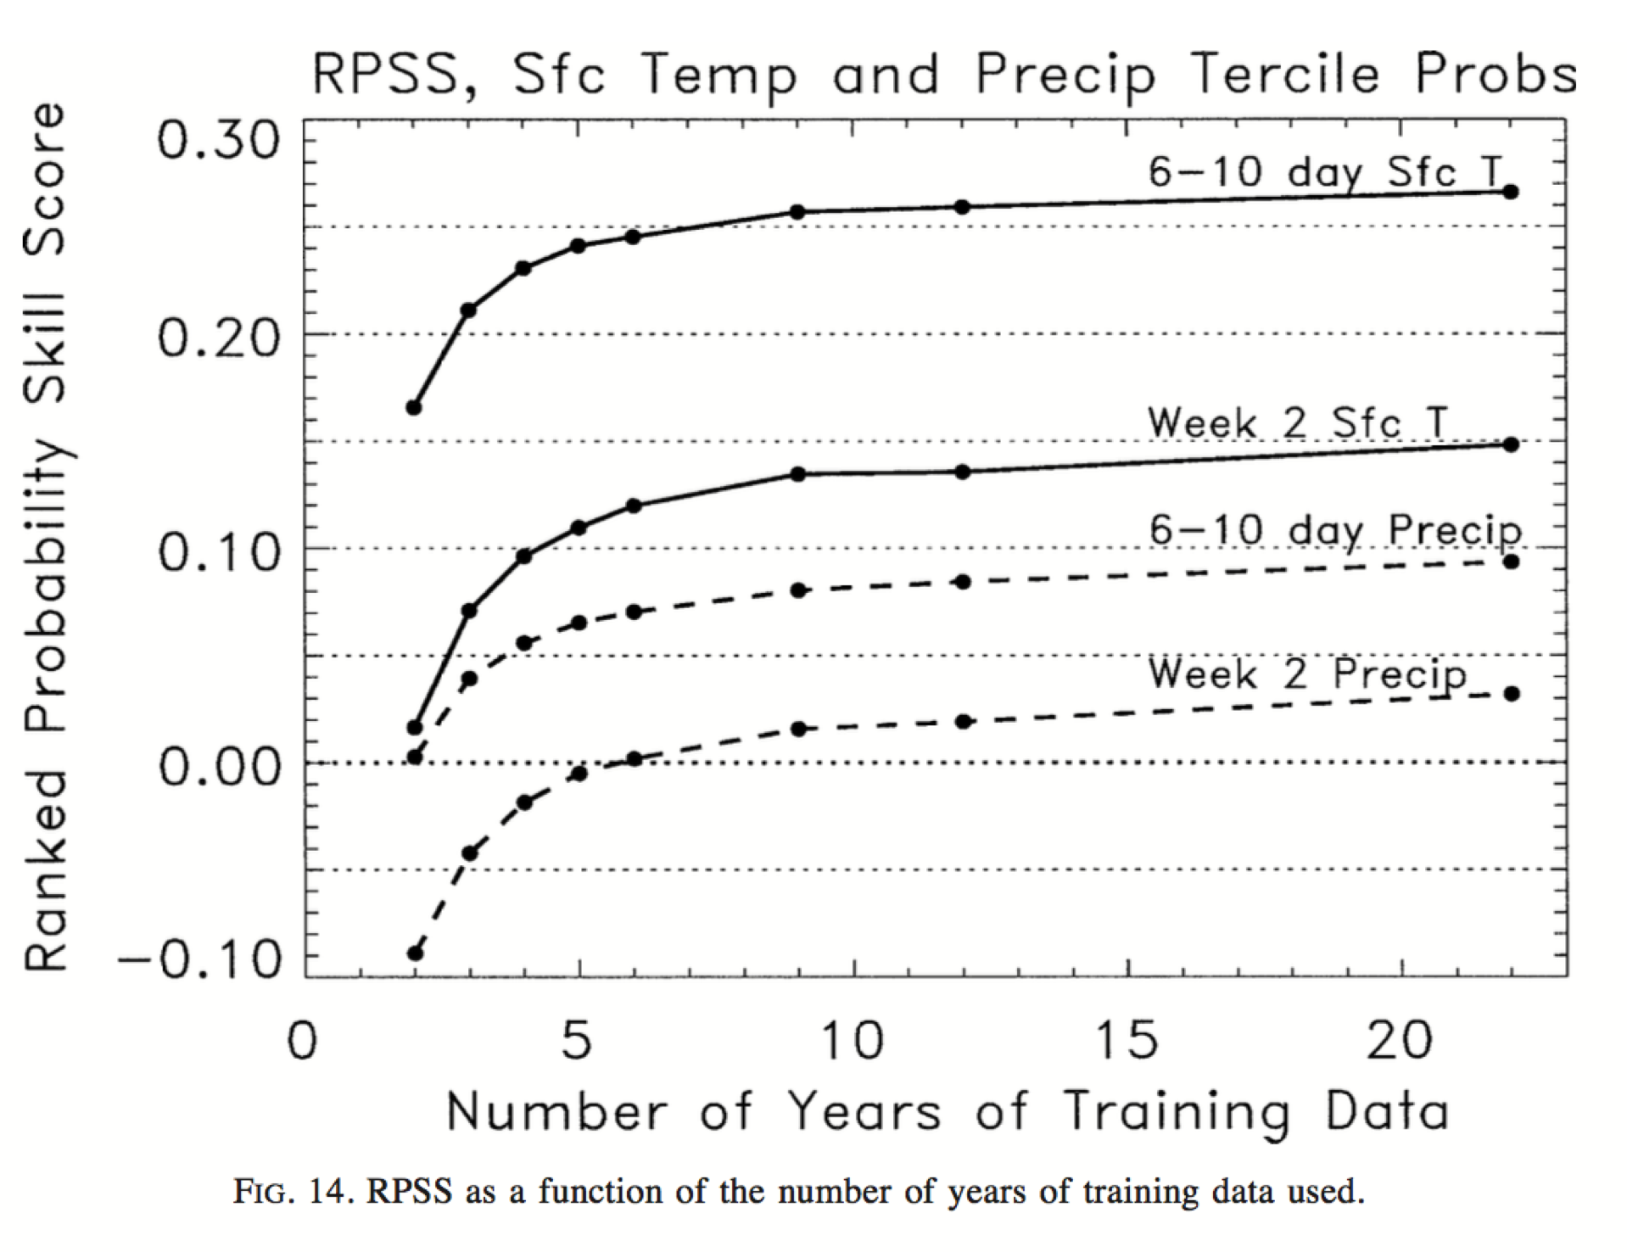
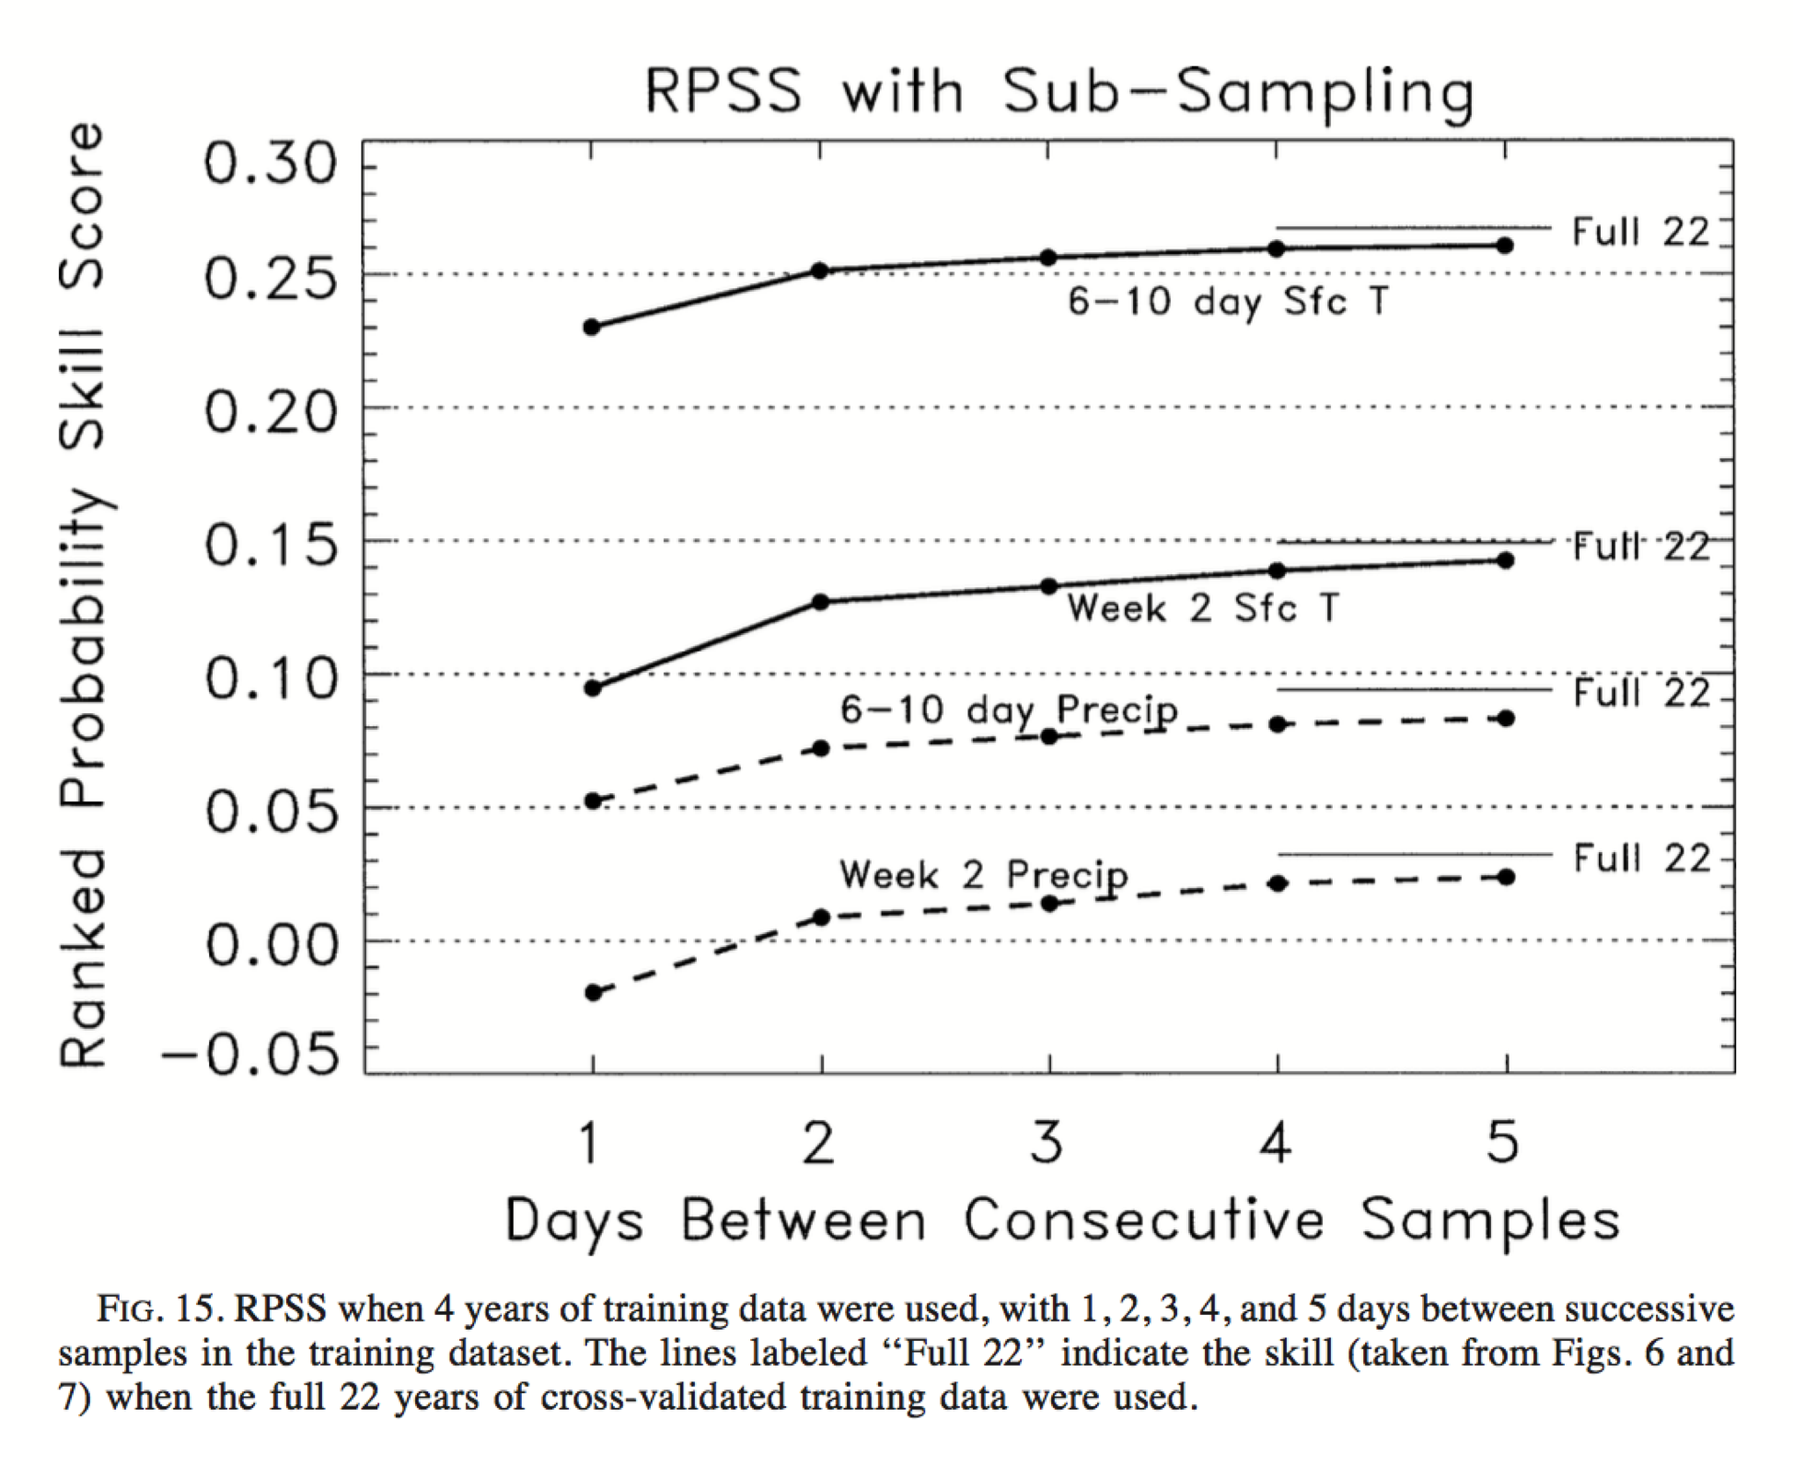
Reforecasts are expensive and a hassle to generate & archive. When is their production justified? (b) time averages, longer leads.
A training sample spanning 10 + years is very
helpful for 6-10 day and 8-14 day postprocessing.
If one can generate only 4 years of samples, better
to generate one forecast every 5th day over 20 years.
from Hamill et al. 2004, MWR, here.

Slide 14
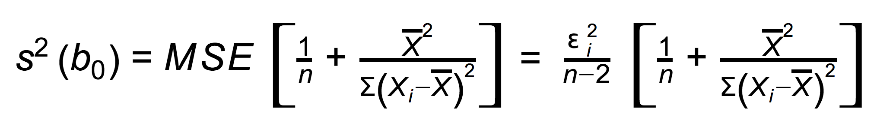
Why is the enlarged sample size so important at long leads?
Consider a simple linear regression: Y_{i} = β₀ + β₁X_{i} + ϵ_{i}
We fit estimated regression coefficients b₀, b₁ given training data [Y₁, … Y_{n}], [X₁, ... , X_{n}]
The sampling distribution of the bias is (b₀-β₀) / s(b₀) ~ t(n-2)
For large n, s(b₀) ~ 1 / √n
So, to quantify bias to some error tolerance, at long leads either the bias must be large to be detected with fewer samples, and/or the sample size must be large to makes s(b0) smaller.

Slide 15
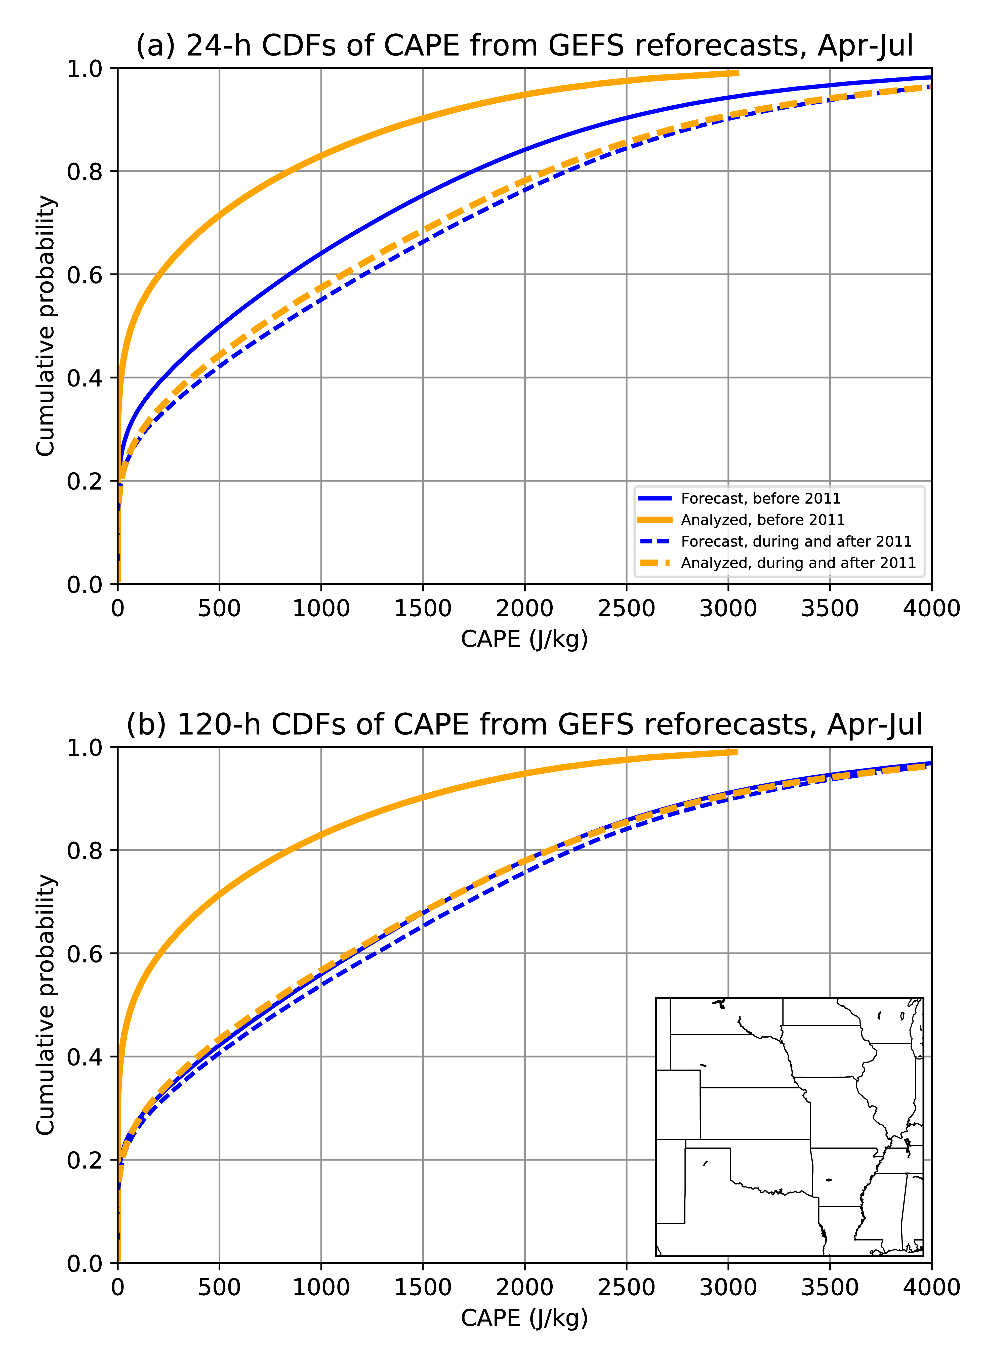
Non-stationarity of reforecast CAPE introduced by a change in the data assimilation system.
Prior to 2011, GEFS reforecasts were initialized from NOAA’s Climate Forecast System reanalysis, version 2.
After 2011, GEFS reforecasts were initialized from the real-time initial conditions, using a changing data assimilation / forecast system.
Using a consistent forecast model not enough for producing reforecasts; need underlying DA system with stable bias characteristics.
from Hamill, 2017 MWR, here.

Slide 16
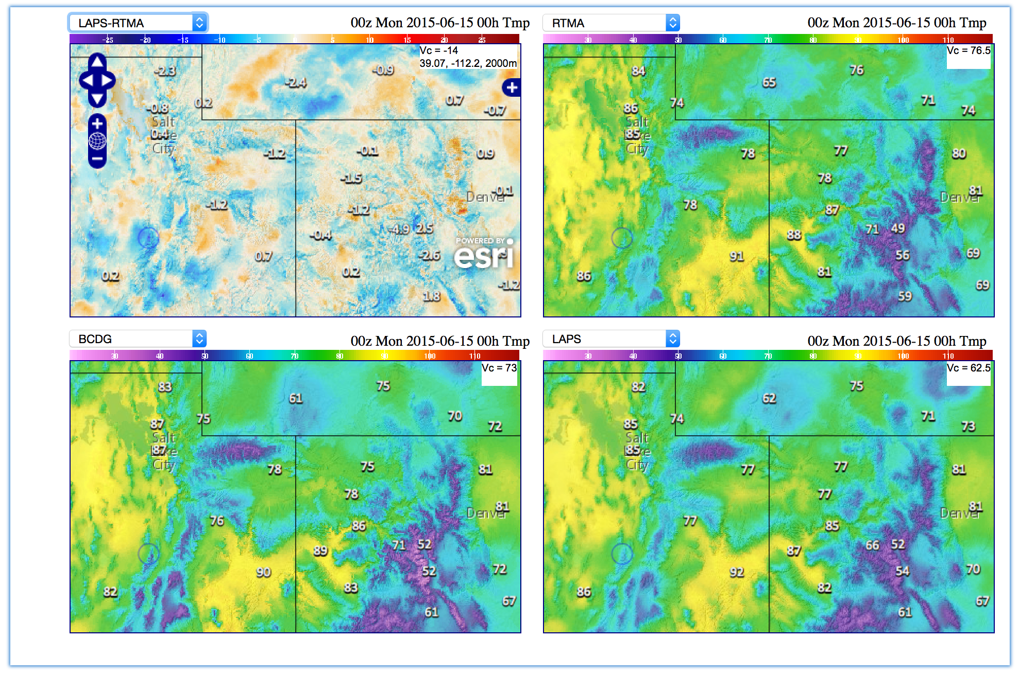
Post-processing product skill will be limited by the quality of training data.
Example: uncertainty in T_{2m} analyses.
14 degrees F different!
Upper left shows the differences between two surface-temperature analyses. The methods are broadly similar; the main difference is that different forecast models provide the first guess in each. When the first guess is different and surface observations are sparse, the analyses are likely to be lower in quality.
From (internal NOAA) http://www.mdl.nws.noaa.gov/~blend/blender.prototype.php

Slide 17
Recommendations for improving the science. (1). Hire professional statisticians.
Will work with atmospheric scientists at weather services.
  Interim measure: summer visitors from prominent university programs.
  Existing staff will be more productive through interactions with statisticians.

Slide 18
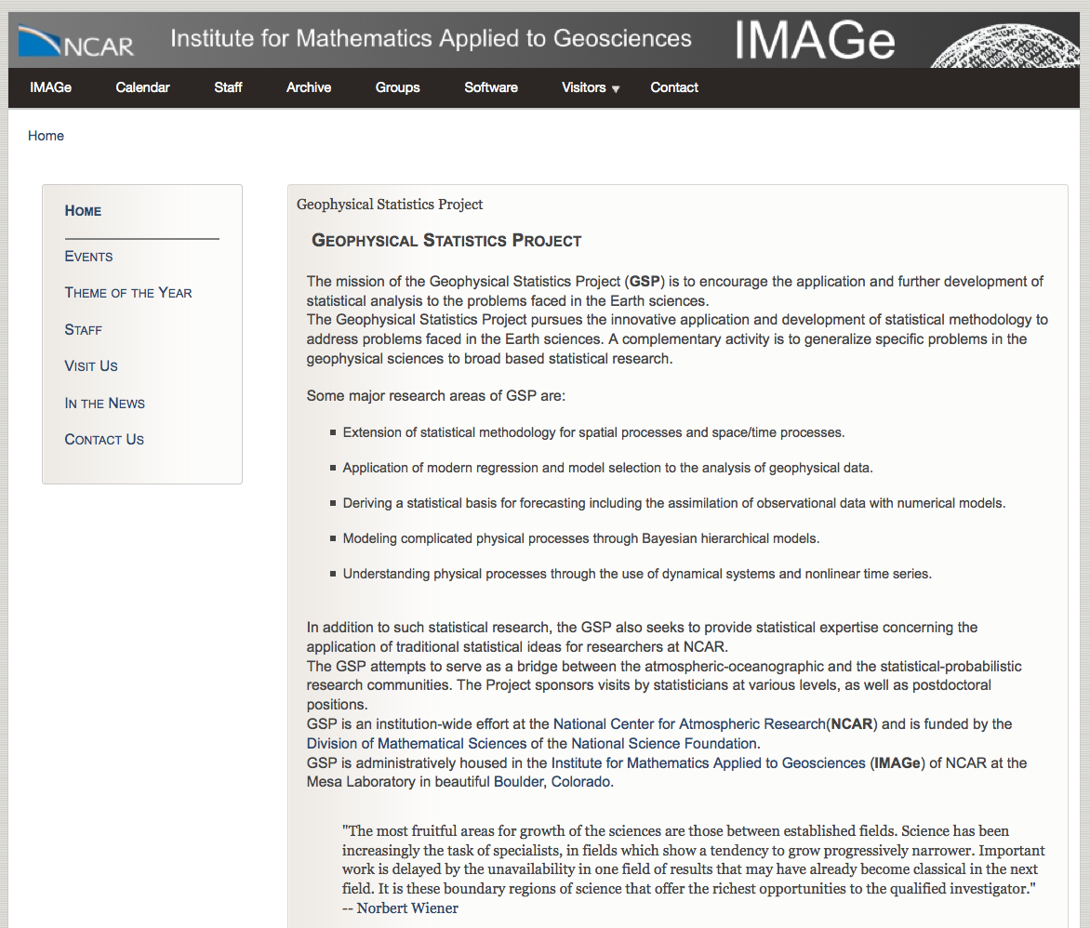
NCAR’s Geophysical Statistics Project, an exemplar for utilizing statisticians in service of atmospheric science.
Recognizing that atmospheric scientists did not always have the statistics background needed, NCAR built a staff of professional statisticians to collaborate with the atmospheric scientists.
https://www2.image.ucar.edu/gsp

Slide 19
Improving the science (2): deciding on and deploying foundational algorithms
Weather services should develop and deploy a consolidated post-processing code base to produce “foundational” guidance spanning time scales.
  Perform systematic comparisons of existing and proposed algorithms.
    Determine parameters (e.g., precipitation) where unified code possible.
    Define the methods of evaluation before seeing results.
    Re-code the best algorithm(s) so that they can be applied broadly across prediction systems and time scales.
    Test algorithms.
    Decide which to deploy.
    Optimize their performance.
    Deploy in public repositories.
  Improved software maintainability can lead to a more efficient use of resources throughout weather services.
  More seamless products, increasing credibility with customers.

Slide 20
Improving the science (3): data generation.
Determine situations where reforecasts are worth the computations and hassle.
Generate high-quality reanalysis and reforecast data, and generate them regularly.
  May determine that a year or two is sufficient for week +1, decade or more needed for week +2.
  Given potential for changing bias in initial conditions, suggest movement toward “bias-aware” data assimilation or other ways to ameliorate analysis bias.
Generate high-quality, high-resolution analysis data to train against.

Slide 21
Post-processing challenges.
Lack of community infrastructure
Organization
Science
Getting the right data in place.

Slide 22

Providing ready access to training data.
The latest retrospective forecast, real-time forecast, and hi-res. analysis data are not readily available to all developers (government, university, business).
Formats not widely used (grib used, not netCDF).
Want fast access (disk) to crucial data, not deep storage on tape.

Slide 23
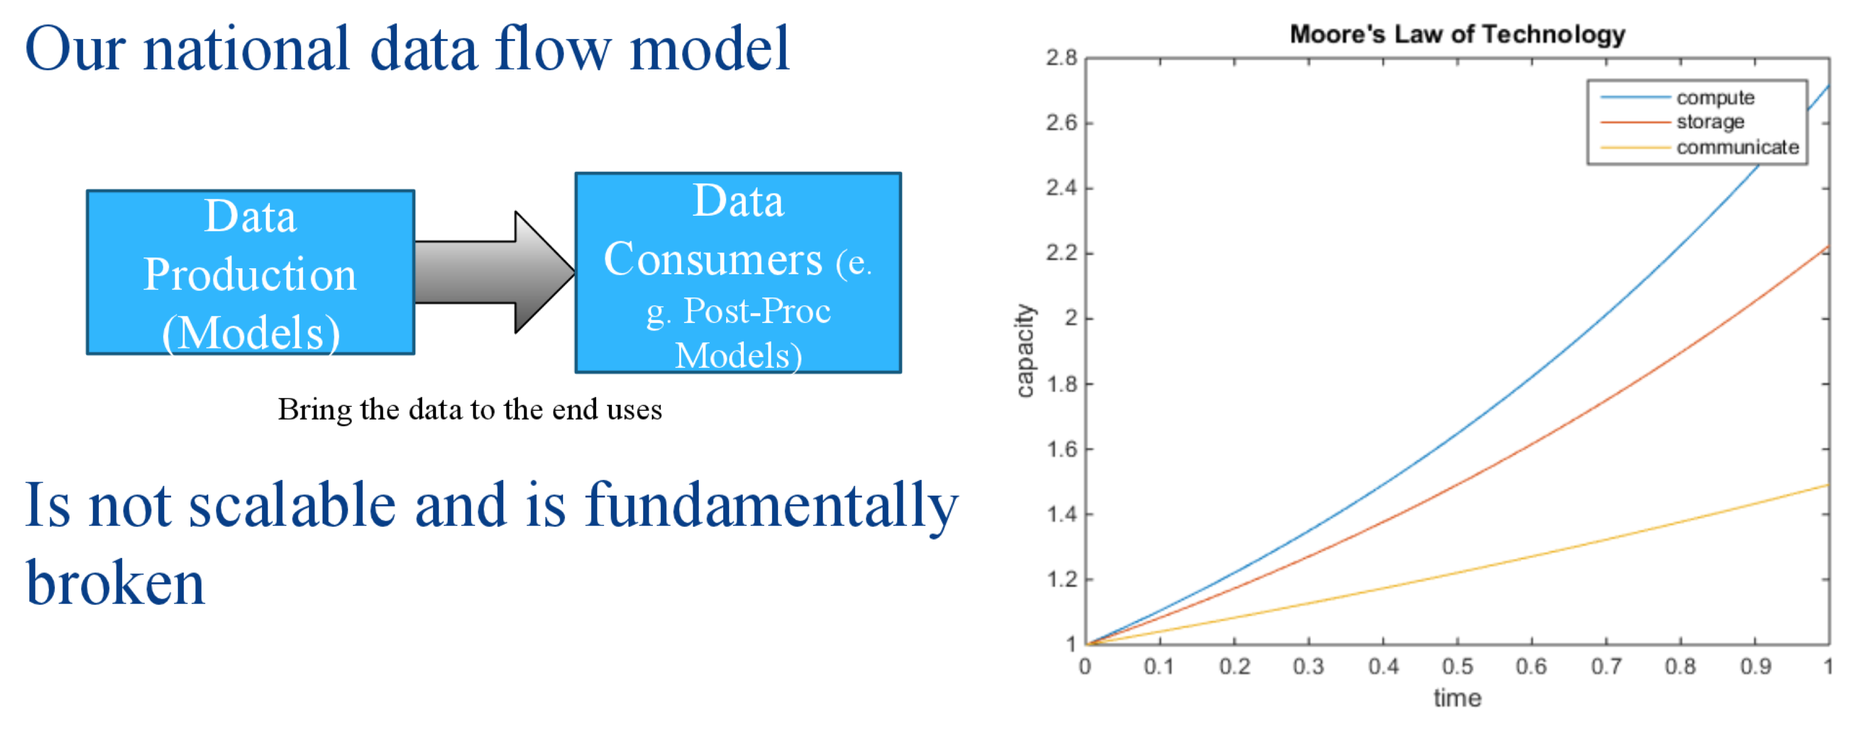
Moving data around is getting harder.
A data storage plan that’s convenient for weather service internal development may not be convenient for broader NOAA, industry, academia, or inter-governmental collaboration.
Performing the post-processing development on different systems from the production of data will cause even greater challenges in the future, as CPU increases faster than disk and communication.
slide c/o Peter Neilley, the Weather Company/IBM

Slide 24
Data and infrastructure recommendations: (1)
Decide where reforecasts needed, where they’re not.
Incorporate reforecast / reanalysis production into future high-performance computing, storage planning.
Weather services should post-process and make readily available “foundational data” for use insider the weather service and across the broader enterprise.
  Foundational data: variables like 2-m temp, precipitation.
  Private companies heavily use this post-processed guidance.
Quality global data sets (reanalysis, reforecast, post-processed, satellite, radar, point data) should be made easily accessible, if possible.
  Via public servers and/or cloud.
  Risks: computational expense, questionable quality in data-sparse regions.

Slide 25
Data / community infrastructure recommendations (2):
Explore alternative community storage paradigms, including:
Create an area where data can be accessed and processed by internal and external collaborators easily, including international collaborators.
Convenient workaround for storage, I/O bottleneck, especially for corporate partners.
Risk: can security concerns be addressed?
Weather service
high-performance
computing
R/W
Disk and tape
storage of the
massive datasets
R
Private computing
resource for
post-processing
R/W
smaller, value-
added datasets,
easier to transfer
proposal inspired by Peter Neilley, the Weather Company, following UK Met Office paradigm.

Slide 26
Data and infrastructure recommendations: (3)
Follow up the workshop with a structured survey of post-processing product developers to make sure we are saving on disk the relevant predictor information.
  Some notes on preliminary survey are in the supplementary slides.
Requirements for products should incorporate predictability considerations.
  Example: production and storage of day +7 hourly precipitation forecasts at 1 km not warranted.

Slide 27
Post-processing challenges.
Lack of community infrastructure
Organization
Science
Getting the right data in place.

Slide 28
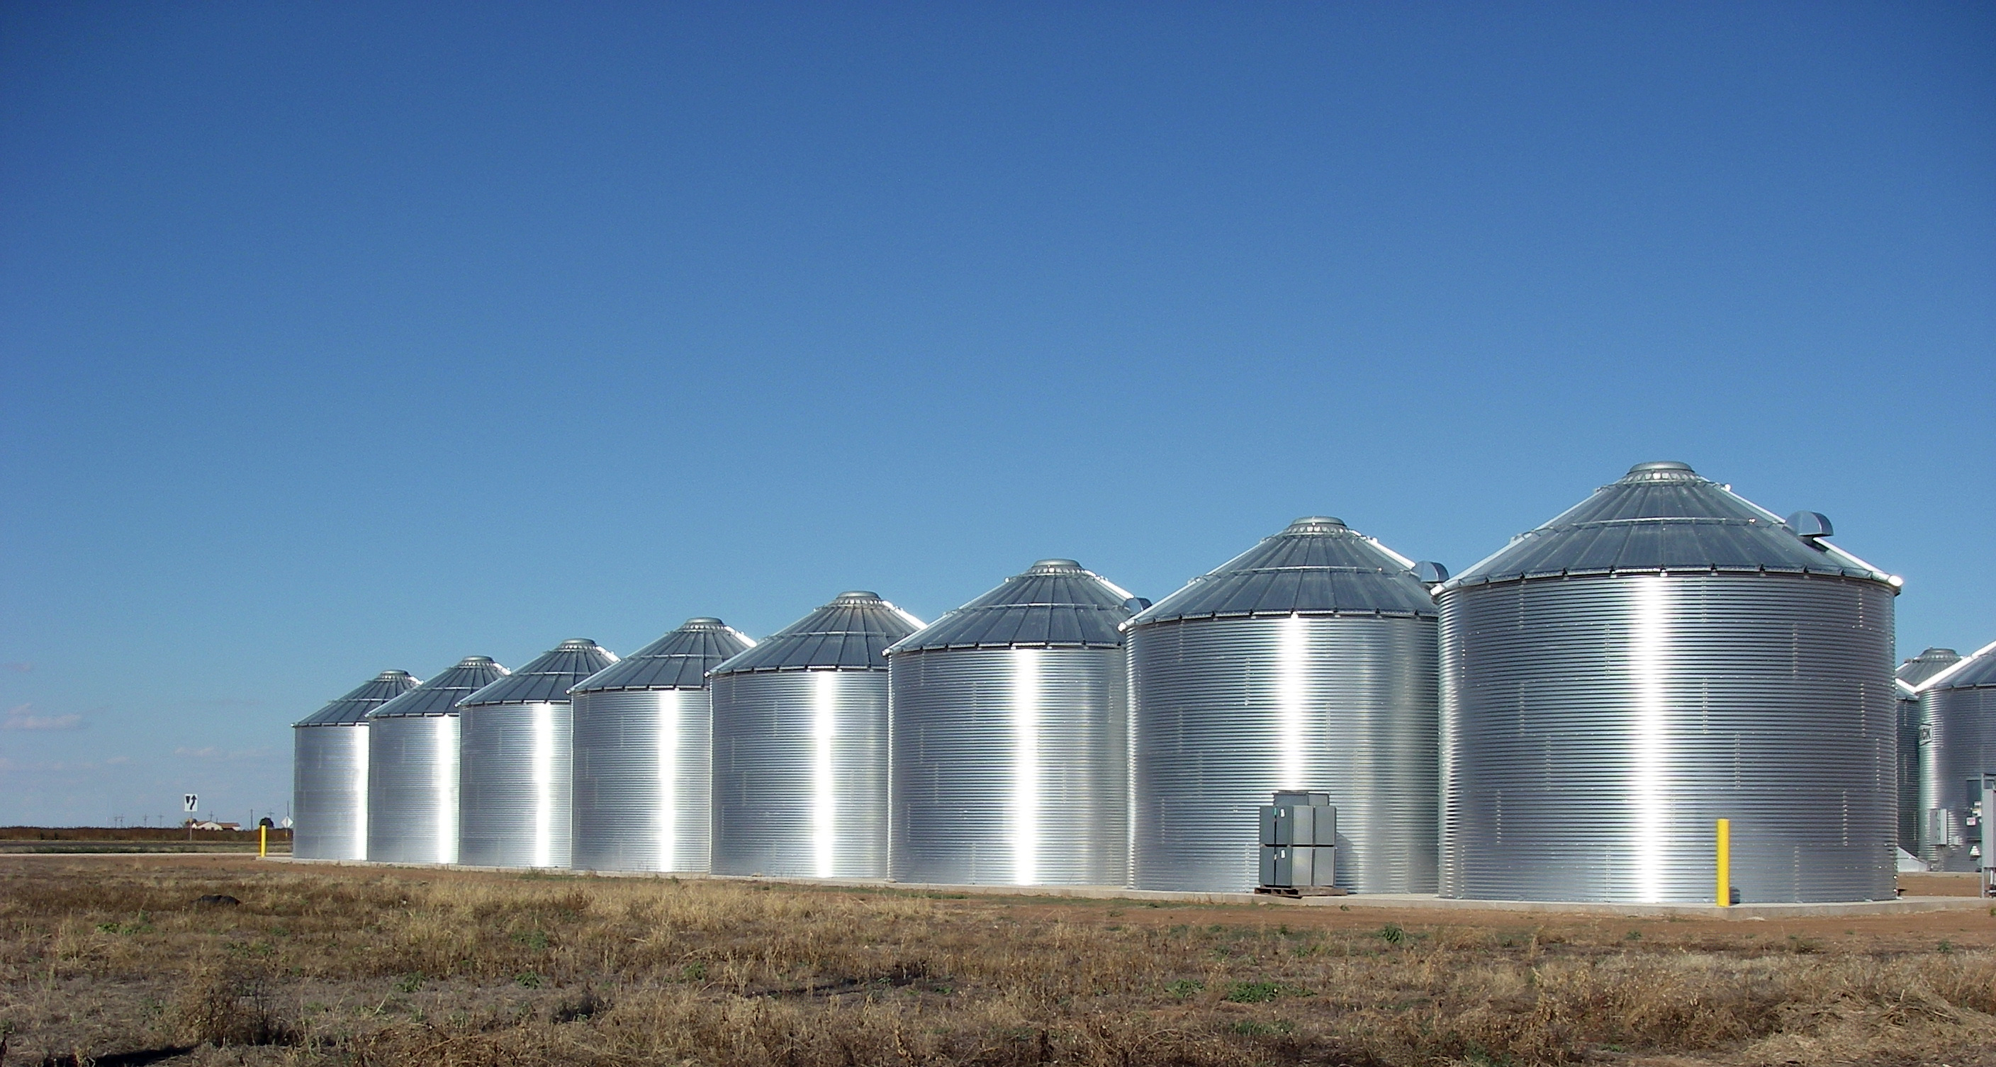







Little sharing of post-processing software and test data.
(Mostly) unconnected silos of software development; hard to find each other’s code; sub-standard documentation;
government agencies may not embrace use of public repositories; lack of modern version control; training data hard to get.

Slide 29

Yet sharing software is easier than ever.
The tools are available to make co-development much easier and faster, to facilitate inter-comparisons.

Slide 30
Community infrastructure recommendations (1): Build a community repository, and …
Establish modern, widely utilized distributed repository and version control system; Git and GitHub are established industry standards.
Potential tiers in the repository:
  inner: operational weather service, closely maintained;
  middle: undergoing testing for eventual transition to ops.
  outer: with comparative ease for external collaborators to use and modify.

Slide 31
Possible repository configuration (c/o Tom Auligné)
NOAA
Operations
Met Office
Météo France
Development
Operations
Operations
Development
Development
Central
Repository
University
Government
Lab
Business

Slide 32
Community infrastructure recommendations (2)
Establish governance plans to enable groups to work together and methods of making decisions¹.
  Institute a ticket-tracking system to monitor requested product improvements and their disposition.
  Establish process and allocate resources to manage incorporation of internal and external code contributions into the main repository, i.e., a change control board.
Establish requirements for metadata, tests, and documentation¹.
Establish common vocabulary and use it¹.
Establish a centralized location for documentation and data access (e.g., data.gov). Focus on a few core documents¹.
Leverage work already done by 18F (digital government), as well as work with them on creating guidelines and standards¹.
Work with the community to determine two or three modern common data formats that should be used (e.g., netCDF, HDF, geoJSON) that will satisfy operational, research, collaboration, and archival purposes¹.
Provide assistance to collaborators¹.
¹ Tom Auligné calls this “entropy management” for his proposed data assimilation code refactor, and envisions a team to govern this; we suggest something similar.

Slide 33
Conclusions
Hire professional statisticians
Inter-compare algorithms more, and use the best.
Improve training data source (retrospective forecasts, unbiased analyses).
Bring the computing to the data rather than disseminate raw guidance widely.
Build a community, share algorithms, test and real-time data.

Slide 34
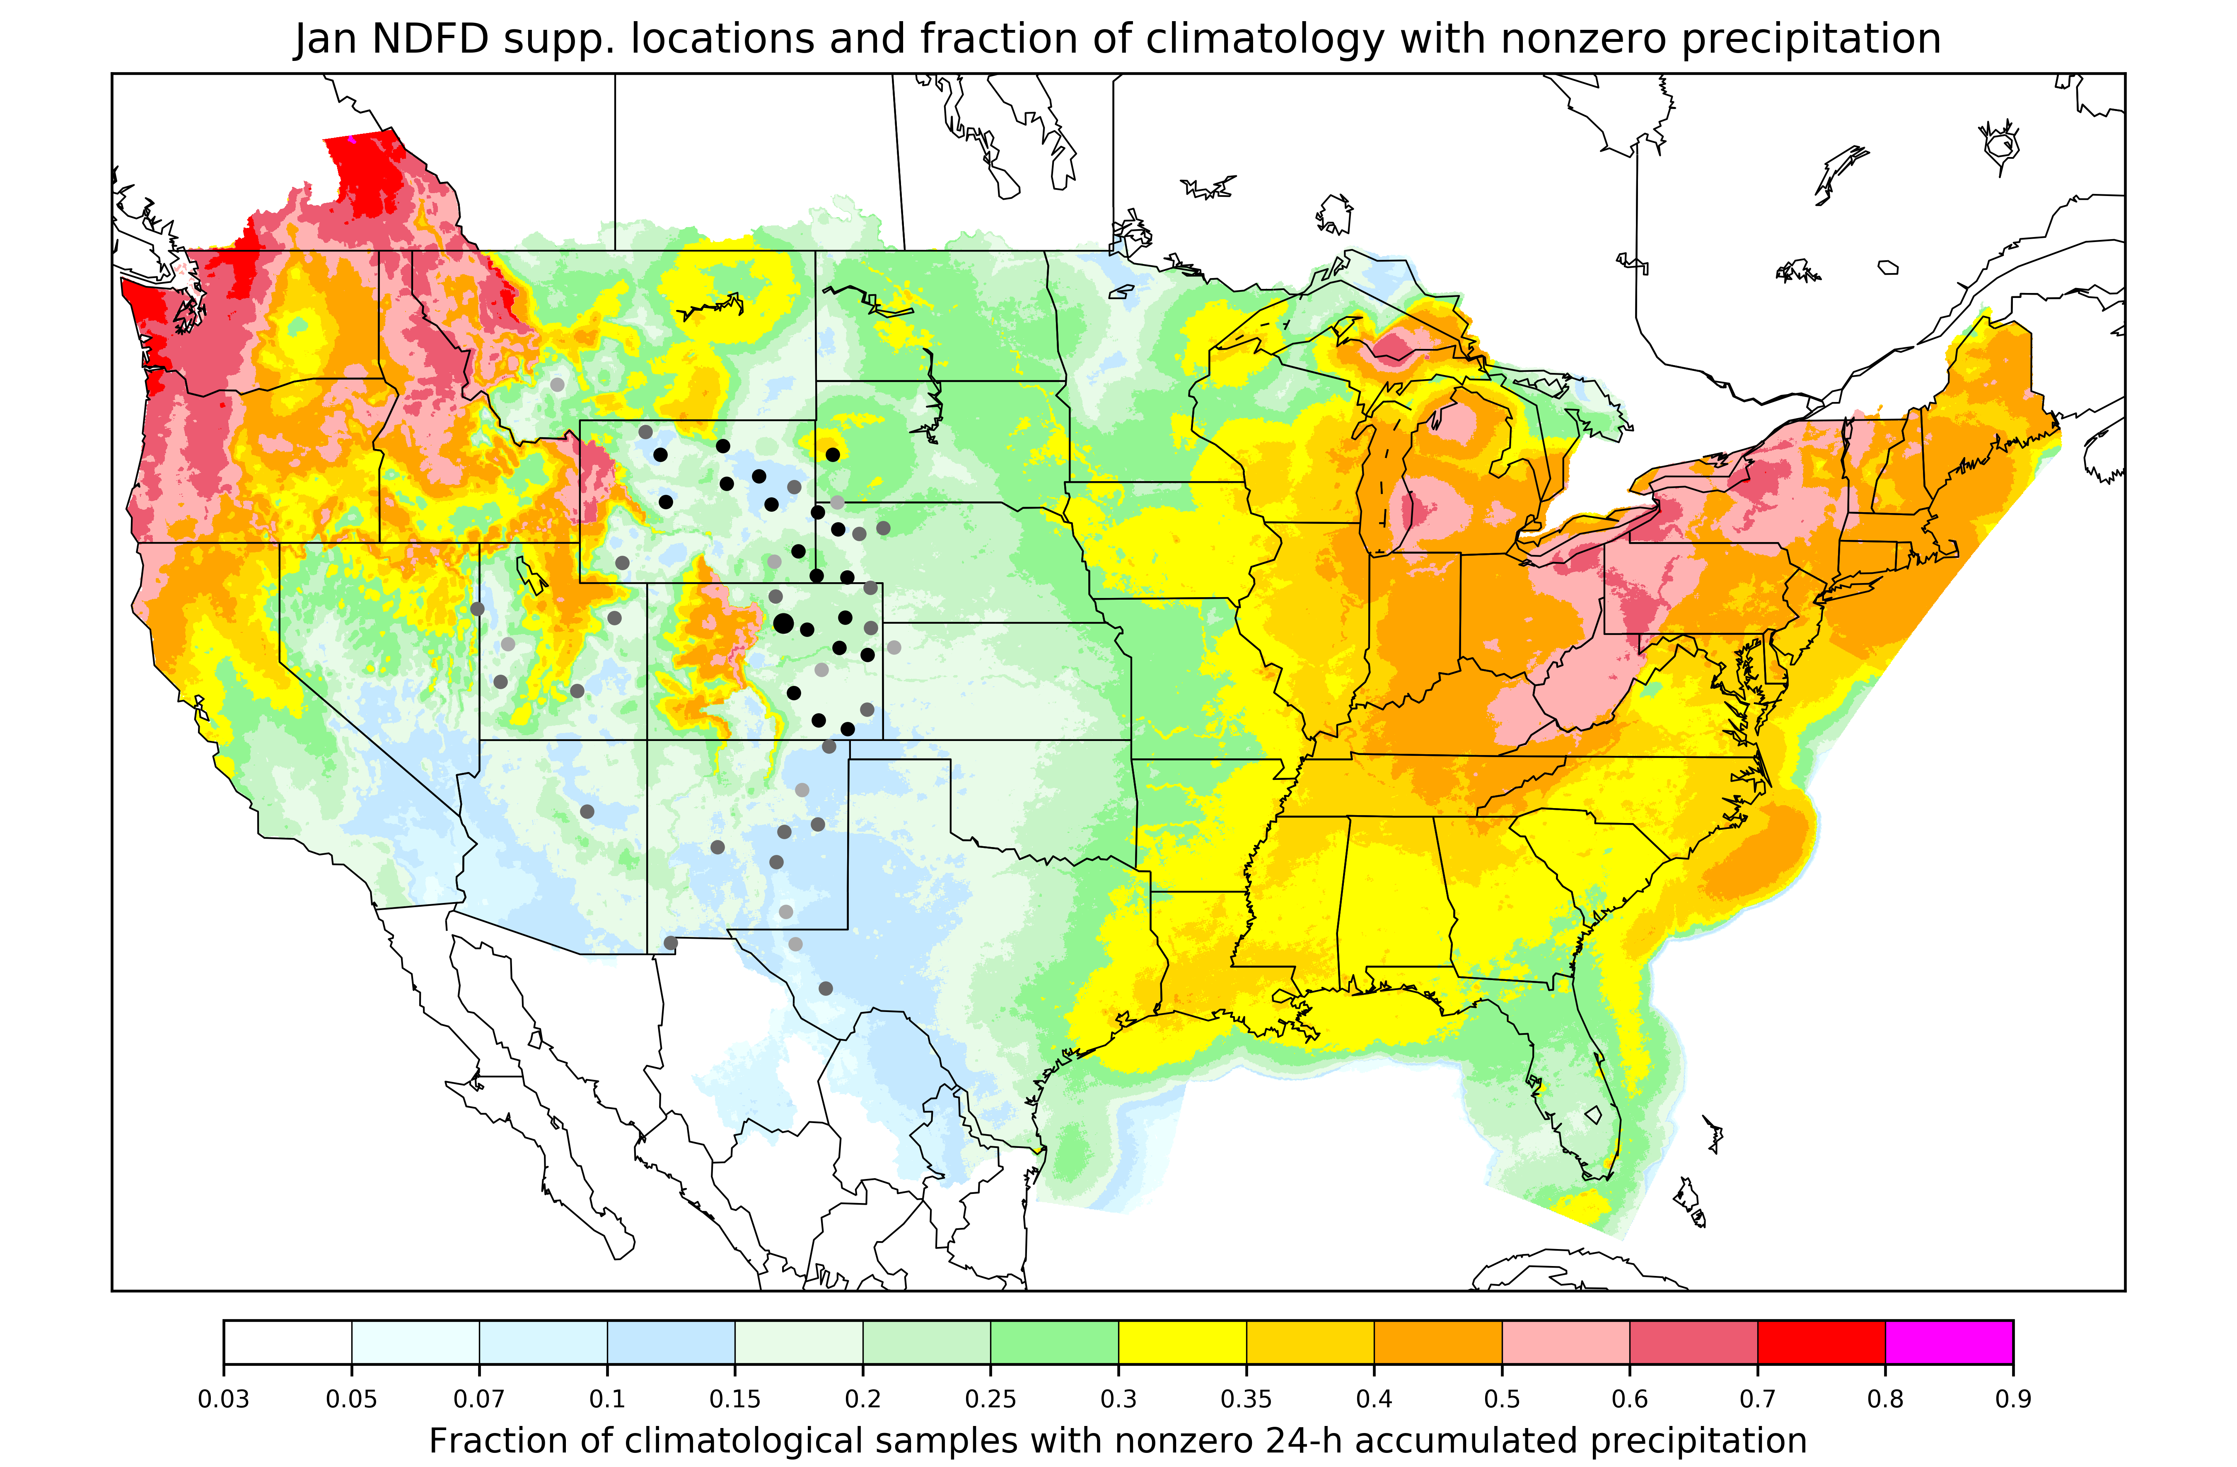
Supplemental locations example
For each model grid point
or station, identify other
locations with similar
climatology and terrain
characteristics.
Then train the statistical
model for this grid point
using data from the
supplemental locations.
Unique supplemental
locations pre-defined for
each grid point in the
domain.
More here.

