Slide 1
New ensemble-based products for tropical cyclones
NOAA ESRL
Tom Hamill
NOAA / ESRL, Physical Sciences Division
also: Ed Rappaport (NHC), Mark DeMaria (NESDIS),
Zoltan Toth (ESRL), Barb Brown (RAL), Bob Gall (NWS/OST)
presentation at 91st Annual AMS, Seattle, WA in 24th WAF / 20th NWP, 24 January 2011

Slide 2
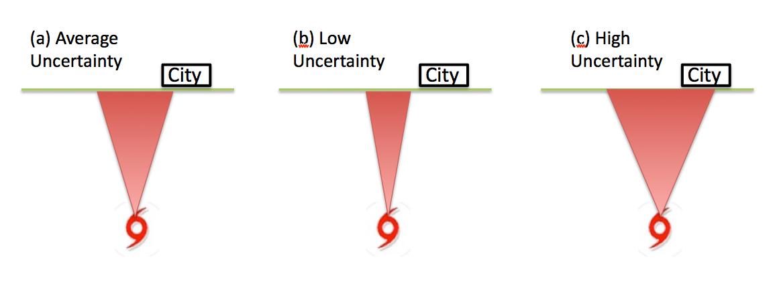
Why uncertainty products?
Paraphrasing Vice President Joe Biden:
“Barack, if you lived in this city, then knowing
the uncertainty would be a big *&^%ing deal.”

Slide 3
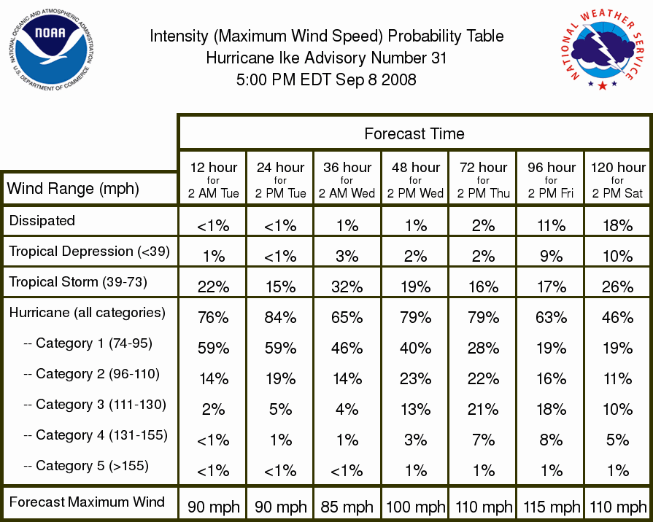
There are existing NHC uncertainty products, but they are primarily based on average statistics of past forecast errors

Slide 4
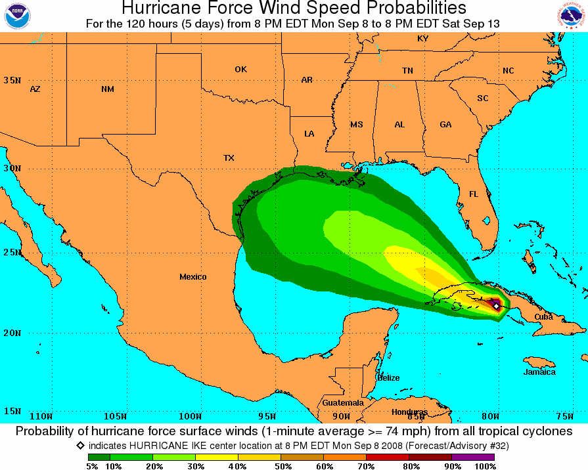

Slide 5
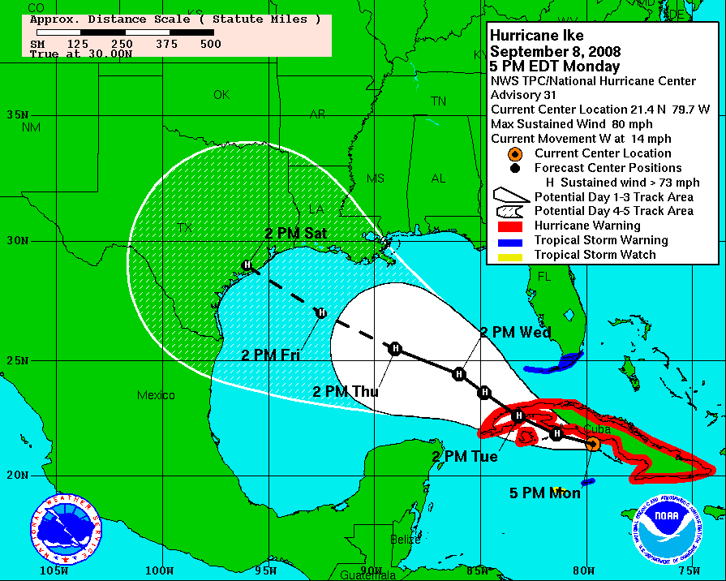
“Cone of uncertainty”

Slide 6
Are we ready for ensemble-based products?
Ensembles still exhibit systematic errors
Global models under-forecast hurricane intensity
Ensemble spreads often too small – direct use may result in overconfidence in forecasts.
Still…
There are methods such as statistical post-processing to ameliorate the errors.
Forecasters, media, emergency users want the products, even if imperfect.
It makes sense to start planning for a future with ensemble-based products.

Slide 7
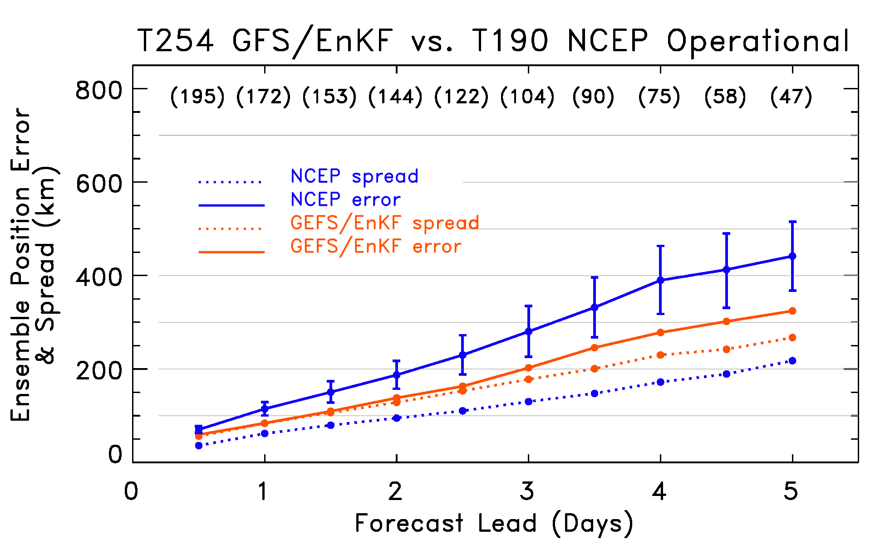
And we are getting better.
As models and ensemble techniques improve, ensemble predictions will increasingly be used to improve hurricane forecasts.
Example:
improvement
to track forecasts
from experimental
EnKF-based
GFS ensemble
relative to
operational NCEP
ensemble.
Still, there are not that many tropical cyclone forecast products that leverage
the uncertainty estimates produced by ensembles.

Slide 8
The remainder of the
presentation will
summarize recommendations
from this workshop.

Slide 9
Recommendations for products oriented toward forecasters
Intensity and intensity change
Cyclogenesis
Structure
Track
Associated phenomena (storm surge, winds, rainfall, tornadoes).
Locations for supplemental adaptive observations.
Non forecasters may be interested in the same products, but given early stage with these
products, may be wise to put “experimental” disclaimer statement if made widely available.

Slide 10
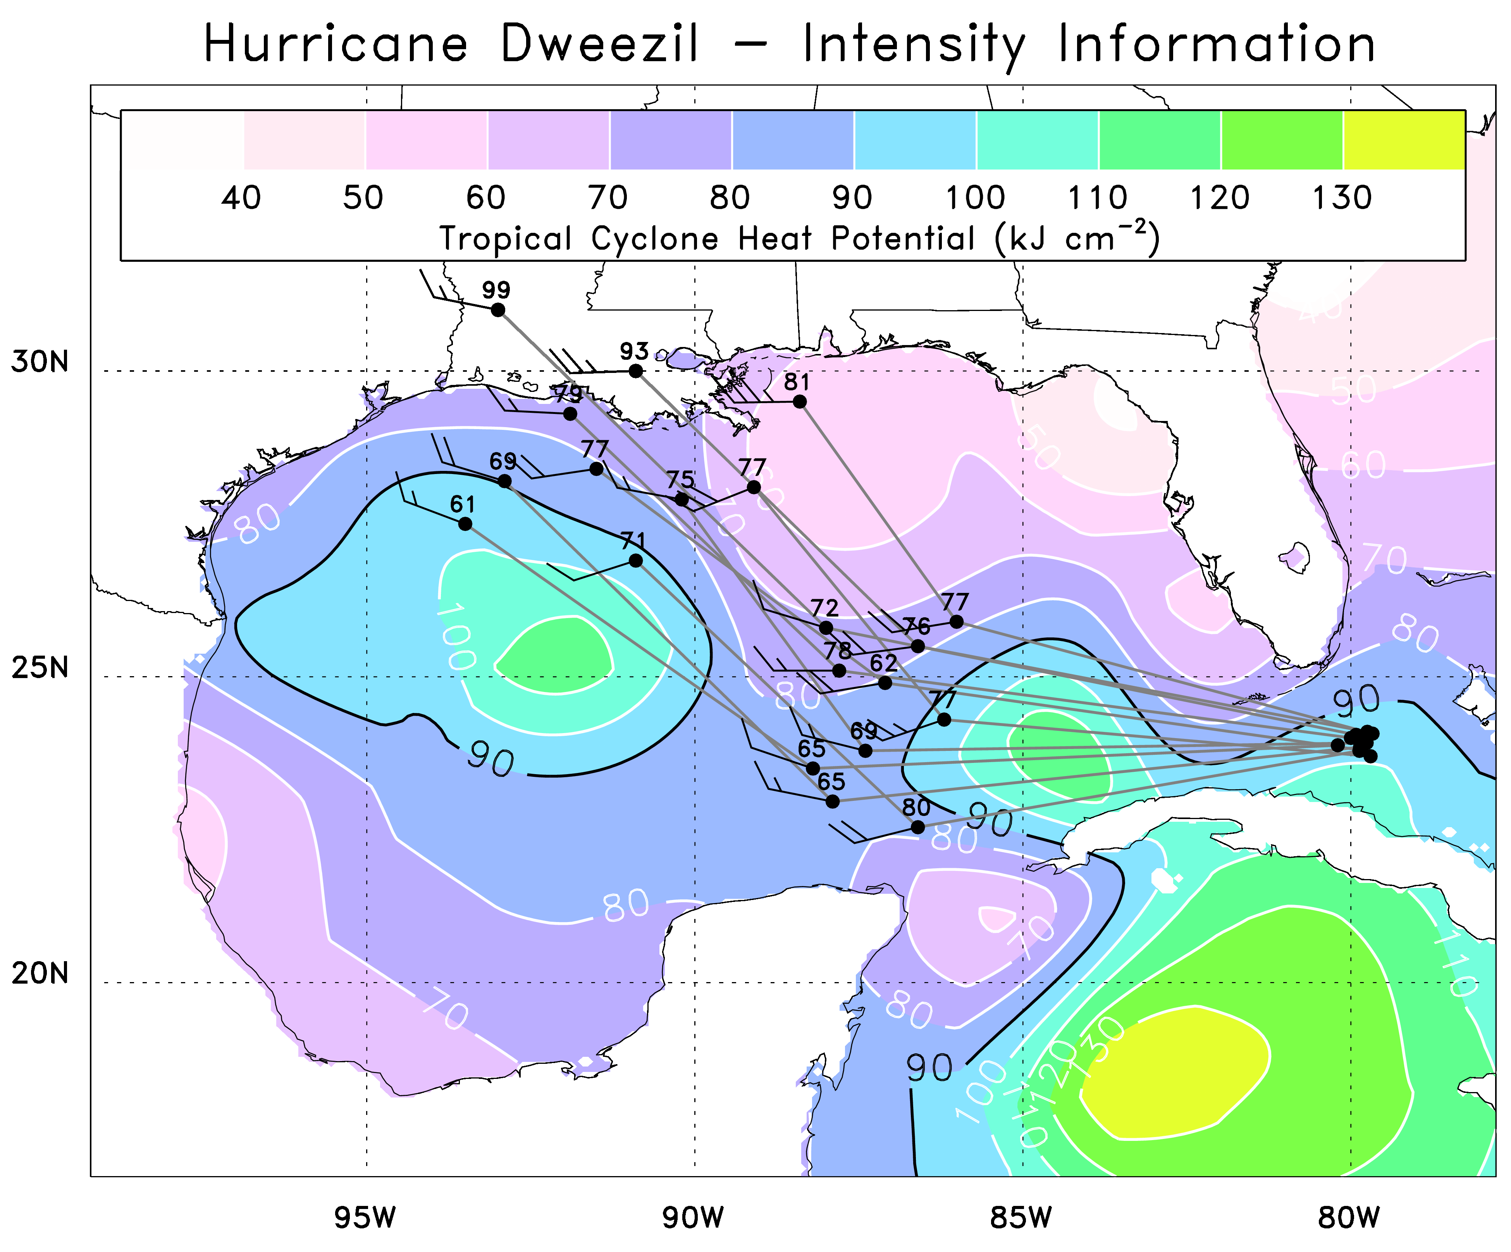
Augment track products with intensity-related information
Analyzed
ocean tropical
cyclone heat
potential (TCHP),
forecast central
pressure
(mb-900) and
vertical wind
shear are shown.
Permits
visualization
of co-variations,
e.g., central
pressure’s
relation to TCHP,
shear.

Slide 11
Time series of variables
that may be related to
intensity, displaying
mean, 20th & 80th percentiles
(white lines) and min/max
from ensemble (blue).
In this case, the min in
central pressure at 51 h
appears to be related to
a decrease in vertical
shear.

Slide 12
Incorporate ensemble information into LGEM (Logistic Growth Eqn. Model)
V = forecast velocity
V_{mpi} = maximum potential intensity (a function of SST at forecast position)
S = 850-200 shear (normalized)
C = 0-15 km average vertical velocity from plume model using SST, temperatures
and humidity in a 200 to 800 km ring around storm.
Red are parameters of the model, fit using reanalysis data, an adjoint algorithm,
and steepest descent algorithm.
Ref: DeMaria, MWR, January 2009

Slide 13
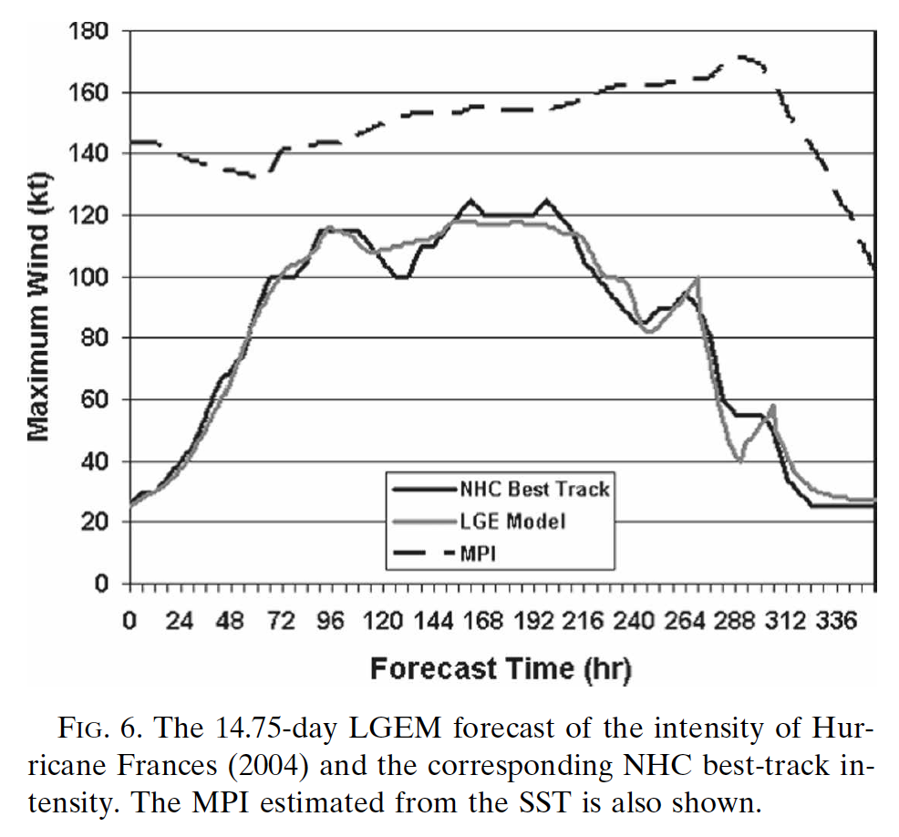
LGEM intensity “forecast” (fit with dependent reanalysis data and observed track info)
When trained after the fact
on environmental analysis
data from Frances, the
reconstructed intensity
is very accurate.
(But of course less accurate
when trained on data across
many storms and feeding
real-time forecast information,
with its biases).
Ref: ibid

Slide 14
Possible ensemble improvements to LGEM
Provide ensemble of tracks and environmental forecasts to LGEM, resulting in ensemble of intensity forecasts.
If large data set of past forecasts (reforecasts) are available from same model run operationally:
Statistically adjust forecasts for systematic errors (in position, in thermodynamic profiles, etc.)
Possibly train LGEM on forecast data as opposed to analysis data (i.e., MOS instead of perfect-prog).

Slide 15
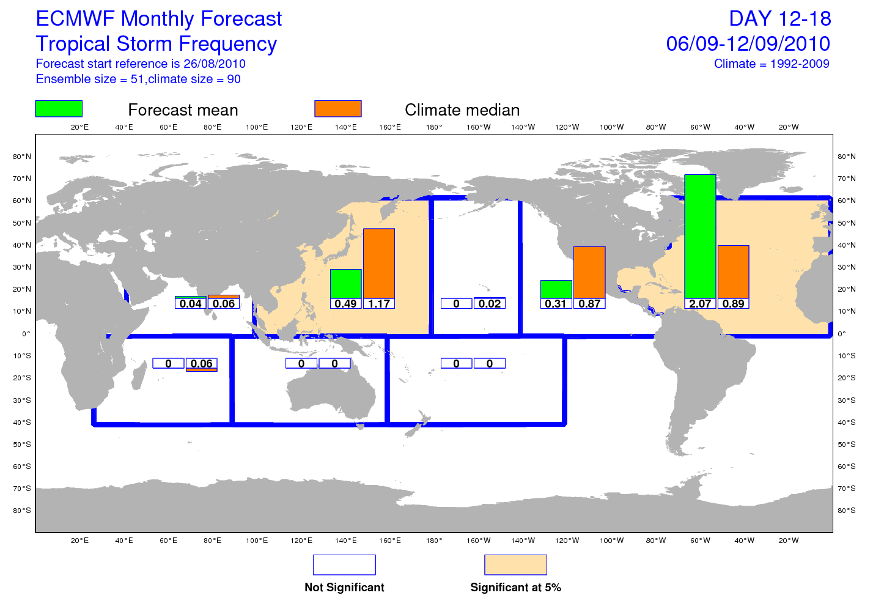
Tropical cyclogenesis
Uses TCgenesis from reforecasts to provide some calibration for possible biases.
Ref: D. Richardson, personal communication, ECMWF.

Slide 16
Other recommendations for new ensemble products for cyclogenesis, storm structure, storm surge, winds, rainfall, tornadoes in slides after conclusions.

Slide 17
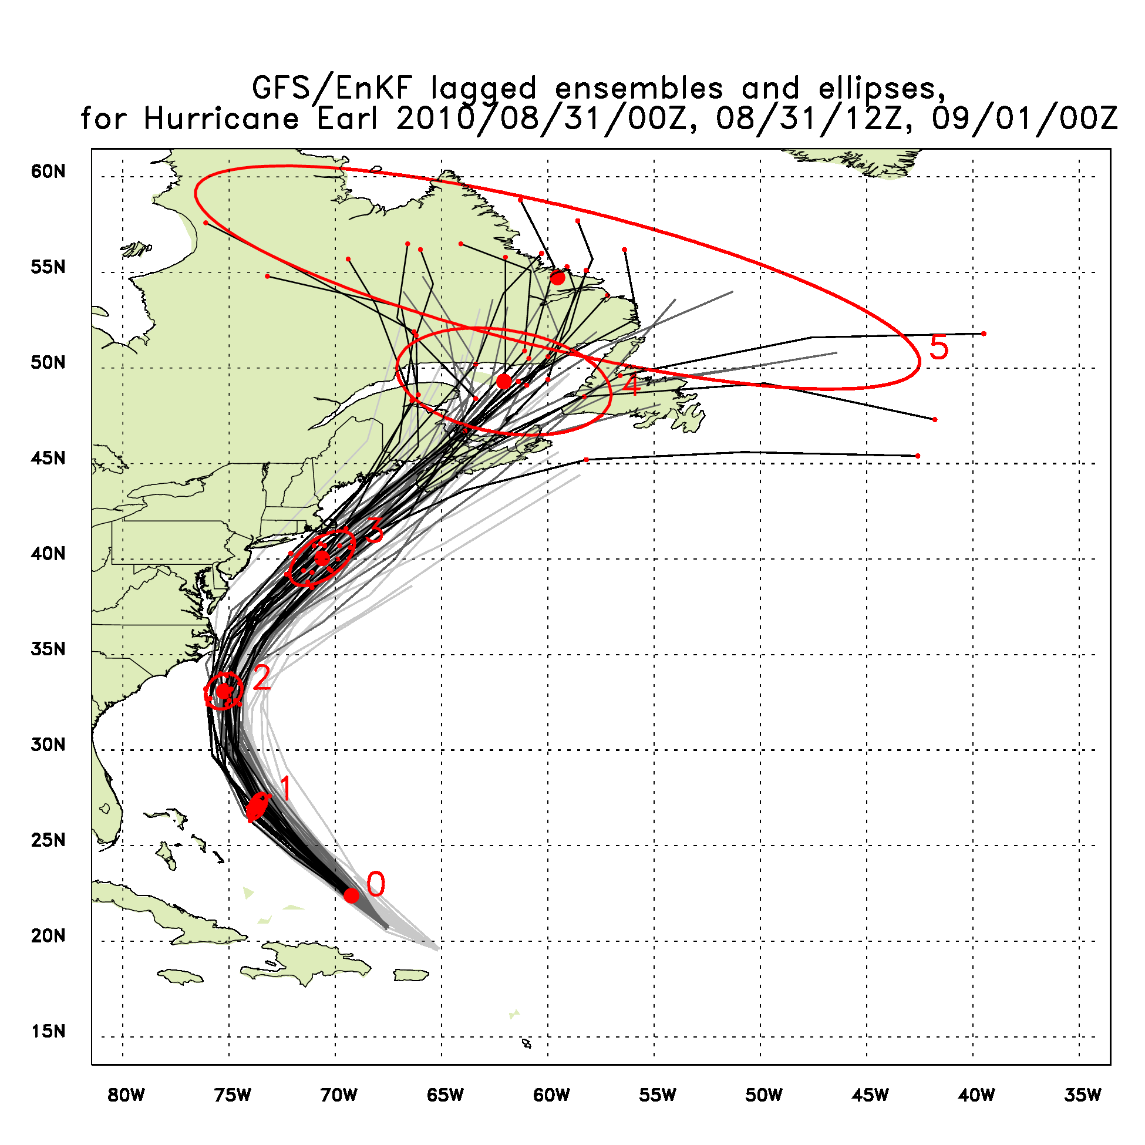
Track products
Innovations here:
Cone of
uncertainty
estimated
directly from
ensemble
(contains 90% of
probability).
(2) Lagged
forecast track
data shown in
lighter grey colors,
provides sense
of trends in track.

Slide 18
Recommendations for/from media, emergency managers, end users.
Keep it simple! Perhaps red/yellow/green confidence levels on deterministic forecasts.
Desire some products similar to but simpler than those for forecasters.
Associated explanatory web pages to accompany new graphics.
Train product recipients, possibly by COMET.

Slide 19
Conclusions
Several possible new ensemble-based graphics shown here.
We welcome your input concerning other possible new graphics that will be useful to the community.
BAMS draft article at tinyurl.com/4t6onm4

Slide 20
Other cyclogenesis recs.
Include tracker output of model-generated storms and genesis probabilities estimated from the ensemble in geographical areas, especially at the 48-hour and 120-hour lead times.
Examine whether a statistical model of genesis (Schumacher et al. 2009) incorporating ensemble genesis information might provide skillful guidance.

Slide 21
Storm structure products
Ensemble averages of the radius of the outermost closed isobar (OCI), which provides one possible measure of overall storm size.
Ensemble-mean predictions of 34, 50, and 64-kt (15.4, 25.7, and 32.9 ms⁻¹) wind radii in different quadrants, where the ensemble of storms is relocated to a common position.
Probability distributions of the OCI and wind radii might also be useful.

Slide 22
Targeted observations
Ensemble-based techniques may be useful for determining the most useful locations for supplemental observations.
Typically, an ensemble-based targeting algorithm considers how much the forecast uncertainty (usually measured in this case as some function of the ensemble spread, i.e., the standard deviation about the mean) would be reduced as a result of the reduction in analysis-error variance in an ensemble due to the assimilation of extra data.
Techniques are promising but are limited in their utility by the lack of calibration of the ensemble and the assumption of linear error growth (Majumdar et al. 2006; Reynolds et al. 2010).

Slide 23
Storm surge, winds, rainfall, tornadoes
Storm surge probabilities might be generated by driving surge models like SLOSH (Sea, Lake, and Overland Surges from Hurricanes; Houston et al. 1999) with ensemble guidance.
Post-processed ensemble guidance may provide improved estimates of precipitation from land-falling TCs.
Statistical models may also make it possible to estimate tornado likelihood based on the environmental characteristics.
Additional probabilistic forecasts could be generated for winds above critical thresholds such as tropical-storm or hurricane-strength and could provide information on the timing (onset, duration).

