Slide 1
Model Evaluation Tools MET

Slide 2
What is MET
Model Evaluation Tools (MET)-a powerful and highly configurable verification package developed by DTC offering:
Standard verification scores comparing gridded model data to point-based observations
Standard verification scores comparing gridded model data to gridded observations
Spatial verification methods comparing gridded model data to gridded observations using neighborhood, object-based, and intensity-scale decomposition approaches
Ensemble and probabilistic verification methods comparing gridded model data to point-based or gridded observations
Aggregating the output of these verification methods through time and space

Slide 3
What is MET

Slide 4
MET Steps
Configuration:
A configuration file* (specific to each MET tool) detailing the different verification settings needs to be configured and supplied prior to a MET verification run.
-ASCII text format
-All settings are explained in comments in the file
-Can be reused for multiple runs
*More info on all of the settings in the configuration file can be found in the MET Tutorial PDF, available at http://www.dtcenter.org/met/users/docs/overview.php

Slide 5
MET Steps
Running selected MET Tool:
-MET Tool name
-Forecast data file
-Observation data file
-Configuration file
-Output directory
-Additional arguments
Example for GRID-STAT:
METv3.0.1/bin/grid_stat "$FCST_FILE" "$OBS_FILE" “$CONFIG_FILE” –outdir "$OUTPUT_DIRECTORY" -v 2;
Example for POINT-STAT:
METv3.0.1/bin/point_stat “$FCST_FILE” “$OBS_FILE” “$CONFIG_FILE” –outdir “$OUTPUT_DIRECTORY” –v 2;

Slide 6
MET automation
Without automation, MET verifies 1 forecast file with 1 observation file and is nearly impossible to use for actual data sets. Usually only used for testing
Shell Scripts provide:
-Speed (MET tools are run thousands of times over entire data sets)
-Control (MET is run using specified settings or only if conditions are met)
-Data collection, formatting and conversion
-Ideal bookkeeping (Based on time, settings, etc.)
-Custom, correct, and consistent output filenames
-Tree-like folder structure ideal for METViewer
-Easily adjusted to run over different models and/or times

Slide 7
MET Automation
Depending on usage, automation scripts can vary greatly. However, most tend to have a general structure:
1. Set settings (period, domain, initialization times, etc.) 2. Gather forecast data
3. Gather observation data
4. Reformat forecast and observation data to be MET-readable
5. Iterate over time, computing forecast and observation filenames
6. If a match is found in step 5, run MET tool with given parameters from step 1
7. Aggregate and reformat output data
8. Repeat for different models

Slide 8
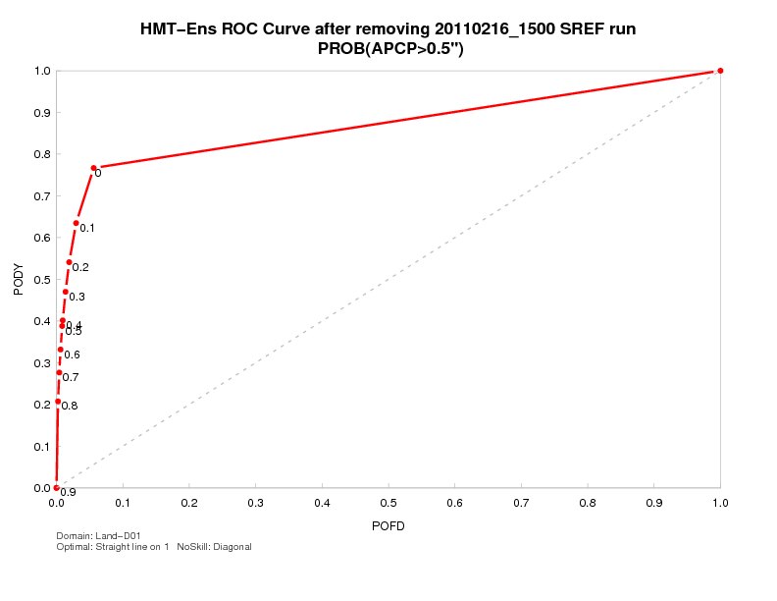
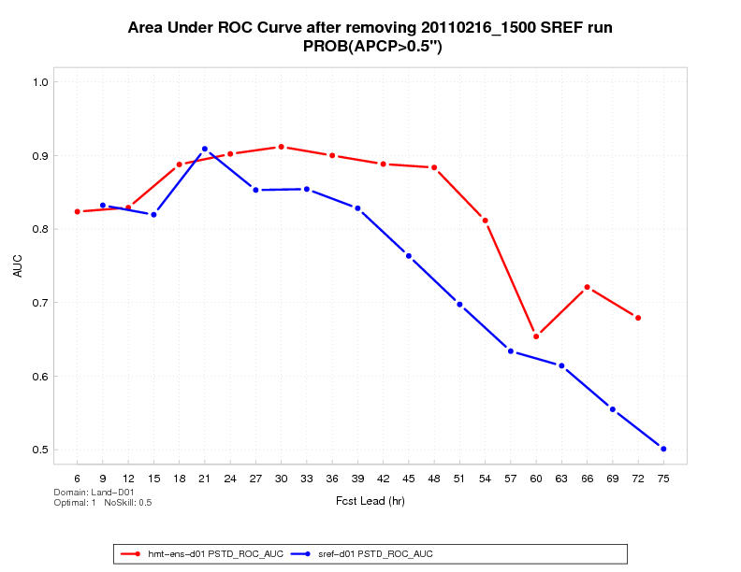
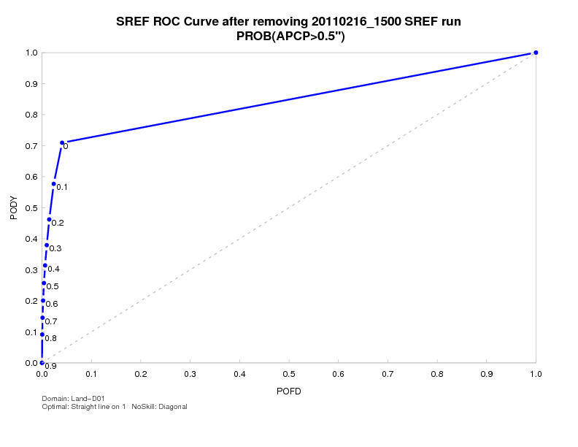
DTC/HMT Collaboration: Ensemble QPF Comparisons
Area under the ROC Curve for SREF and WRF ensembles for 3 IOPs in February 2011 over California Domain for Rainfall greater than 0.5 inch

Slide 9
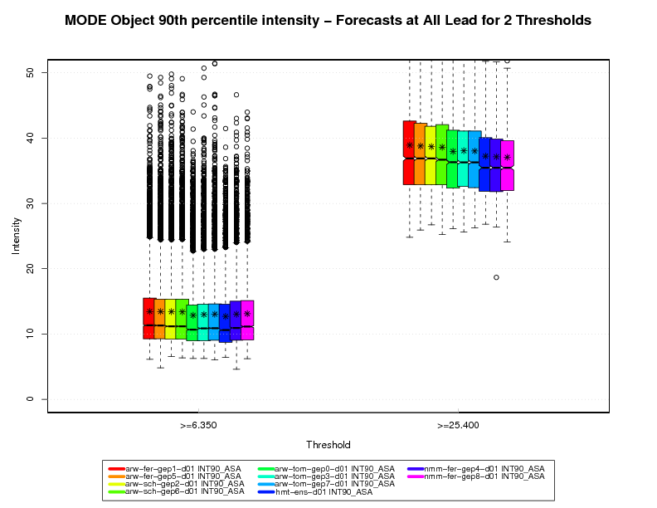
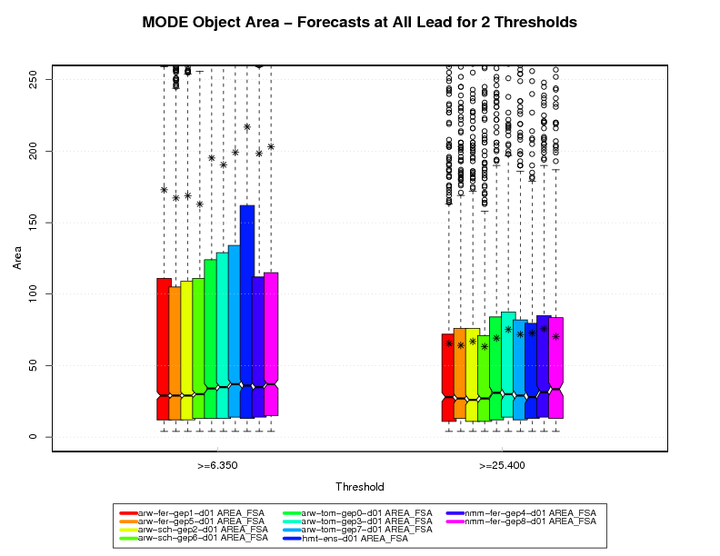
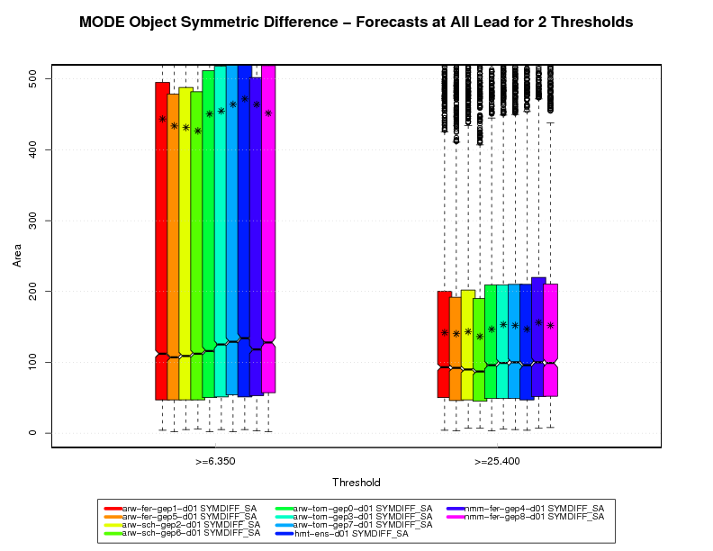
MODE Attributes and Model Diagnostics
Ensemble Members and Systematic Microphysics Impacts
Thompson microphysics scheme members: Colors 5-7
Others are Ferrier or Schultz
Thompson members are less Intense but larger (see averages especially)
Note extrema tails for both size and intensity (medians vs. averages)

Slide 10
Graphics
MET does not have a built in way to display the computed statistics
MET outputs all statistics in ASCII text files which can be be plotted by many different software packages if desired, or METViewer can be used
MET Viewer is a separate software package which visualizes MET output and is highly configurable

Slide 11
More information
MET & MET Viewer on FAB Website: http://laps.noaa.gov/met/
DTC Online MET Tutorial: http://www.dtcenter.org/met/users/support/online_tutorial/METv3.0/index.php

Slide 12
MET Viewer

Slide 13
What is MET Viewer
The MET Viewer tool
reads MET verification statistics output from a database
creates plots using the R statistical package
includes a web application that can be accessed from a web browser to create a single plot
the specification for each plot is built using a series of controls and then serialized into XML
for each plot, METViewer generates a SQL query, an R script to create the plot, a flat file containing the data that will be plotted and the plot itself
Available to anyone online:
http://www.dtcenter.org/met/metviewer/metviewer.jsp?db=hmt_2010
Note: the link is a public test version and hence is limited to a single database.

Slide 14
METViewer
Fully customizable and very powerful but has a learning curve
Can produce fully customizable:
-Series plots with confidence intervals
-Box plots
-X-Y scatter plots
-Histograms

Slide 15
METViewer Usage
METViewer is designed to be configured in a downward direction. This means that the user should set the desired settings in order, gradually moving downward.
The top three settings (shown above) allow the user to select a database and type for the plot.

Slide 16
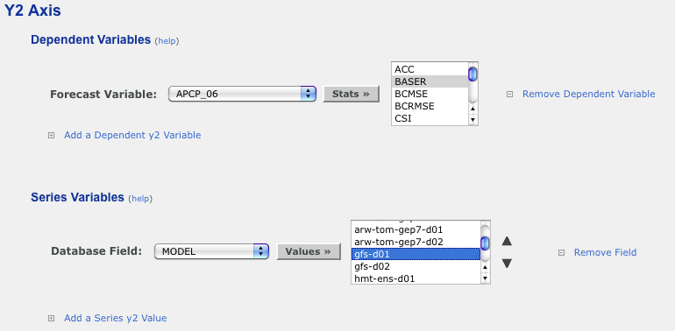
METViewer Usage
The Y2 axis can be used to plot a Base Rate.

Slide 17
Result

Slide 18
What MET Viewer Offers
Useful options that are in MET Viewer
Standard scores: RMSE,ME,MAE,GSS,CSI,FAR,....
Ensemble utilities: ensemble mean, spread, probabilities, ROC, Brier….
Formats: Time series, bar plots, boxplots, rank histograms,….
Aggregate on-the fly, over thresholds, forecast times, valid times, lead times, etc.
Uncertainty options: boxplot notches, error bars, sub-sampling,…
Spatial Techniques displays: MODE, Wavelet methods, neighborhood methods

Slide 19
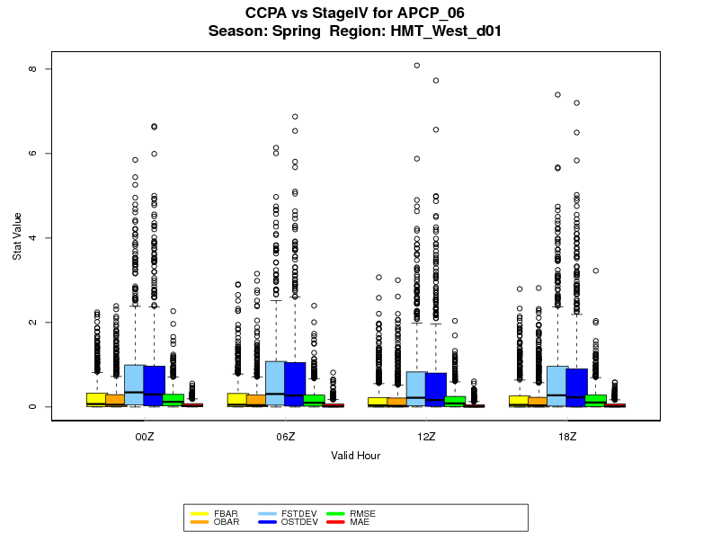
Result
Aggregated by diurnal cycle valid times; Comparison of one gridded dataset with another gridded dataset (StageIV and ‘improved’ StageIV)

Slide 20
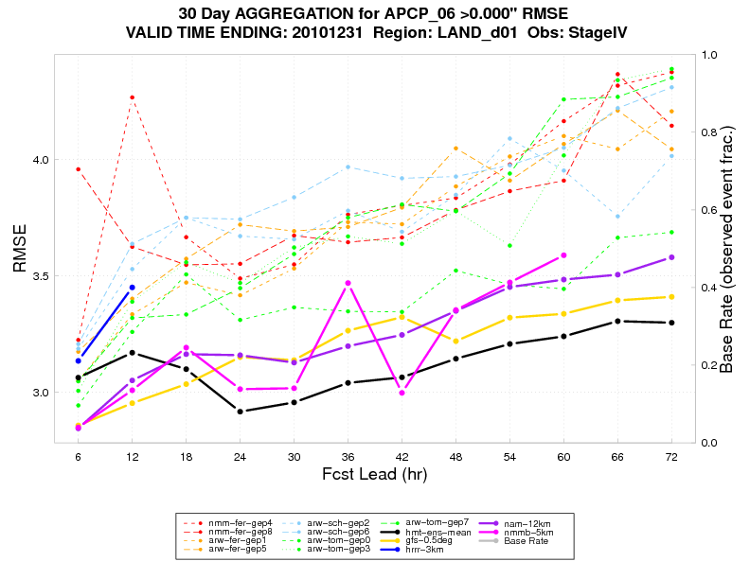
Result
30-day aggregations, with multiple models and ensemble members, plotted over lead times

