Slide 1
AMB verification
Bill Moninger
RAOB/profiler/surface/global verification
Also, Xue Wei, Susan Sahm
Patrick Hofmann / Steve Weygandt
Reflectivity and precipitation verification
Also, Curtis Alexander, Susan Sahm
Mike Fiorino
Tropical cyclone verification

Slide 2
Purpose of AMB: Model development and improvement
Judgments on AMB model/assimilation designs based on objective tests – real-time and retrospective tests
Requirements for verification within AMB
Very fast responsiveness
Add new models or new experiments within 1 day (usually within 15 min)
Add new types of verification (e.g., profiler, QPF) within a few weeks
Ability to look at verification in real-time, including even results within the past few hours
Checked for interconsistency (e.g., lower-troposphere vs. surface) and for consistency with NCEP verification
Used daily
Used for key management decisions (e.g., NCEP changes (RR, RUC, FIM), Stream 1.5 HFIP status for FIMY)
Used for referreed journals (articles on OSEs, TAMDAR impact, GPS-met impact, RUC, FIM (in preparation))
Frequent application of same AMB verification capabilities across diverse AMB models (RUC, RR, HRRR, FIM)

Slide 3
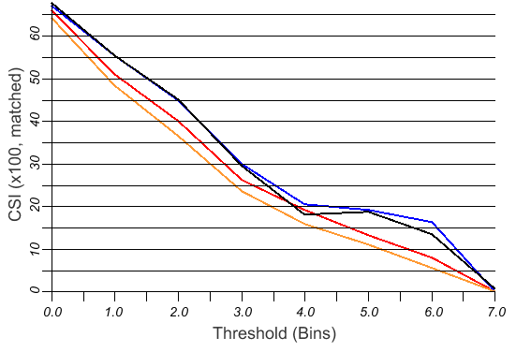
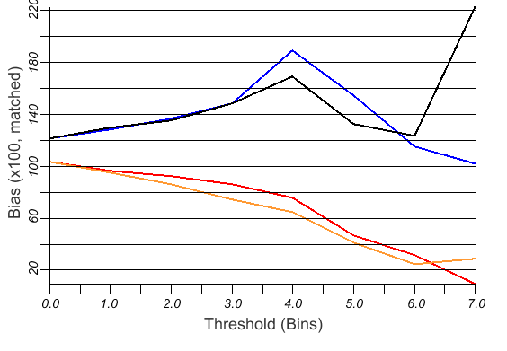
EMC RR vs. oper RUC vs.
GSD RR vs. GSD RUC
Precipitation
Verification
GSD
RR
EMC
RR
CSI
(x 100)
oper
RUC
13-km CONUS
Comparison
2 X 12 hr fcst
vs. CPC 24-h analysis
10 May – 10 June 2011*
Matched
* 6 cases only due to breaks
in cycles
GSD
RUC
| | | | | | | |
0.01 0.10 0.25 0.50 1.00 1.50 2.00 3.00 in.
bias
(x 100)
100
(1.0)
Used in 25 Jul 11 briefing to NCEP on RR status
| | | | | | | |
0.01 0.10 0.25 0.50 1.00 1.50 2.00 3.00 in.

Slide 4
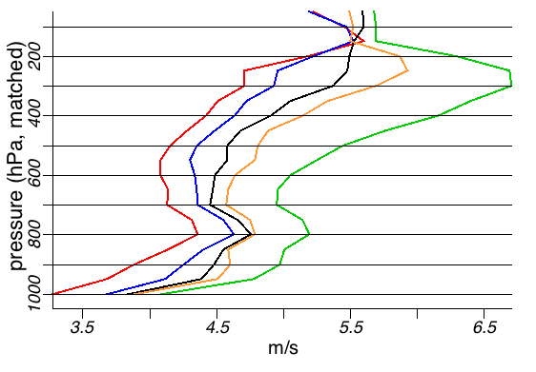
Rapid Refresh
Wind forecast
accuracy vs.
forecast length
1h
3
6
12
18h
March 2011
The Rapid Refresh is able to use recent obs to improve forecast skill down to 1-h projection
Used in several management and technical briefings – key metric for RR and RUC

Slide 5
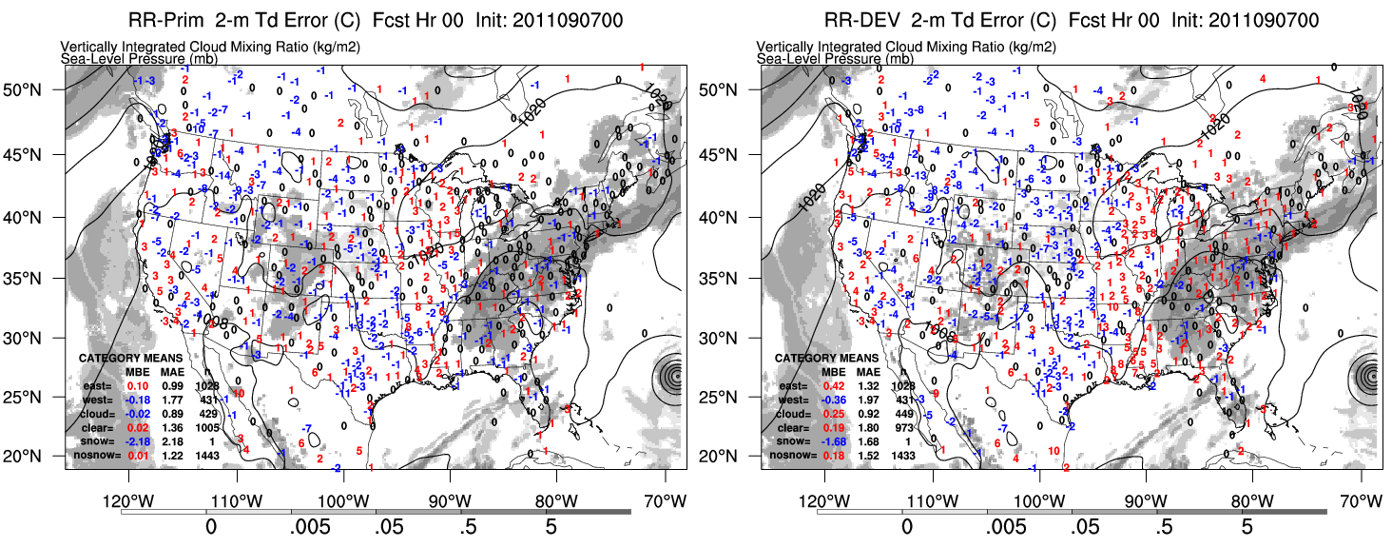
Use of MET for RR/HRRR – surface verification
- Joe Olson - AMB
Real-time surface verification for model/assimilation experiments

Slide 6
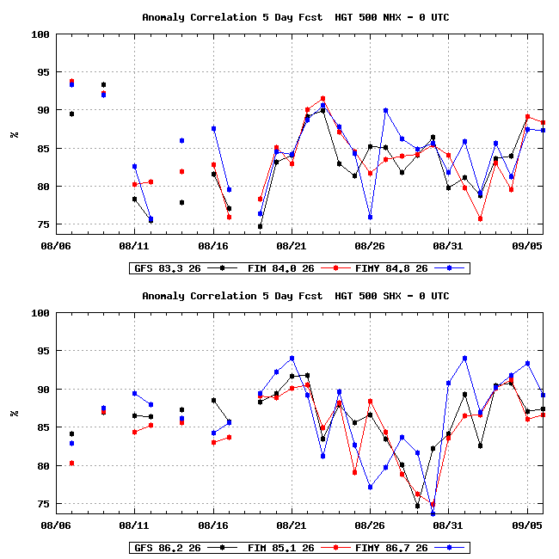
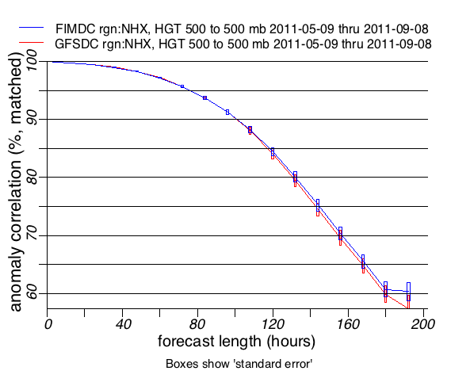
Day-to-day monitoring of FIM vs. GFS, used by AMB staff, Sandy MacDonald, others?
500 hPa anomaly correlation
5-day forecasts – N. Hem. – GFS vs. FIM vs. FIMY
GFS vs. FIM – N. Hem.
May-Sept 2011

Slide 7
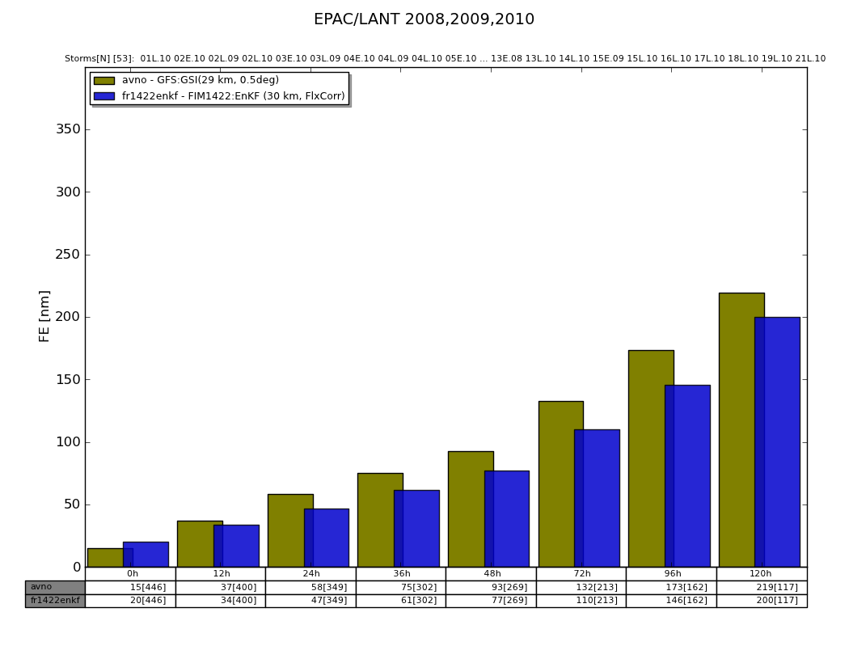
Tropical cyclone forecasting – track error
GFS vs. FIM
Repeatable for different experiments (svn v1422 in this case)

Slide 8
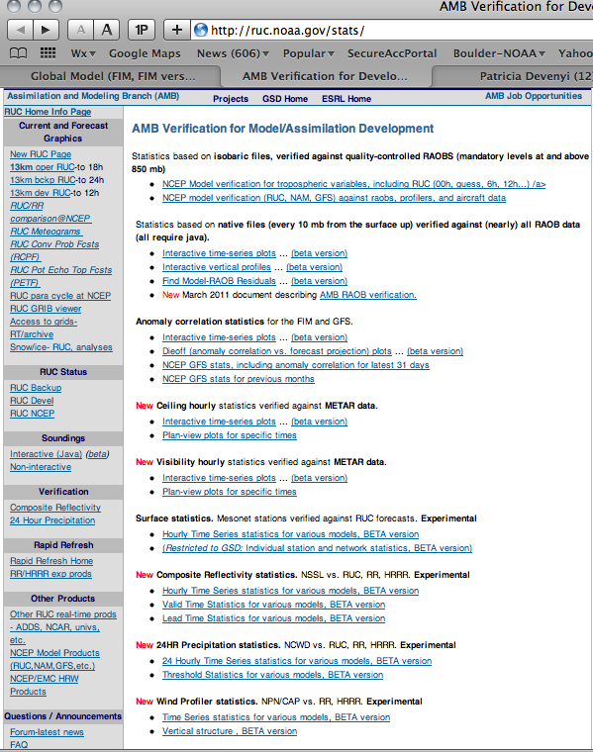
AMB verification web page: http://ruc.noaa.gov/stats

Slide 9
Purpose of AMB: Model development and improvement
Judgments on AMB model/assimilation designs based on objective tests – real-time and retrospective tests
Requirements for verification within AMB
Very fast responsiveness
Add new models or new experiments within 1 day (usually within 15 min)
Add new types of verification (e.g., profiler, QPF) within a few weeks
Ability to look at verification in real-time, including even results within the past few hours
Checked for interconsistency (e.g., lower-troposphere vs. surface) and for consistency with NCEP verification
Used daily
Used for key management decisions (e.g., NCEP changes (RR, RUC, FIM), Stream 1.5 HFIP status for FIMY)
Used for referreed journals (articles on OSEs, TAMDAR impact, GPS-met impact, RUC, FIM (in preparation))
Frequent application of same AMB verification capabilities across diverse AMB models (RUC, RR, HRRR, FIM)

Slide 10
AMB Verification and Quality Control Monitoring Efforts involving RAOB, Profiler, Mesonets, Aircraft Bill Moninger, Xue Wei, Susan Sahm, Brian Jamison

Slide 11
Observations we verify against
RAOBs at 0 and 12 UTC
Temperature, Relative Humidity, Wind, Height
METARs -- every hour
Temperature, Dewpoint, Wind
Ceiling
Visibility
Wind profilers – every hour
Wind
Results available within a few hours of model run time
Results for individual stations and for pre-defined regions

Slide 12
Models in our verification database (upper air, compared with RAOBs):
NCEP operational models in blue
Real-Time:
Regional: Op20 (Operational 13 on 20km grid) Bak13 (Bakup RUC on 13km grid) isoBak13 (isobaric Bak13) Bak20 (Backup on 20km grid) Dev13 (development RUC) Dev1320 (Dev13 on 20km grid) RR1h (1h cycling RR) isoRR1h (isobaric vsn of above) RR1h_dev (dev. version of RR1h) RR1h_dev130 (130 grid) RRnc (non-cycling RR) RRncRLL (rotated lat-lon) | HRRR HRRR_dev isoDev1320 (dev 13 iso on 20km grid) NAM (North America 32 km) Global: GFS FIM FIM_prs (from isobaric files) FIMX FIMY FIM9TACC (GSI initialization) F9EMTACC (EnKF initallization) F0EMTACC (10km grid)
Retrospective:
177 (so far) retrospective model runs
Testing different model configurations,
assimilation methods,
combinations of data

Slide 13
Web interface
Time-series and Vertical profiles of ob-forecast differences
For pre-defined regions (regional to global) and individual stations
Hourly to 60-day averages routinely available
Summary statistics and per-observation differences
Products are experimental; designed for the specific needs of our group

Slide 14
Upper air verification
Bias (forecast minus ob)
RMS (forecast minus ob)
of Temperature, Relative Humidity, Wind, Height

Slide 15
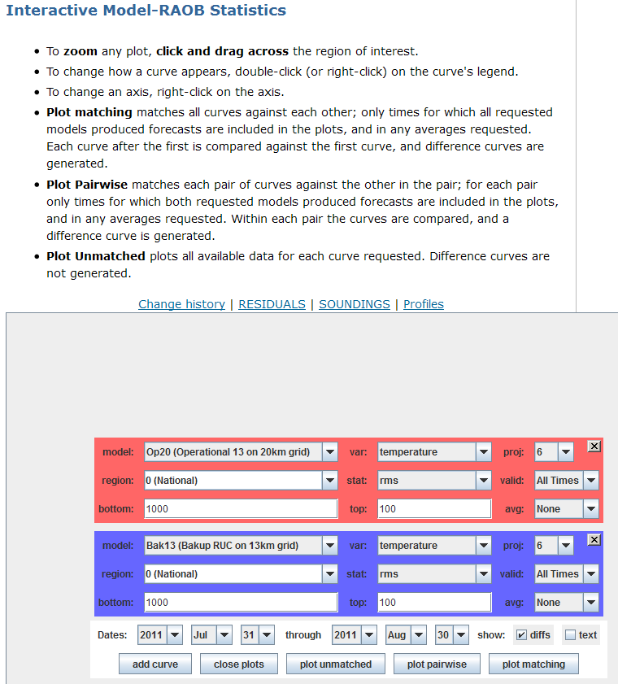
Time Series
Notes:
Maybe do demo here.

Slide 16
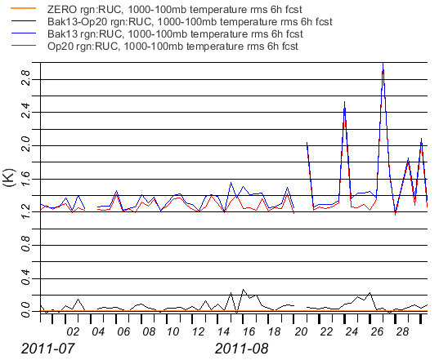
Time-series of RAOB data against Operational and Backup RUC models
For entire RUC region
Results every 12 h (0 and 12 UTC)
Averaged from 1000 – 100 mb
(No time averaging here)
RMS of temperature difference with respect to RAOBs in the RUC region
Difference between the two models

Slide 17
Time-series of RAOB data against Operational and Backup RUC models
For entire RUC region
Results every 12 h (0 and 12 UTC)
Averaged from 1000 – 100 mb
(No time averaging here)
Some apparent bad RAOBs on Aug 21st 24th and 27th effect both models equally, as indicated by the difference curve
RMS of temperature difference with respect to RAOBs in the RUC region
Difference between the two models

Slide 18
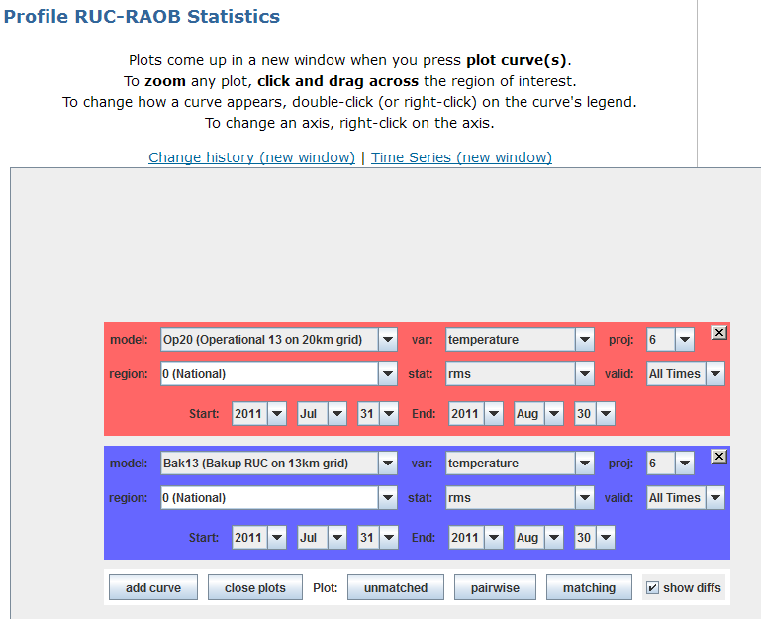
Vertical Profiles

Slide 19
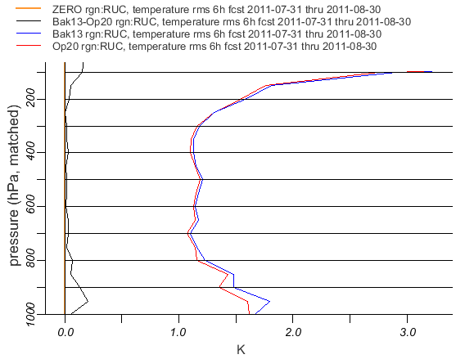
Profile of RAOB data against Operational and Backup RUC models
For entire RUC region
Results every 12 h (0 and 12 UTC)
Averaged for the month of August 2011

Slide 20
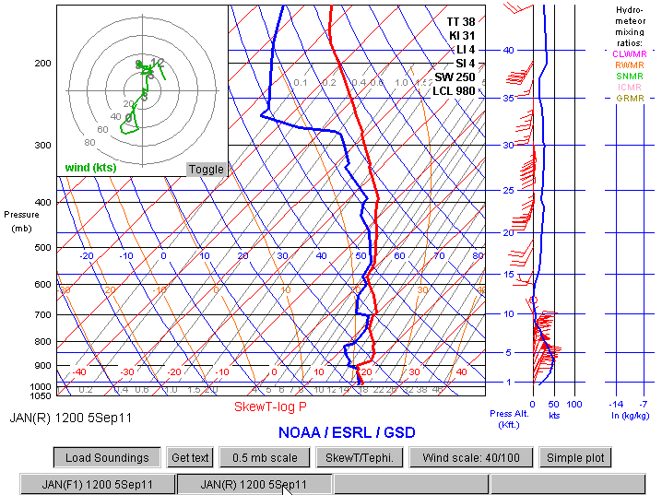
We can look at the individual soundings these statistics are based on.
Here’s RAOB from Jackson, MS…
Notes:
These statistics compare RAOB soundings with model soundings. We can look at individual soundings if needed.

Slide 21
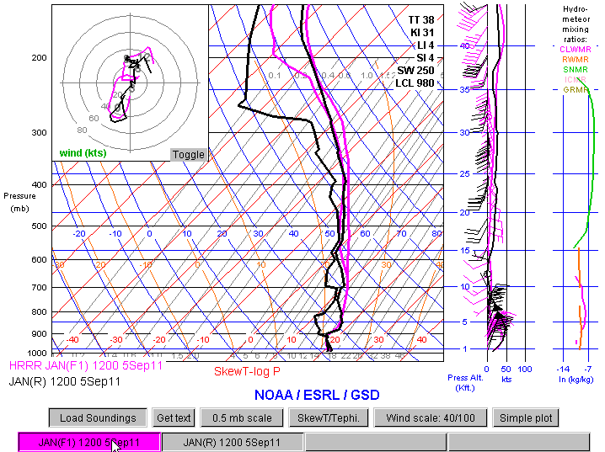
Overlaid with HRRR 1h forecast for the same location
Includes hydrometeors (Cloud, Rain, Snow, Ice, Graupel)

Slide 22
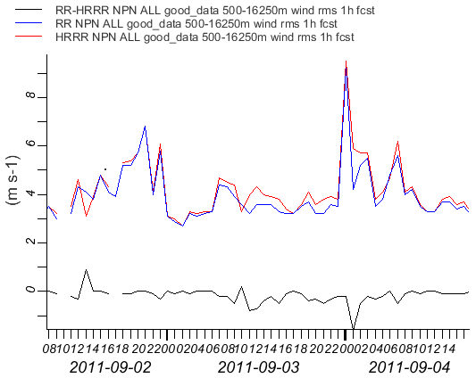
Time-series of Wind Profiler data against HRRR and RR models
For entire NPN profiler network
Note results are available for every hour (instead of every 12h with RAOBs)

Slide 23
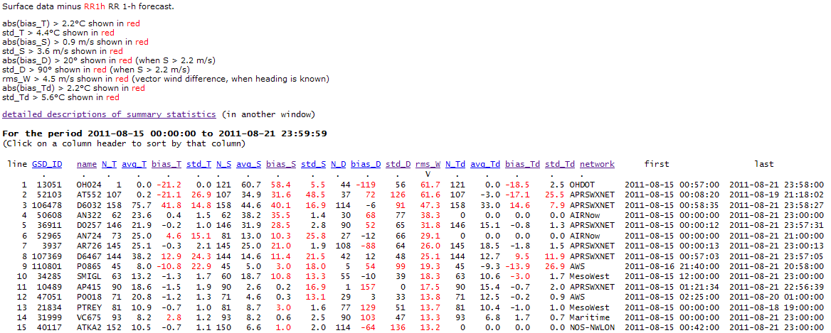
Surface verification
Week-long statistics of mesonet sites against Rapid Refresh 1-h forecasts
Used to generate ‘use lists’ of good surface sites, used at GSD and NCEP.
This list sorted by RMS of vector (forecast – ob) wind difference

Slide 24
Mesonet corrections
We plan to use our long-term observation-model statistics to experimentally correct surface observations where possible
We generate ob-model wind biases
For each model wind octant
For most sites, biases are relatively constant month-by-month
So we can potentially correct for these biases
The test will be if these “corrected” winds improve model forecasts
We plan a similar effort for correcting Temperature and Dewpoint

Slide 25
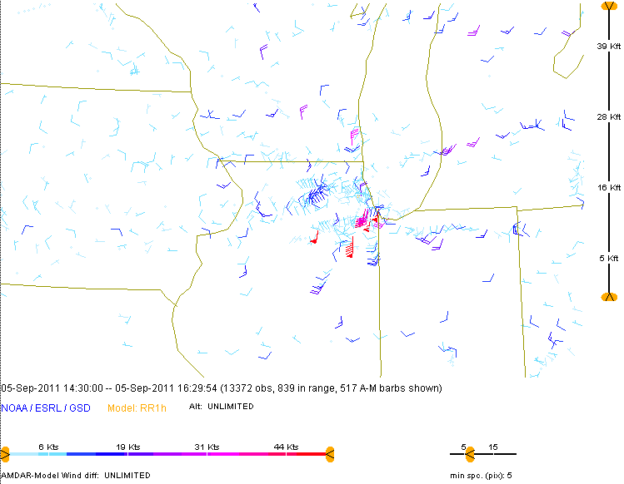
Aircraft – Model differences
This shows vector wind difference between AMDAR obs and RR 1h forecasts.
Shows some obvious bad aircraft winds near Chicago.
(Used by NWS to help identify bad aircraft data.)

Slide 26
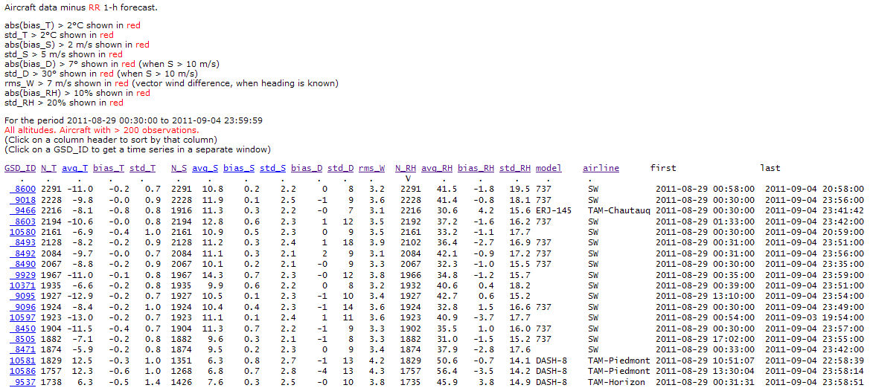
Aircraft weekly statistics
Week-long statistics of aircraft obs against Rapid Refresh 1-h forecasts
Used by us to generate daily aircraft reject lists for RR, HRRR and backup RUC
Used actively by NWS and AirDat

Slide 27
Verification infrastructure
MySQL database
MyISAM tables – good for our ‘data warehousing’ application
Currently about 300 G in size
C, Perl, Java, Python used to populate the database via cron on jet and other computers
Java web pages for data display
Perl and Python cgi scripts provide data from the database to web pages

Slide 28
Thank You
Questions?

