Slide 1
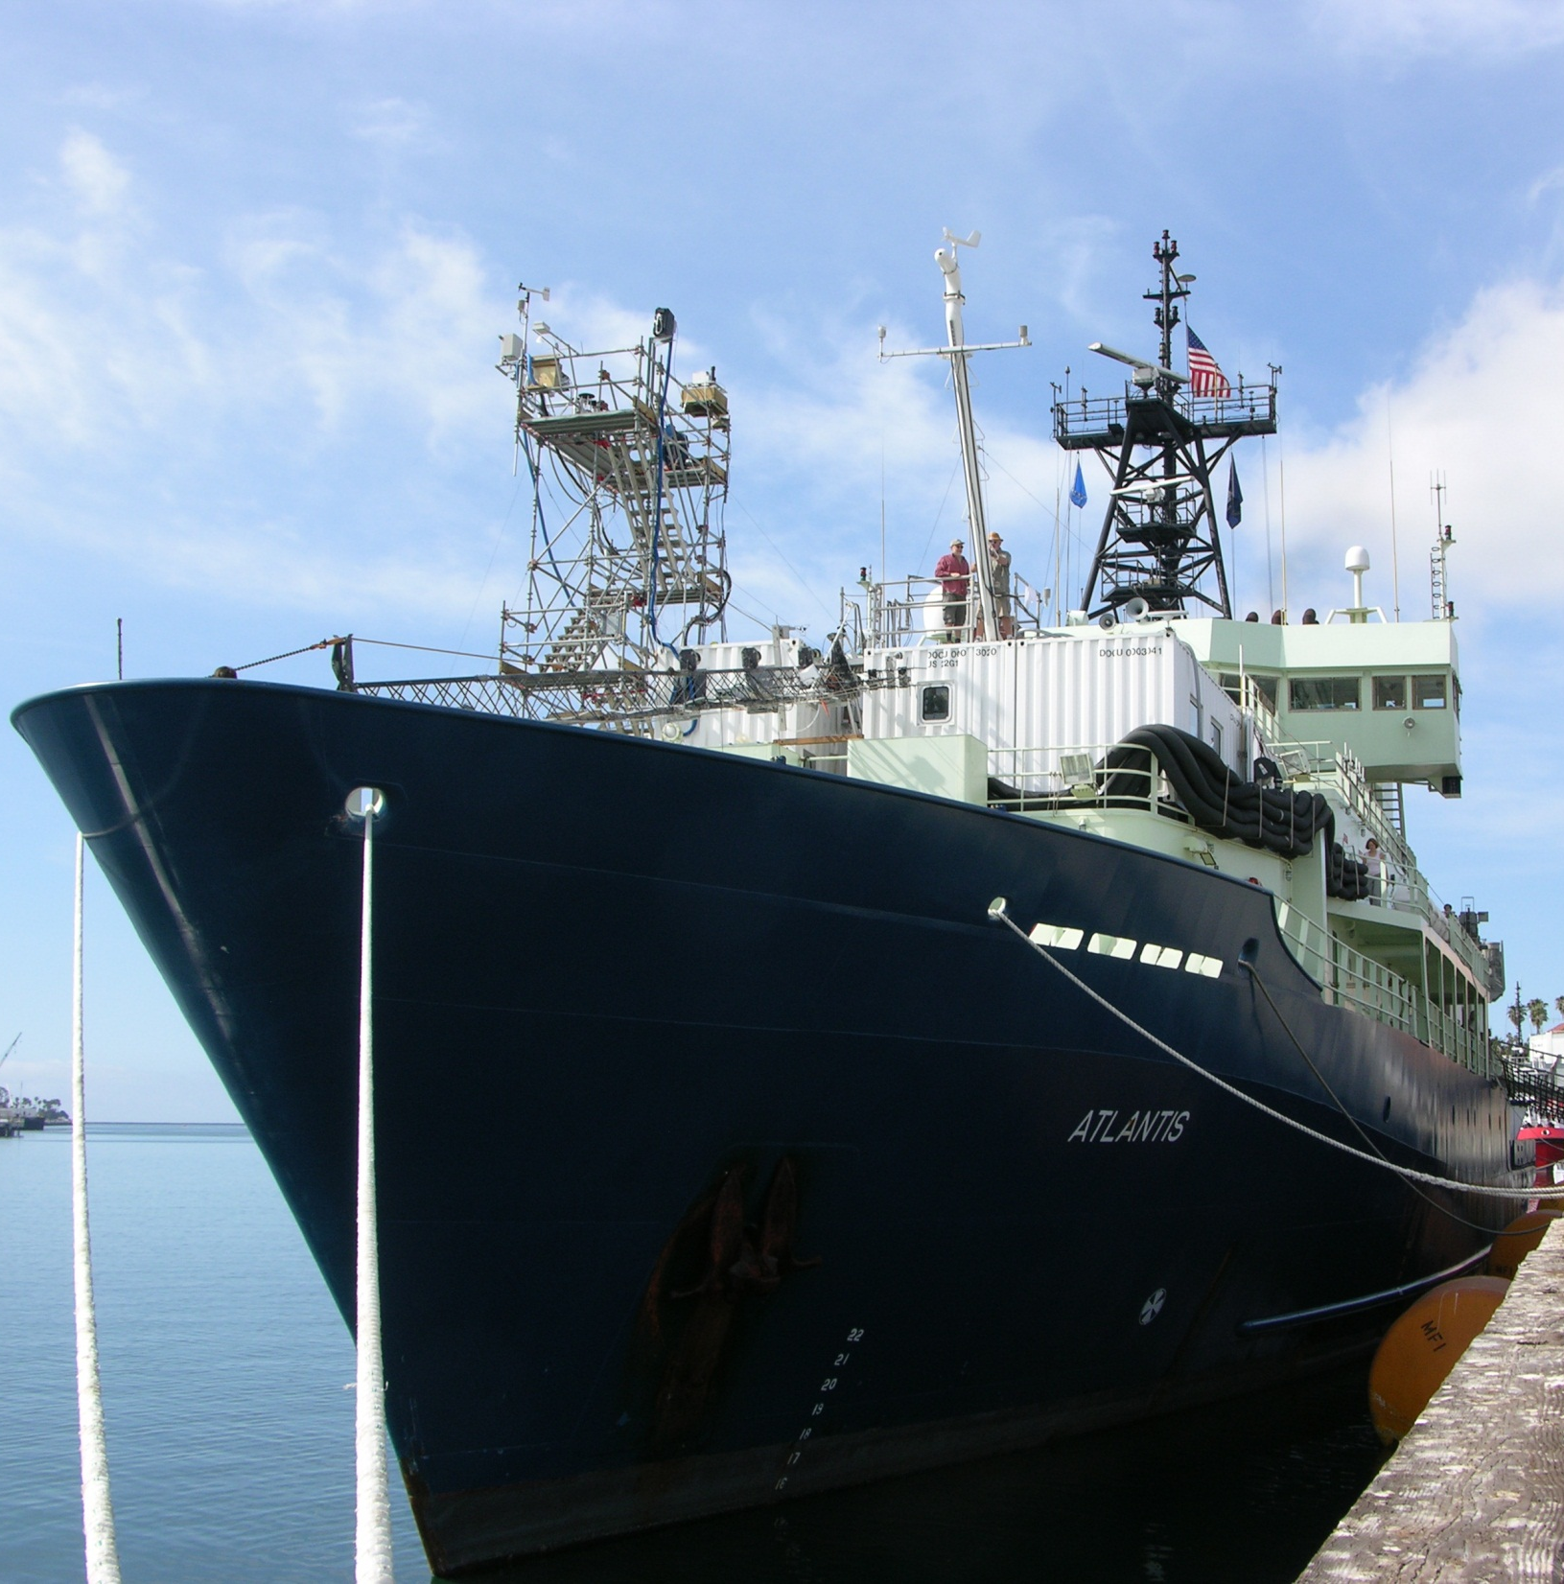


Absorption by ambient aerosols during CalNex
Chris Cappa (UCD)
Paola Massoli
Tim Onasch
Doug Worsnop
Katheryn Kolesar
Jani Hakala
Shao-Meng Li
Ibraheem Nuaaman
Kathy Hayden
Trish Quinn
Tim Bates
Dan Mellon
and more…
A
t
l
CaLNex
n
t
i
s

Slide 2
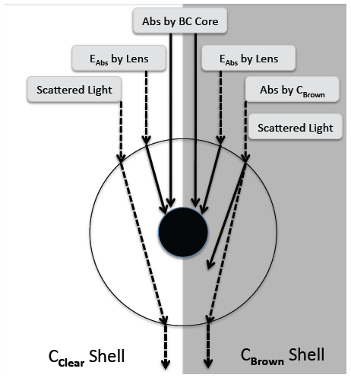
Aerosol Volatility and Optical Properties
Light absorption by particles from black carbon (soot) and brown carbon
Coatings on BC can theoretically enhance absorption in climatically important ways
[e.g. Jacobson, Nature, 2001]
Enhancement factor can be calculated from Mie theory, but limited validation from ambient measurements
Objective: to directly measure the absorption enhancement factor for ambient particles at multiple wavelengths
[Lack and Cappa, ACP, 2010]

Slide 3
Approach: Heat Particles to Drive Off Coatings
Ambient
Really hot
Large Enhancement
Small Enhancement
Highly Scattering
Less Scattering
Brown Carbon
No Brown Carbon
Absorption by brown carbon should contribute more to total absorption at short λ

Slide 4
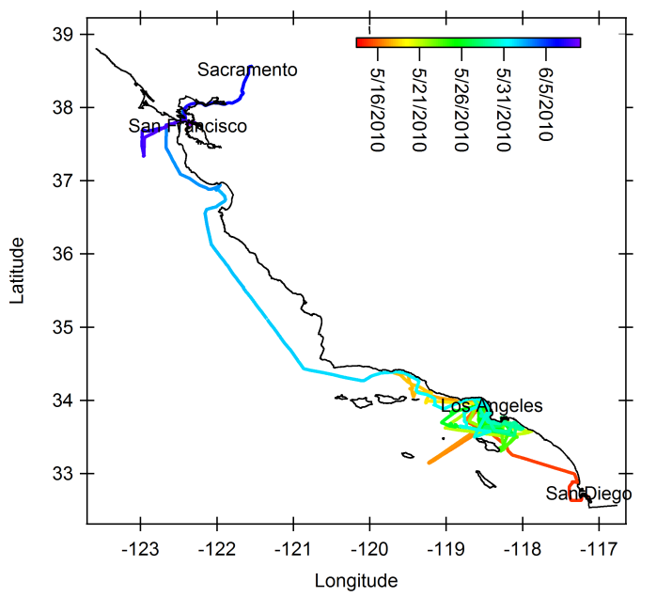

Slide 5
Measurements
MAST
Note: PM1 cutoff
or
Env. Ca
Aerodyne
UC Davis
Env. Ca
Env. Ca
Thermo-
denuder
HR-ToF-AMS
SP-AMS
PAS/CRD
SMPS
SP2
Non-refractory particle composition
BC & coating composition
Particle absorption & extinction
Size Distribution
BC mass distribution
PAS/CRD measures light absorption and light extinction at 532 nm and 405 nm
SP-AMS measures BC mass and coating composition
SP2 measures BC mass and infers coating thickness
SP2 and SPAMS tell us something about how coating thickness has changed upon heating
SP2 BC measurement can tell us about particle losses through the TD

Slide 6
Particle Transmission Correction
Similar results to Huffman et al. (2008): Tr = 0.98 – 0.00082*Temp

Slide 7
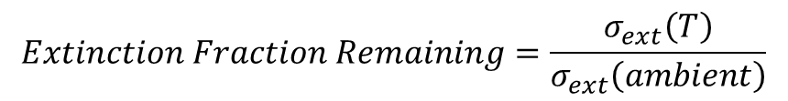
Influence of heating on particle extinction (532 nm)
Black = ambient
Red = denuded
$$Extinction Fraction Remaining=\frac{σ_{ext}\left(T\right)}{σ_{ext}\left(ambient\right)}$$

Slide 8

Influence of heating on particle extinction

Slide 9
Influence of heating on particle extinction
Start of Campaign
End of Campaign
Lines are binned data over different time periods
Total aerosol volatility varies greatly with time/location
Very similar results from SMPS

Slide 10

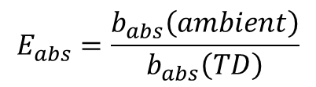
Influence of heating on particle absorption
$$E_{abs}=\frac{b_{abs}\left(ambient\right)}{b_{abs}\left(TD\right)}$$
532 nm
Note: only include periods when
b_{abs,ambient} > 0.5 Mm⁻¹
405 nm

Slide 11
Influence of heating on particle absorption
$$E_{abs}=\frac{b_{abs}\left(ambient\right)}{b_{abs}\left(TD\right)}$$
532 nm
405 nm

Slide 13
Theoretical Calculations of Aerosol Optical Properties
Use “core-shell” Mie theory to calculate evolution of σ_{abs}, σ_{ext} and SSA
D_{p}(particle) = 400 nm
D_{p}(core) = 80 nm
σ_{abs} = 9.8 x 10⁻¹⁵ m²/particle
σ_{ext} = 2.9 x 10⁻¹³ m²/particle
SSA = 0.97
D_{p}(particle) = 100 nm
D_{p}(core) = 80 nm
σ_{abs} = 3.8 x 10⁻¹⁵ m²/particle
σ_{ext} = 4.4 x 10⁻¹⁵ m²/particle
SSA = 0.13
E_{abs} = 2.57
FR_{ext} = 0.015
ΔSSA = 0.84
D_{p}(particle) = 200 nm
D_{p}(core) = 60 nm
σ_{abs} = 2.9 x 10⁻¹⁵ m²/particle
σ_{ext} = 1.5 x 10⁻¹⁴ m²/particle
SSA = 0.81
D_{p}(particle) = 120 nm
D_{p}(core) = 60 nm
σ_{abs} = 2.0 x 10⁻¹⁵ m²/particle
σ_{ext} = 2.8 x 10⁻¹⁵ m²/particle
SSA = 0.16
E_{abs} = 1.45
FR_{ext} = 0.19
ΔSSA = 0.65

Slide 14
Model: Mie Core-Shell
D_{p} = 250 nm
SSA_{i} = 0.95; D_{core} = 50 nm

Slide 15
Model: Mie Core-Shell
D_{p} = 250 nm
SSA_{i} = 0.95; D_{core} = 50 nm
SSA_{i} = 0.88; D_{core} = 70 nm
SSA_{i} = 0.77; D_{core} = 90 nm
SSA_{i} = 0.67; D_{core} = 110 nm

Slide 16
Model: Mie Core-Shell
SSA_{i} = 0.95
SSA_{i} = 0.88
SSA_{i} = 0.77
SSA_{i} = 0.67; vary D_{p}
SSA_{i} = 0.58
D_{p} = 150 nm
D_{p} = 100 nm
D_{p} = 80 nm

Slide 18
Mie “Core-Shell” Results

Slide 19
Mie “Core-Shell” Results

Slide 20
Since we are talking about California anyway…
same experiment done at CARES, but with fixed TD temperature (225 °C) and PM_{2.5}
Note: variation in FR_{ext} from atmosphere, not temperature

Slide 21
Why such an (unexpectedly) low absorption enhancement?
1. Concern: particles are not internally mixed
+
2. Particles are internally mixed, but not with “core-shell” morphology

Slide 22
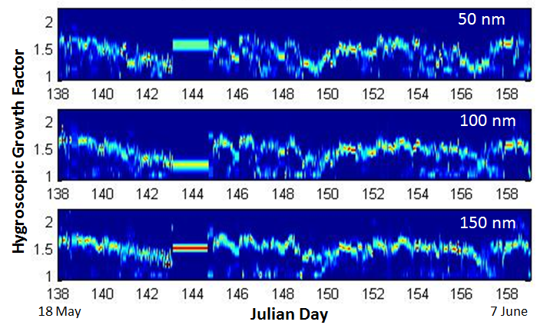
H-TDMA indicates aerosol dominated by single growth mode

Slide 23
Points = observed
Lines = calculations
D_{p,core} = 40 nm
D_{p,core} = 140 nm

Slide 24
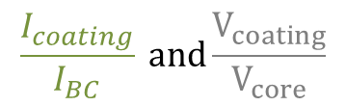
SP-AMS sees only particles that contain black carbon
$$\frac{I_{coating}}{I_{BC}} and\frac{V_{coating}}{V_{core}}$$
SSA shows similar variation with
which would only be the case if particles are internally mixed.
D_{p,core} = 40 nm
D_{p,core} = 140 nm

Slide 25
Brown Carbon Absorption

Slide 26
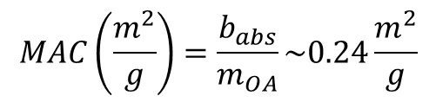
Brown Carbon Absorption
~10% of absorption at 405 nm may be due to “Brown” Carbon
$$MAC\left(\frac{m^{2}}{g}\right)=\frac{b_{abs}}{m_{OA}}\sim 0.24\frac{m^{2}}{g}$$
Imaginary Refractive Index ~ 0.009

Slide 27
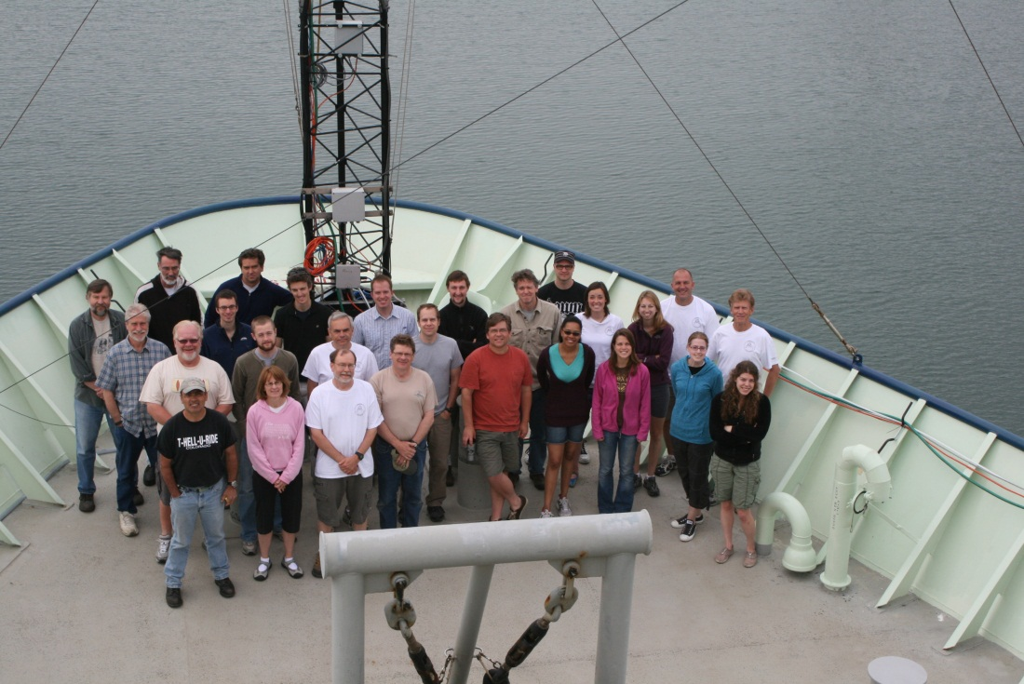
Conclusions
Absorption enhancements much smaller than expected
Suggests internal mixtures but not with “core-shell” morphology
Absorption by “brown” carbon ~ 10% of total at 405 nm
Thanks again to all my great collaborators, the R/V Atlantis Crew and the EPA and NOAA for funding.

